Slide 1
Journey to the Jungle

Slide 2
Monday 31st January 2022
LO: To create a text map.

Slide 3
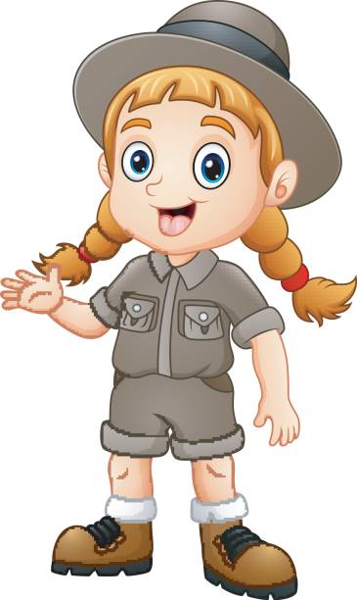
I’m your explorer and guide!
Welcome to my world of exploring! Over the next few weeks, you’ll find lots of fun things that will help you with your writing skills.
So let's get on and discover new lands together!

Slide 4

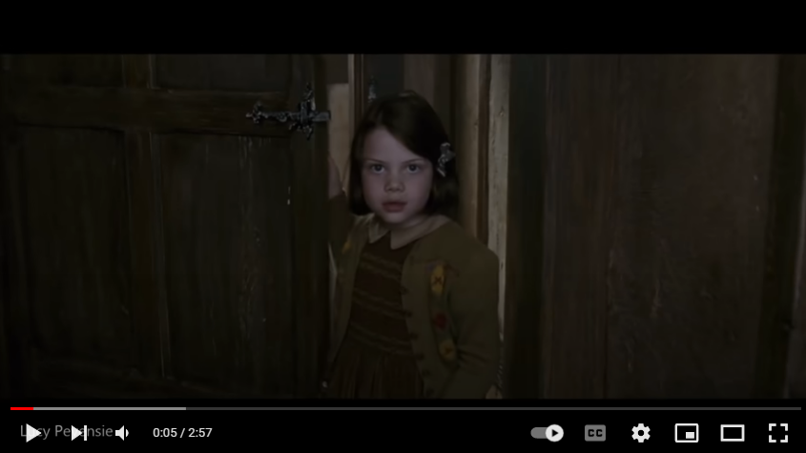
You know The Lion, the Witch and the Wardrobe. Let’s watch a clip…

Slide 5
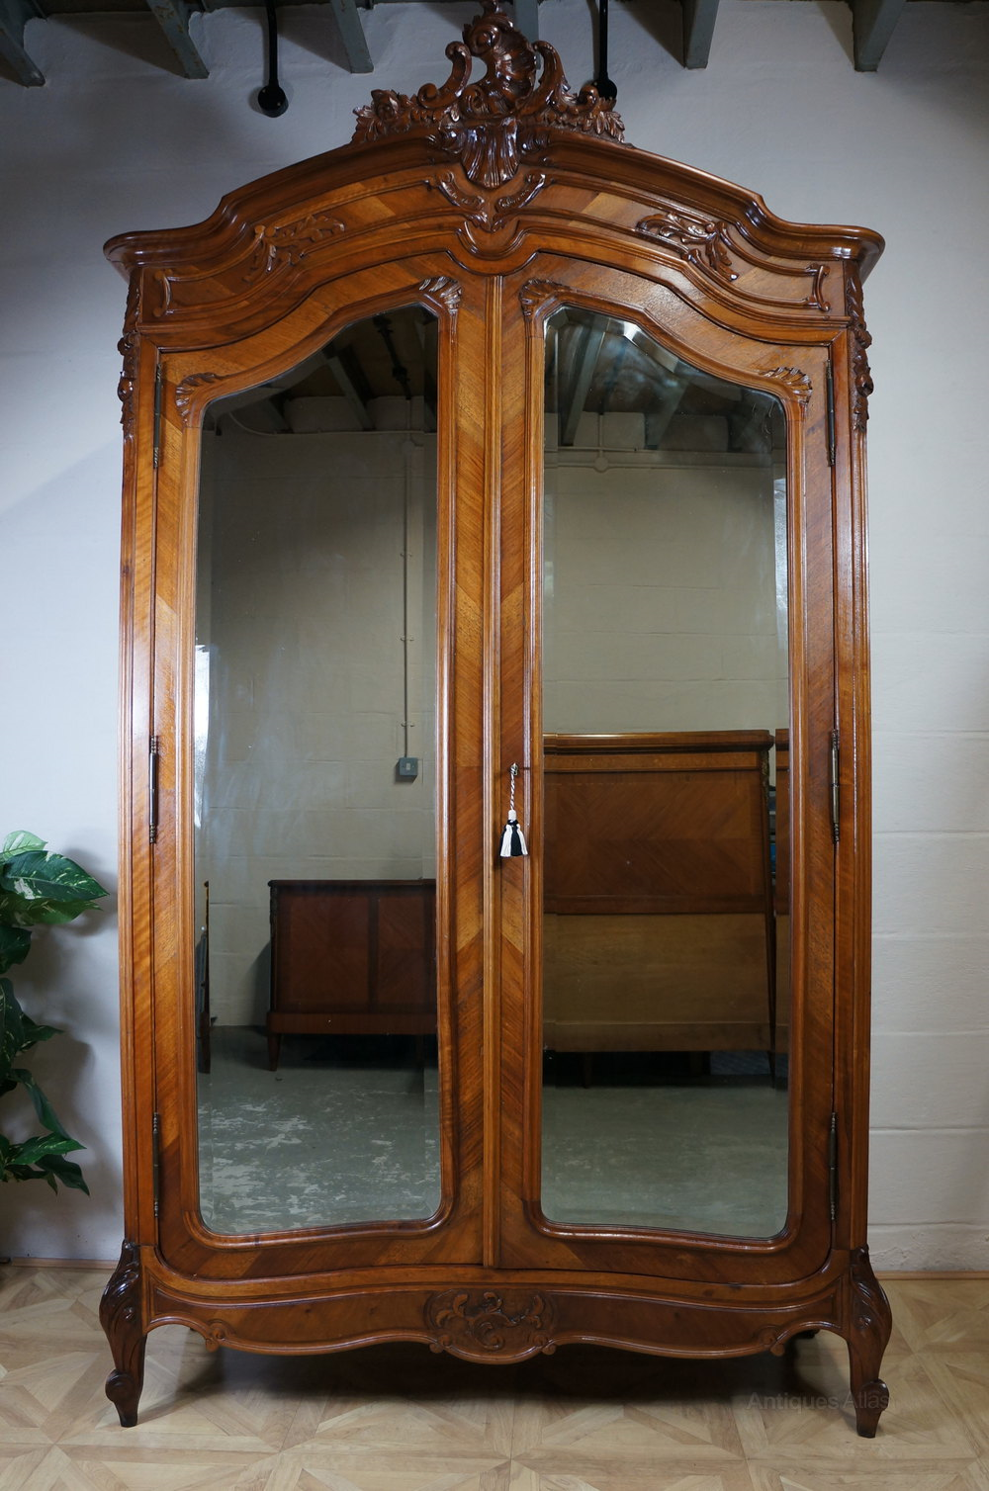
This is my magic wardrobe.
I go into the wardrobe to discover new lands. Do you want to hear about where I explored recently?

Slide 6
Visiting a jungle
★ Exploring jungles is very exciting. Every time I go through my wardrobe and discover a new one, I write in my ‘Jungle Log’. It is a bit like a diary and it is where I write down what has happened on my visits. Here is my entry from my visit to the Atlanti Jungle in Orneo, an amazing place where the sky is yellow and the soil pink.

Slide 7
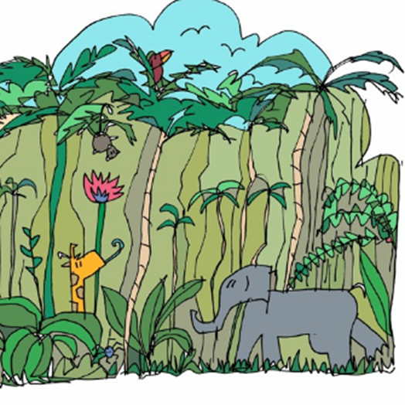
Click on the picture to listen (From 0.22 seconds)
You can read the text on the next few slides.

Slide 8
Jungle Log: 31st January, 2022
Today has been an amazing day of discovery! I woke early and got ready for my trek into the Atlanti Jungle. I was excited and couldn’t wait to see what lay ahead of me. I packed my rucksack and put on my sturdy walking boots. I made sure my camera was working because I wanted to record as much of the day as possible. I left the camp at 6am.

Slide 9
First, I trudged through the dense forest and collected samples of the plant life. My favourite was a thorny bush. It had tiny, yellow flowers growing on it, which smelt like ice cream! Next, I studied some of the mesmerising insects that were crawling up the rough bark of every tree. One insect looked like a caterpillar but had 2 sets of wings and tiny hands on the ends of its 20 legs. Excitedly, I photographed as many creatures as I could because I wanted to show my explorer friends what I had discovered.

Slide 10
After a short tea break, I measured the circumference of the tallest trees to work out how old they were. One measured 10 metres around and was so tall that I couldn’t see the top of it. It reminded me of the beanstalk in a famous children’s story. Next, I trekked to a clearing and found a beautiful plunge pool. The water was turquoise and tiny neon fish were splashing on the surface. I tried to catch one, but they were too fast for me. Then it was time for a rest. I lounged on pink grass, soaking up the purple sun beams and listened to the strange jungle noises around me.

Slide 11
Finally, I headed back to camp because the sun began to set. It sets quickly in Oreno and I was worried I might get lost. When I got to my tent, I unpacked my rucksack and stored my plant samples safely. I’m really looking forward to where my wardrobe will take me next week!

Slide 12

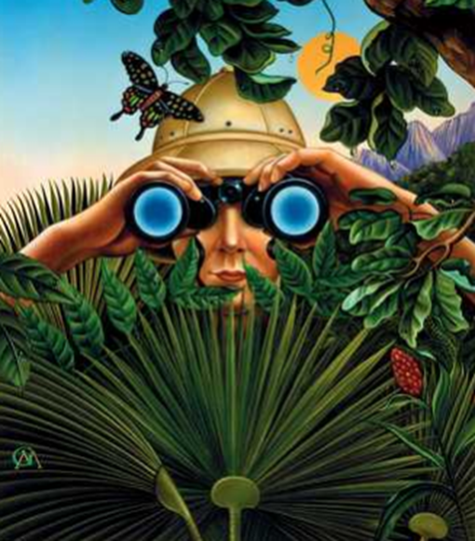
What do you think of my adventure?

Slide 13
Now let’s start to create our text map and learn to say our text. We will do this over 2 days.

