Slide 2
Diving into Mastery Guidance for Educators
Each activity sheet is split into three sections, diving, deeper and deepest, which are represented by the following icons:
These carefully designed activities take your children through a learning journey, initially ensuring they are fluent with the key concept being taught; then applying this to a range of reasoning and problem-solving activities.
These sheets might not necessarily be used in a linear way. Some children might begin at the ‘Deeper’ section and in fact, others may ‘dive straight in’ to the ‘Deepest’ section if they have already mastered the skill and are applying this to show their depth of understanding.
Diving
Deeper
Deepest

Slide 3
Aim
Recall multiplication and division facts for multiplication tables up to 12 × 12.

Slide 4
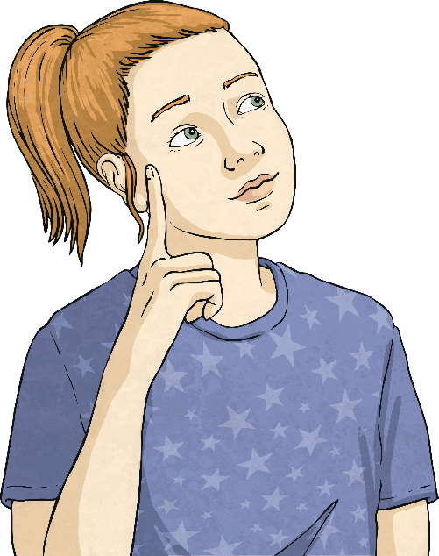
Multiply and Divide by 9
Diving
Draw an array to match this calculation.
3 × 9 =
27
Now complete these sentences about the array:
There are lots of 9.
There are nines..
3
3

Slide 5
Multiply and Divide by 9
Diving
Write a fact family to match this representation.
× = .
× = .
7
9
63
9
7
63
÷ = .
÷ = .
63
9
7
63
7
9

Slide 6
Multiply and Divide by 9
Diving
Complete the calculations below.
81
12
9 × 9 =
6 × 9 = 108
54 ÷ 9 =
6
2
18 ÷ = 9

Slide 7
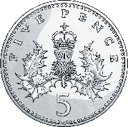
Multiply and Divide by 9
Diving
Write a calculation to help solve this word problem:
Alec has nine 5p coins in his money box. How much money does Alec have altogether?
9 × 5p =
45p

Slide 8
Multiply and Divide by 9
Deeper
Uma has written out the fact family for 8 × 9.
Check her work and then correct and explain any mistakes she has made.
Uma’s answer is incorrect because 9 × 8 = 72 and not 79.
In the last example, Uma is incorrect because she has used the same divisor as in the fact above, whereas the missing fact in this family is 72 ÷ 8 = 9 not 72 ÷ 9 = 9.
✓
8 × 9 = 72
9 × 8 = 79
72 ÷ 9 = 8
72 ÷ 9 = 9
X
✓
X

Slide 9
Multiply and Divide by 9
Deeper
Read the statement below.
Is it true or false? Explain your answer.
36 is a multiple of nine and of six.
This is true. Six lots of 6 make 36 and four lots of 9 make 36.
6 × 6 = 36
4 × 9 = 36

Slide 10
Multiply and Divide by 9
Deepest
Read the clues below to see if you can identify which multiple from the 9 times table they represent.
The tens digit is less than 4.
It is a two-digit odd number that is less than 30.
When doubled, it makes 36.
27
18
18, 27, 36
48

Slide 11
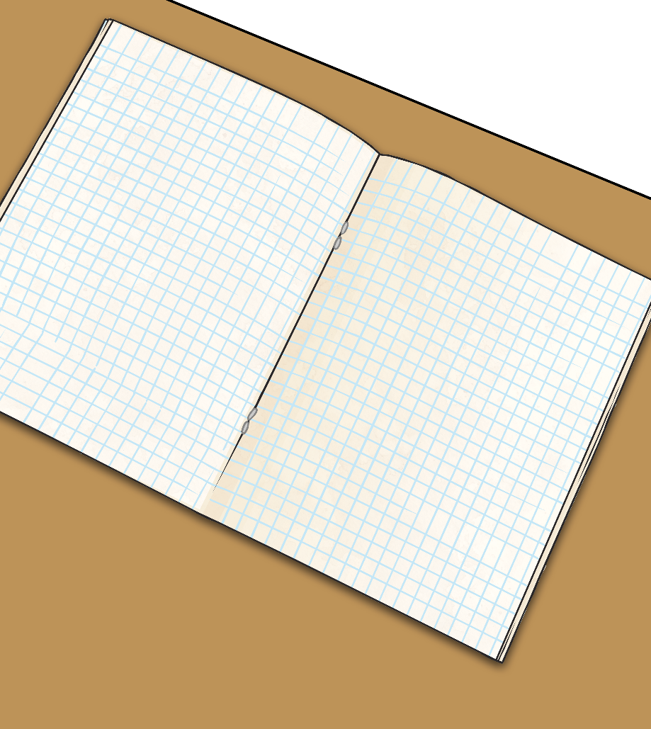
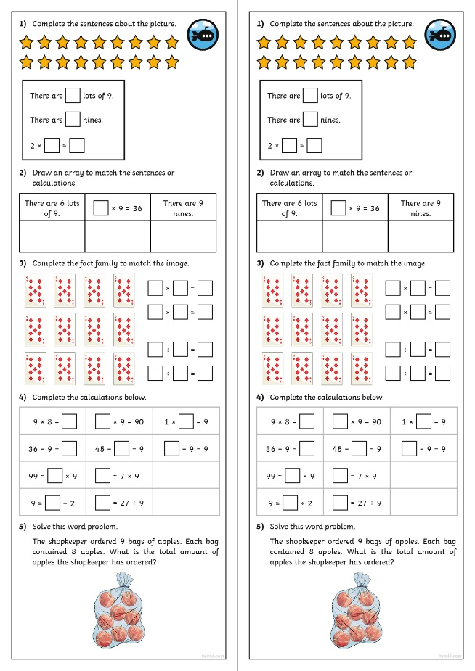
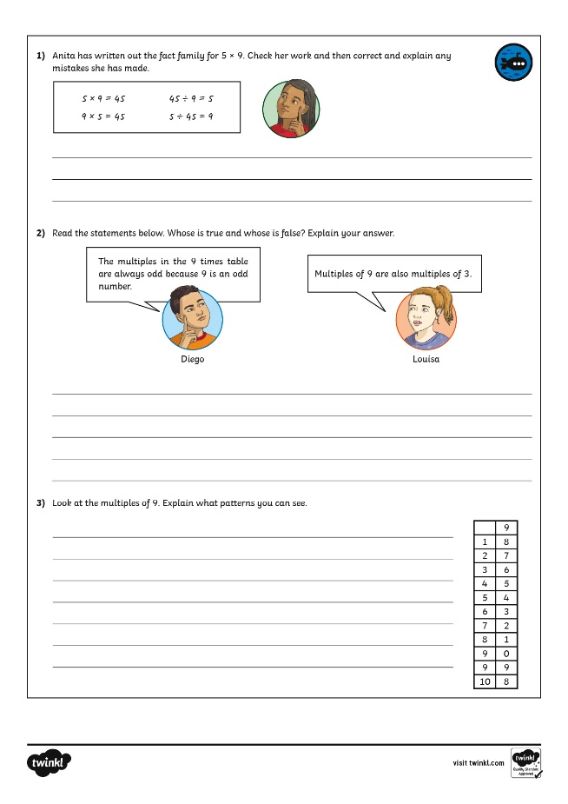
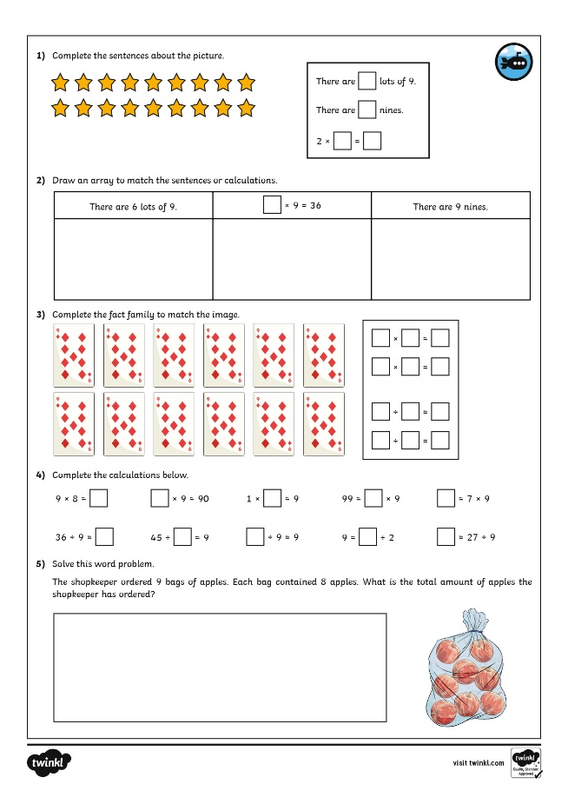
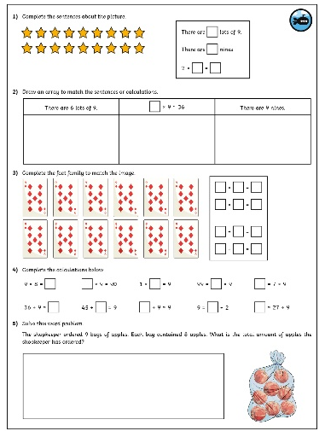
Multiply and Divide by 9
Dive in by completing your own activity!

Slide 12
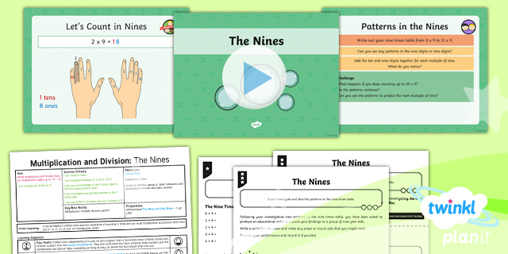
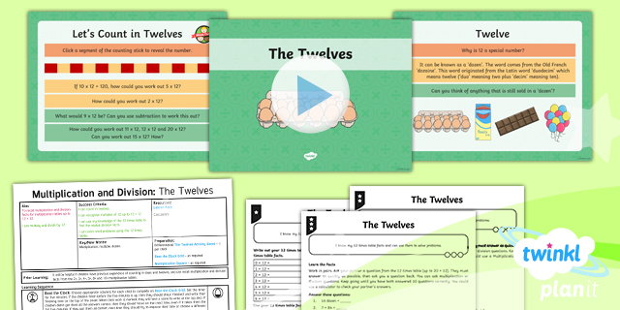
Need Planning to Complement this Resource?
National Curriculum Aim
Recall multiplication and division facts for multiplication tables up to 12 × 12.
For more planning resources to support this aim, click here.
Twinkl PlanIt is our award-winning scheme of work with over 4000 resources.

