Slide 1
Retrieve: What can you tell me that you can prove is definitely correct?
Predict: What do you think might happen in this story?
Infer: How do you think the boy in this image is feeling? Why?
Notes:
Use this as a short activity to introduce the reading that you will be doing over the next 3 or 4 days. Discuss the covers and gather opinions and predictions.

Slide 2
Vocabulary Corner
THRIVE WITH FIVE
We are going to do things a little differently today!
As you watch The Snowman, I would like you to write down any words that pop into your head! Try to think of at least 5 words to describe feelings and events.
Notes:
Can children show some of these words? Act them out?

Slide 3
Watch the first 6 minutes of The Snowman (1982) - https://www.youtube.com/watch?v=5A3THighARU
Rapid Retrieval
THRIVE WITH FIVE
Why is the boy excited when he wakes up?
What item of clothing does the boy’s mum put on him before he leaves the house?
Who tells the boy off for throwing a snowball at a window?
True or False – the Snowman is given coal for eyes?
What time is the boy’s bedtime?

Slide 4
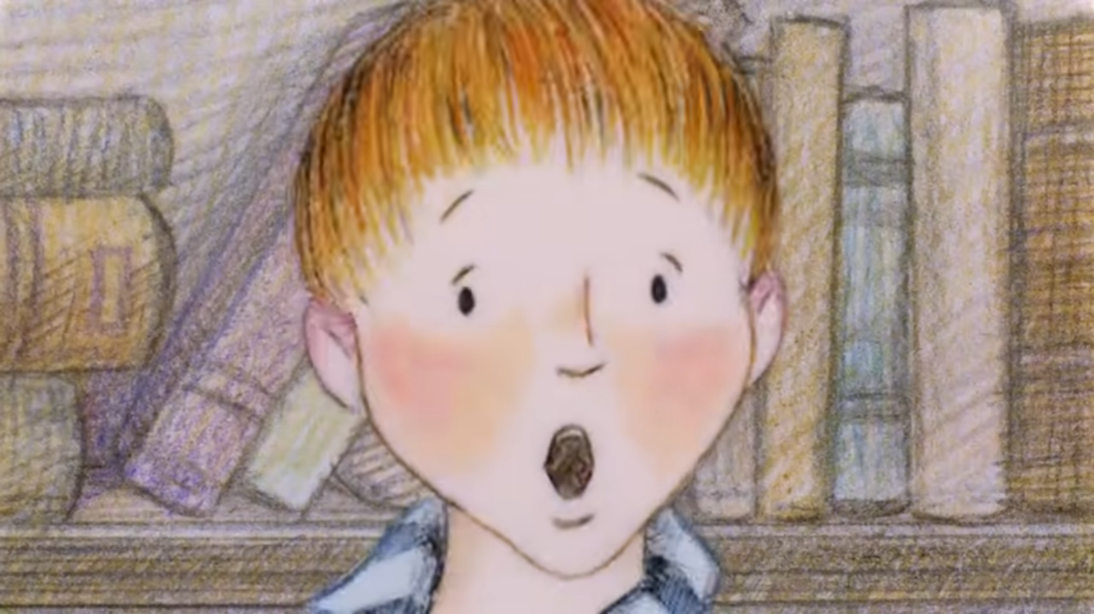
Time To Talk…
How do you think the boy feels here? Why is he feeling this way?
EXT: Have you ever woken up to discover that is has snowed overnight? How did you feel about this?

Slide 5
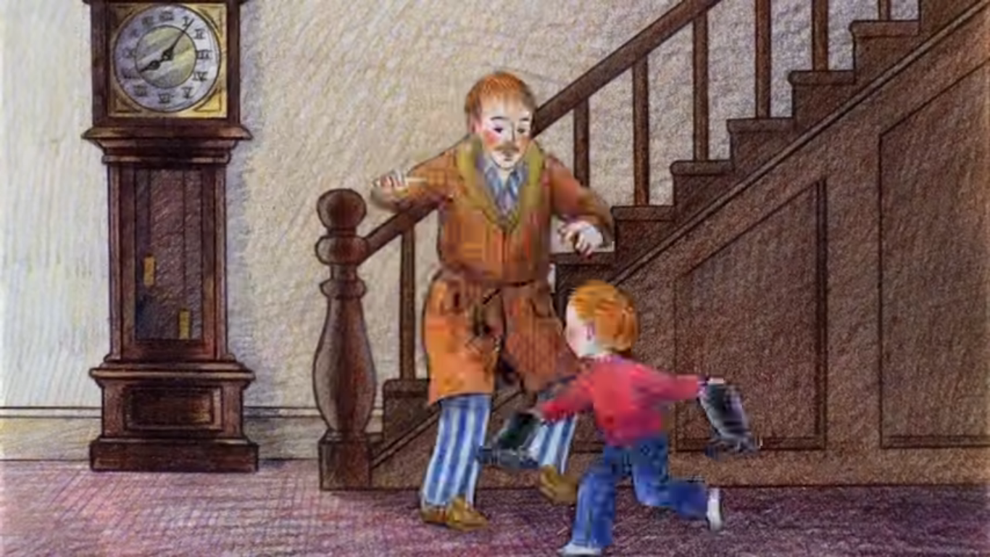
Think for yourself…
1) Why do you think the boy’s mum and dad are not as excited about the snow as he is?

Slide 6
Watch from 6mins to 12mins 13secs of The Snowman –
https://www.youtube.com/watch?v=5A3THighARU
Rapid Retrieval
List three fruits that the Snowman tries on as a nose.
Whose clothes does the Snowman enjoy trying on?
Why do the pair have to leave the parent’s bedroom?

Slide 7
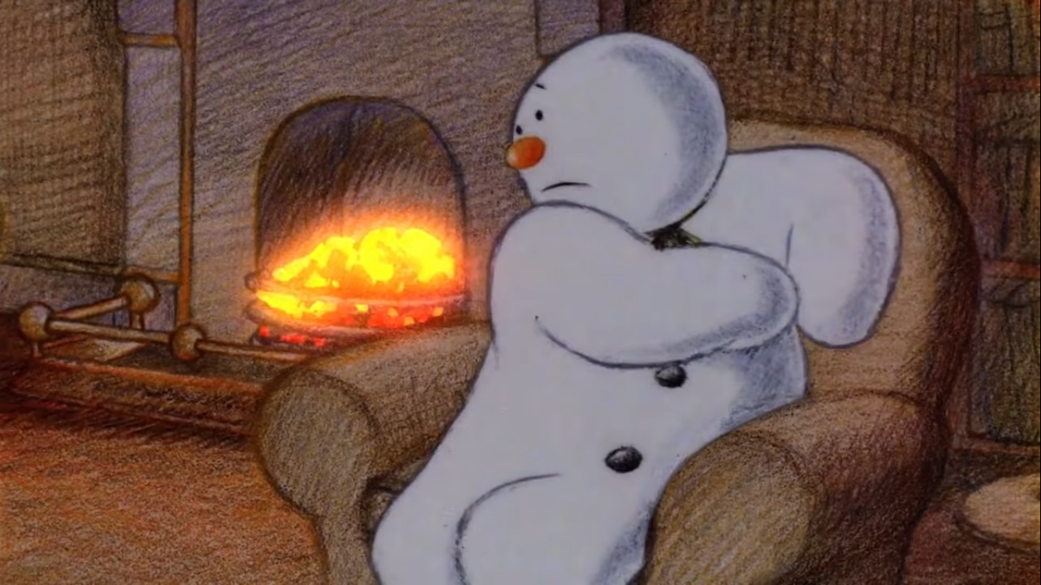
Time To Talk…
How is the Snowman feeling here? How do you know?
EXT: Explain why would a fire be really bad for a snowman?

Slide 8
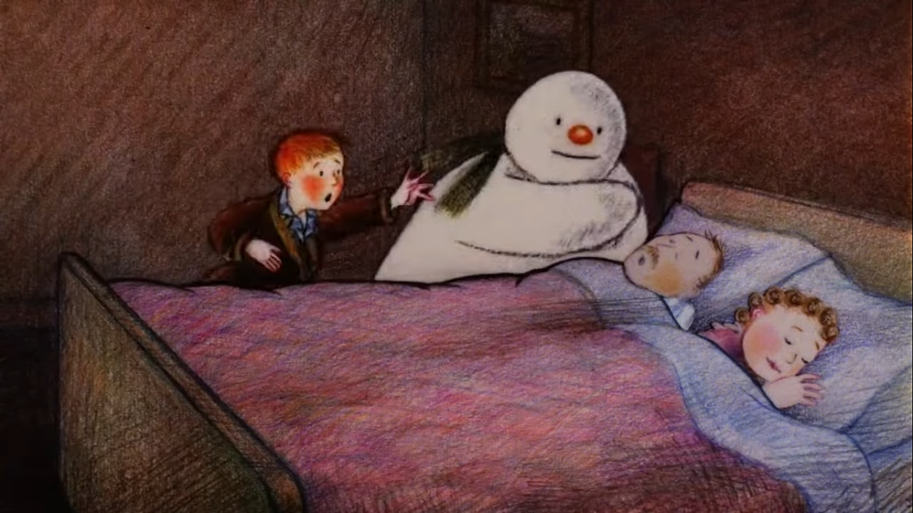
Think for yourself…
Why might the Snowman be so interested in the sleeping parents?

Slide 9
Watch The Snowman from 12mins to 19mins –
https://www.youtube.com/watch?v=5A3THighARU
Rapid Retrieval
What machine is under the cover?
List three animals the pair see on their bike ride.
True or False – the last animal the pair see is a fox?
Which animal splashes the pair with water?

Slide 10
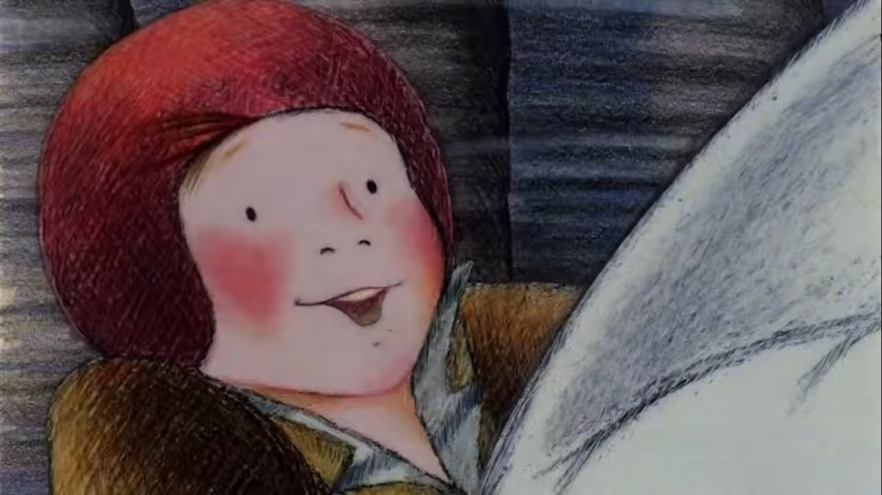
Time To Talk…
Can you think of a word to explain how the boy is feeling here? Be ready to explain your choice.

Slide 11
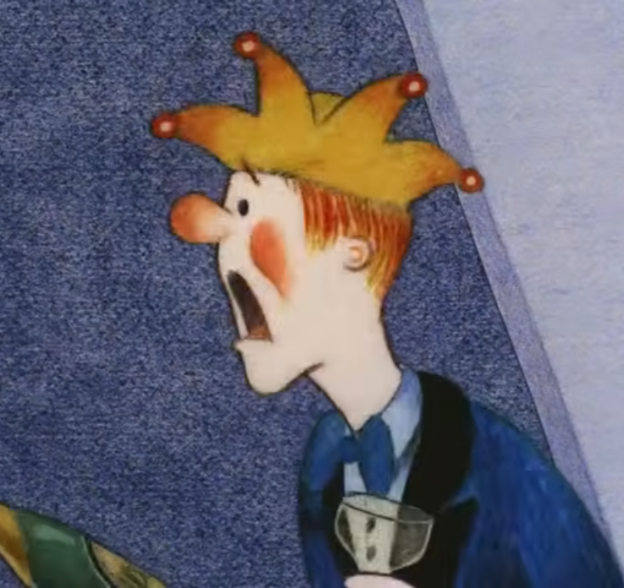
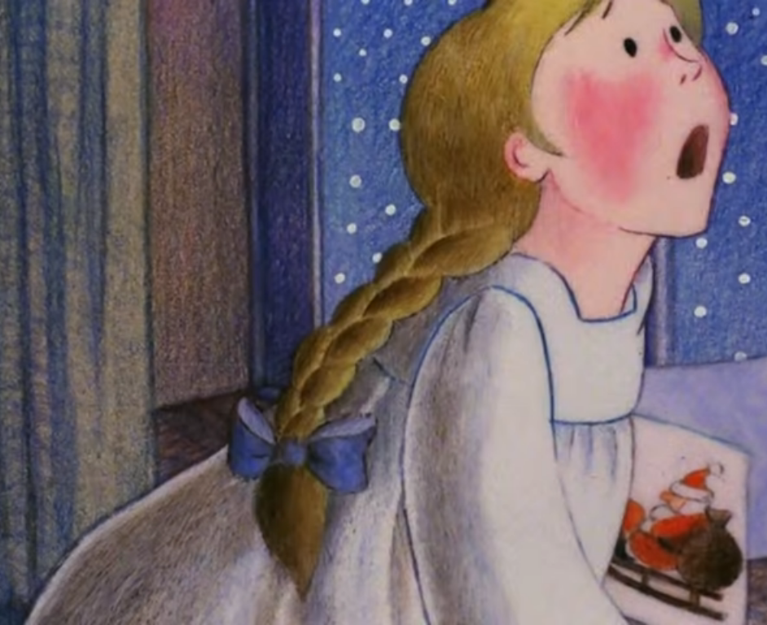
Think for yourself…
Why do both of the people who see the boy and the Snowman flying react in this way?
EXT: Think of a time when you have been left open-mouthed by something you saw. Explain what it was.

Slide 12
Watch from 19mins to the end of The Snowman
- https://www.youtube.com/watch?v=5A3THighARU
Rapid Retrieval
What do the pair find after their walk through the woods?
Who is hidden at the centre of the group of snowmen?
What present does Father Christmas give to the boy?
How many times does the boy hug the Snowman before going back into his house?

Slide 13
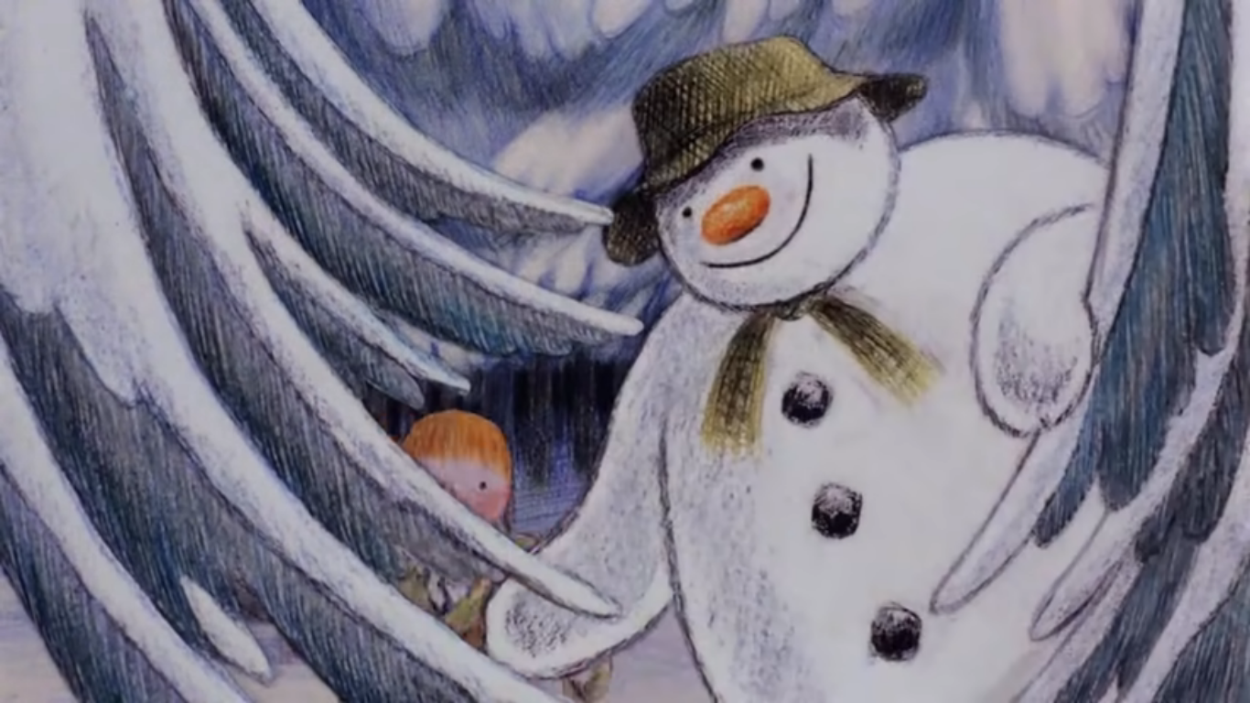
Time To Talk…
How do you think the boy was feeling as he walked through the woods?
EXT: Why do you think the Snowman looks so excited here?

Slide 14
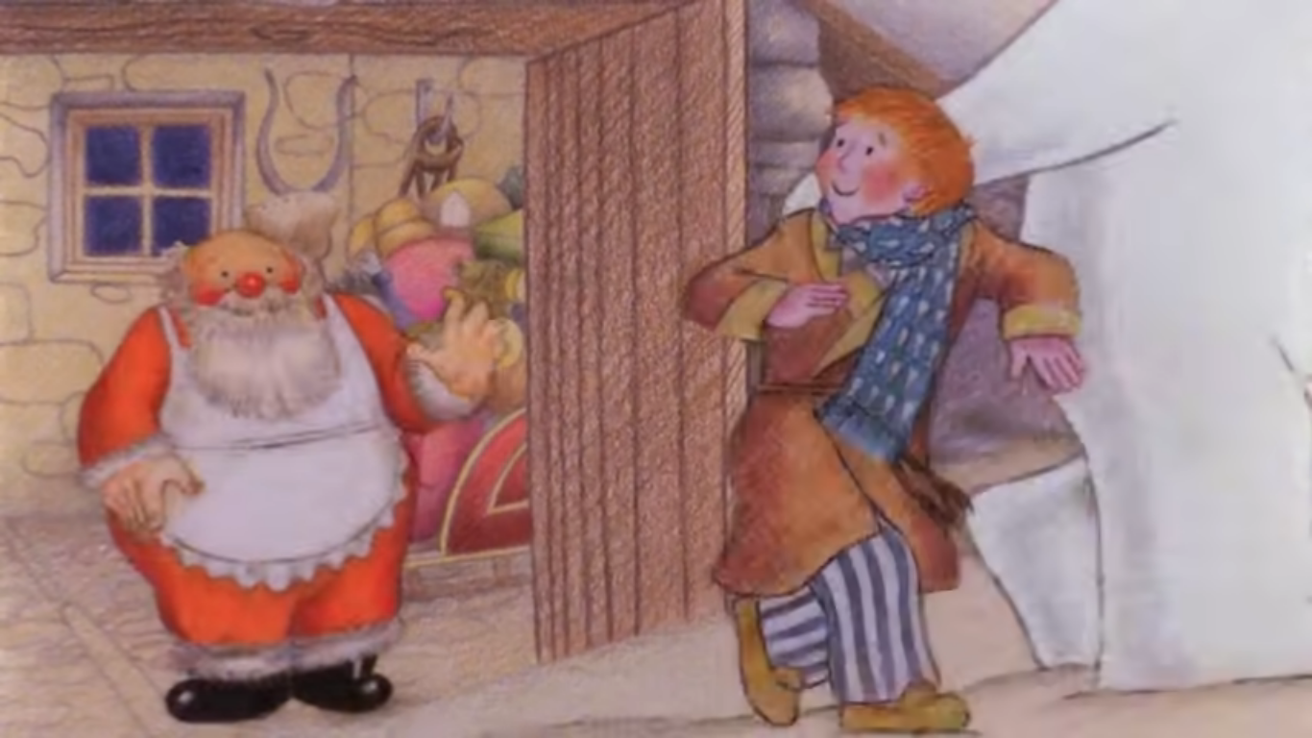
Think for yourself…
What do you think the boy enjoyed most about his visit to the North Pole? Why?

Slide 15
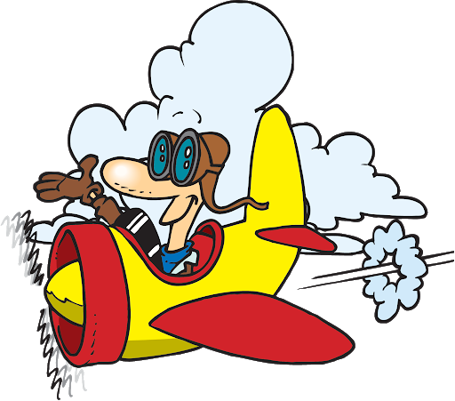
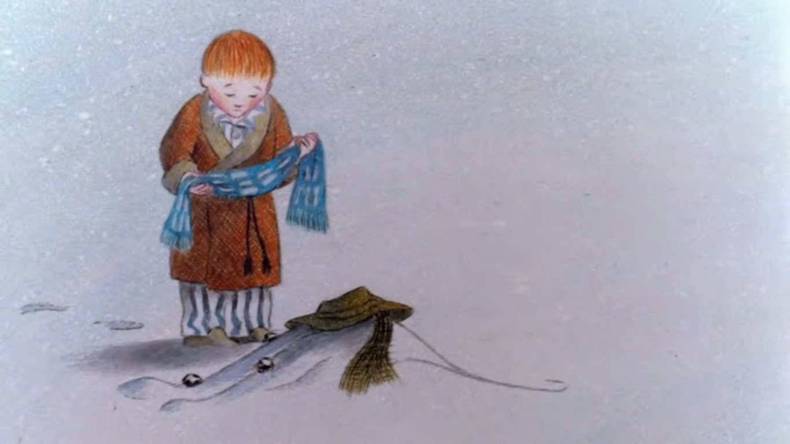
Flying Solo…
Do you think the boy will look back on this time with happiness or sadness? Why?
What do you think of this ending to the film? Explain your thoughts fully.

