Slide 1
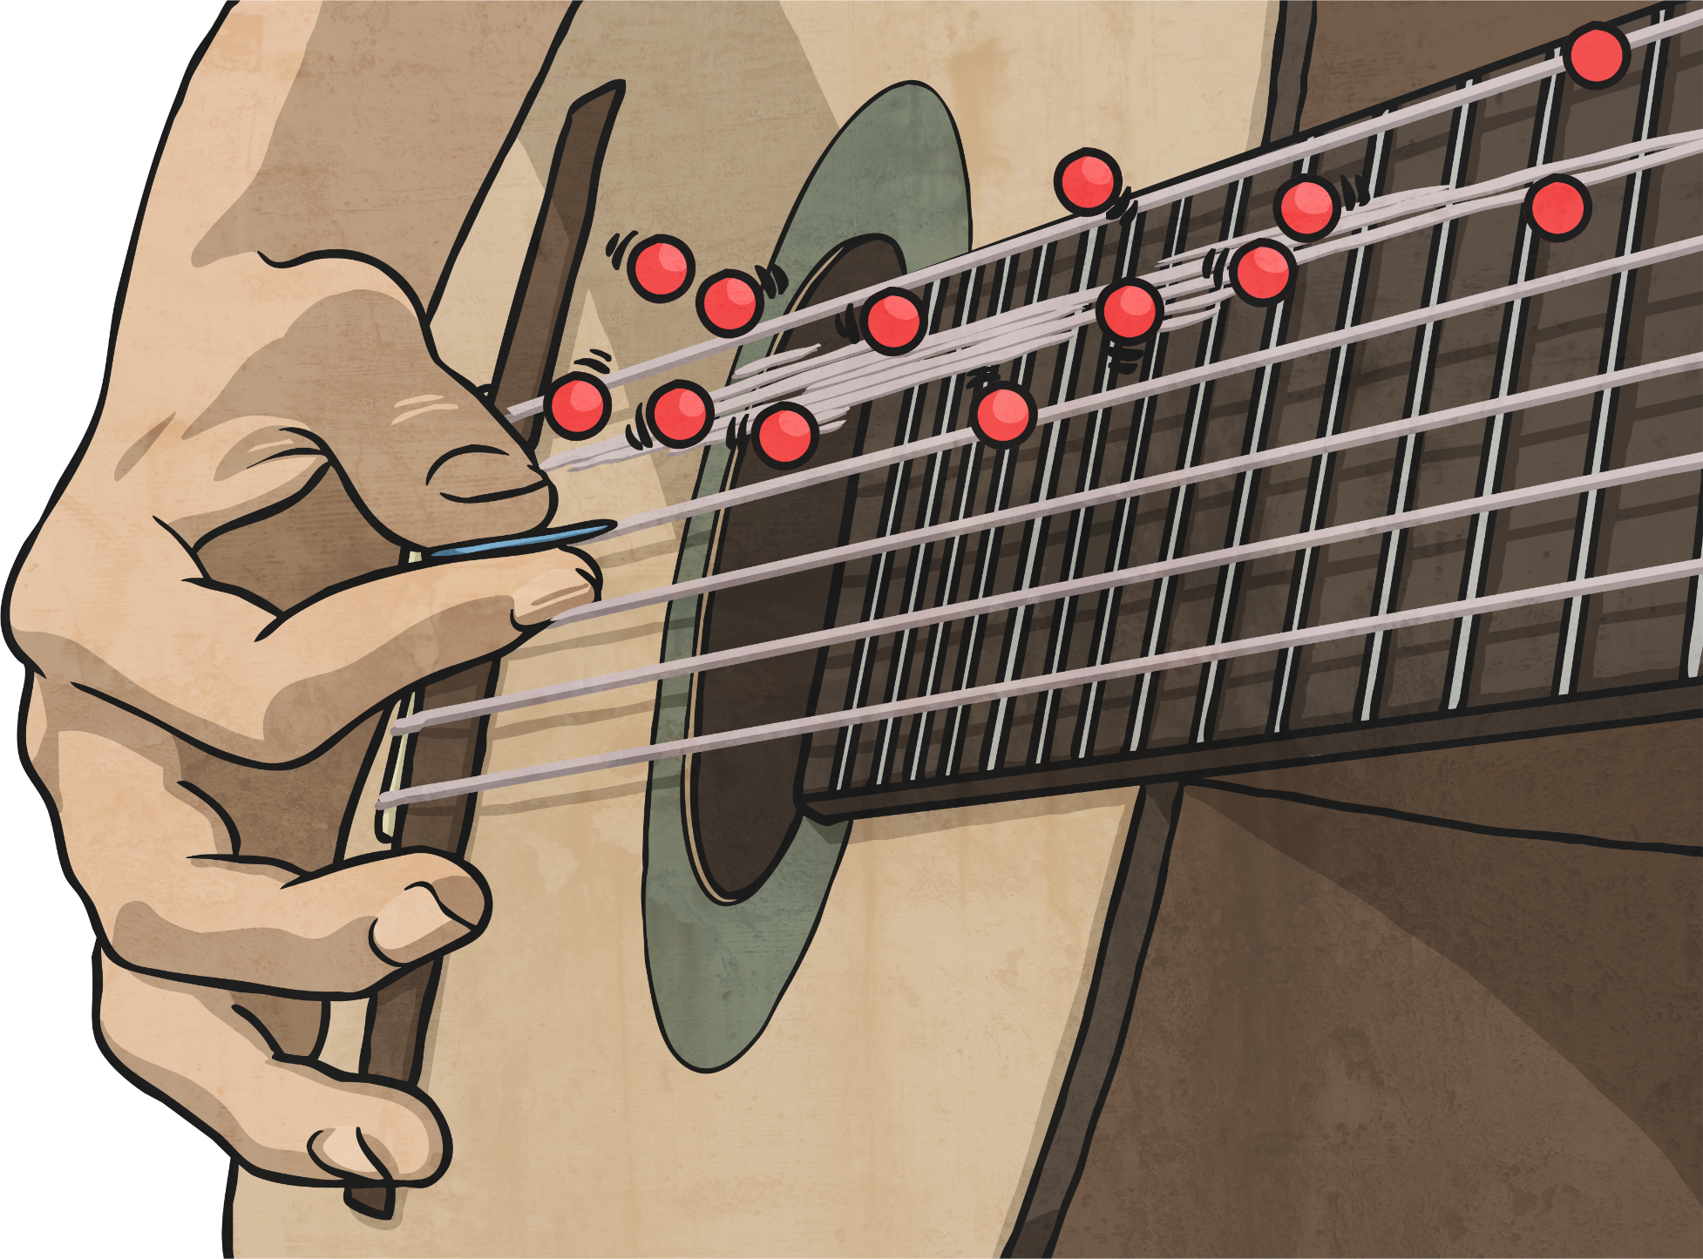
Good Vibrations

Slide 2
Task 1 - create a spider diagram of everything you can remember about our Sound topic.
Task 2 - Draw a diagram including the energy transfer model to show a sound being produced and then travelling to an ear.
Task 3 - Label your diagram using appropriate scientific vocabulary and write an explanation as to what happens. Remember to use all appropriate scientific vocabulary to support you.
Task 4 – Write a sentence explaining how we can change the volume of a sound and how this will affect how the sound travels.
Task 5 - Write an explanation for how to change the pitch of a sound.

Slide 3
If you need some support read through the rest of the PowerPoint but first of all try to see what you can remember yourself ☺

Slide 4
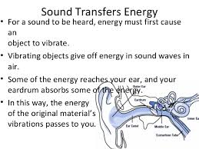
Science model: Energy Transfer

Slide 5
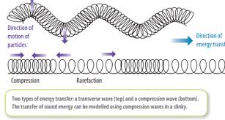
Science model: Energy Transfer

Slide 7
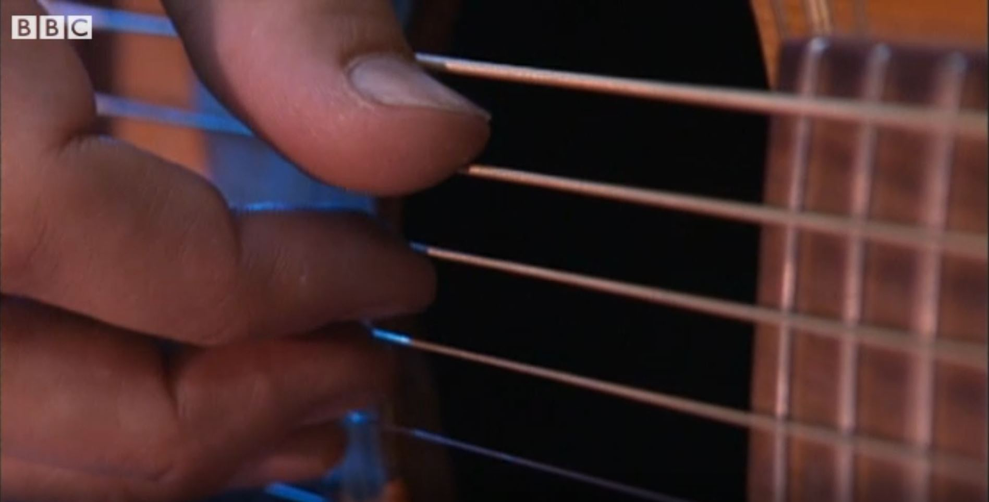
What is Sound?
Watch this clip to see to see how the different families of musical instrument create different sounds.
Click on this image to play the video in a new window.
Notes:
Teacher Note - Please check your volume is set to the appropriate level for this video. Please do not let the next video automatically play at the end of the clip. Please check the content in this link, including any comments, is suitable for your educational environment before showing. Twinkl accepts no responsibility for the content of third party websites.

Slide 8
Vibrations
We can see and feel vibrations whenever sounds are made.
Gently place your hand on your throat.
Say ‘Ah!’
Can you feel the vibrations from your vocal cords?
Ahh

Slide 9
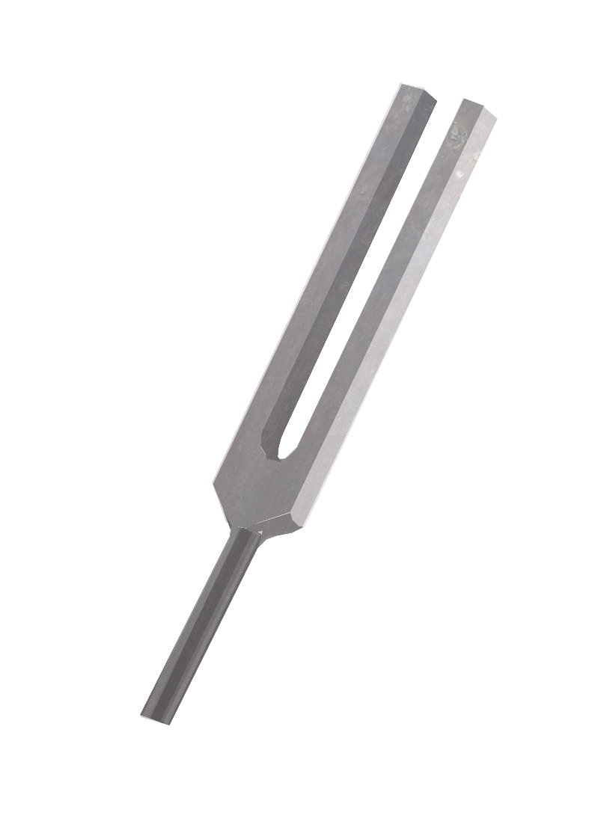
Vibrations
Watch the videos of the tuning fork.
https://www.youtube.com/watch?v=_gbfu4YtTMQ
https://www.youtube.com/watch?v=iRYWmo3Tuq4
You can see the ripples in the water when you place the tuning fork into it.
The tuning fork vibrates when it is hit, making the sound. These vibrations travel through the water, making the ripples as the water vibrates.

Slide 10
What is Sound?
Vibrations are made in a variety of ways
Vibrate
Vibration
Twang
Blow
Bang
Scrape
Shake
Pluck

Slide 11
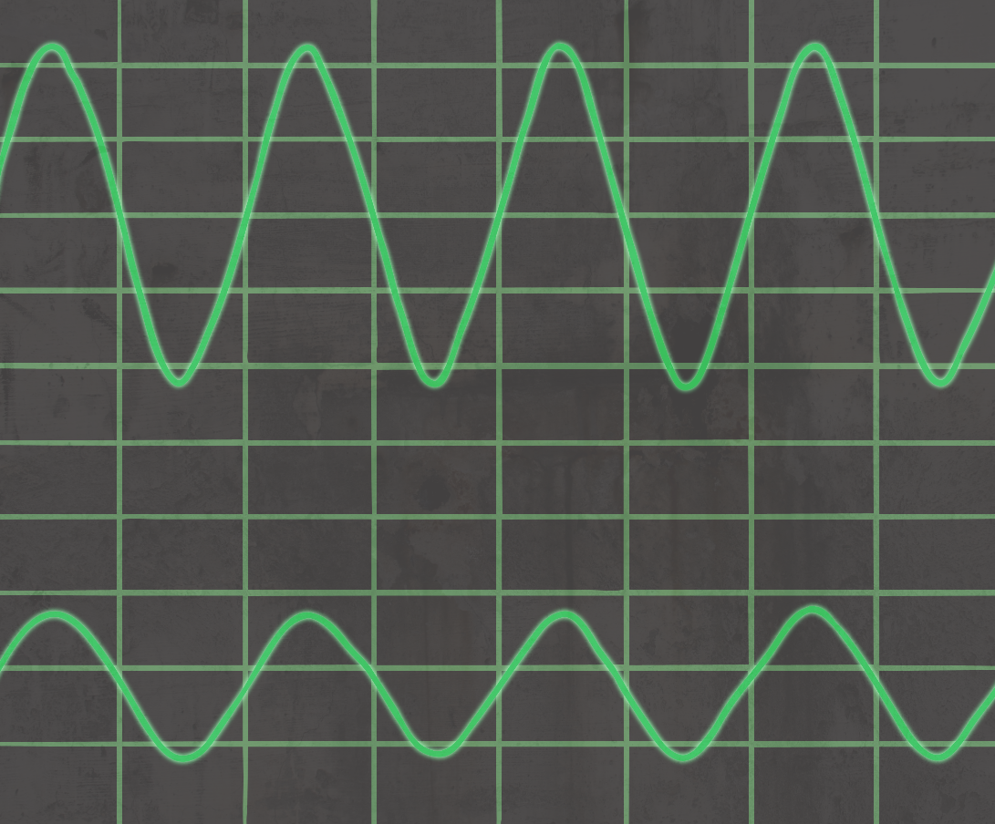
Loud and Quiet
The louder the sound, the bigger the vibration. You should have noticed that the rice grains vibrated more when you hit the drum harder, creating a louder sound.
The size of the vibration is called the amplitude.
Quieter sounds have a smaller amplitude, and louder sounds have a bigger amplitude.

Slide 12
Different Sounds
High and low are words to describe the pitch of a sound.
The pitch of a sound is different to the amplitude.
Amplitude is a measure of how loud or quiet a sound is, and pitch is a measure of how high or low a sound is. High sounds can be quiet or loud, and low sounds can be quiet or loud too!
Amplitude
Pitch

Slide 13
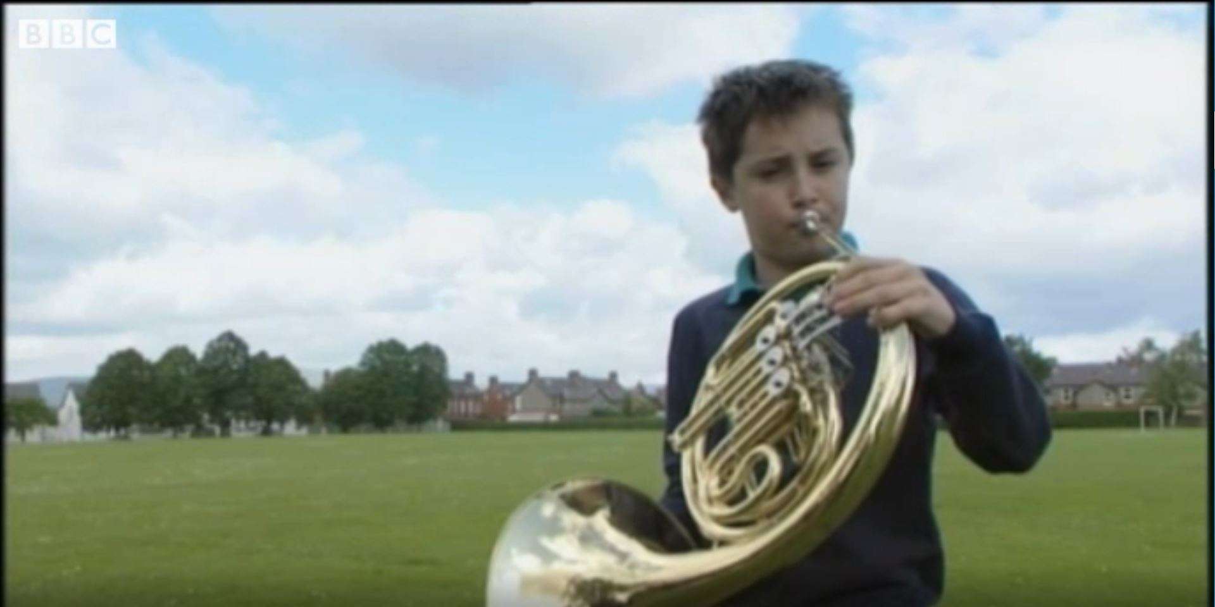
Different Sounds
Watch this clip to see if you can hear and identify how different musical instruments create different sounds.
Click on this image to play the video in a new window.
Notes:
Teacher Note - Please check your volume is set to the appropriate level for this video. Please do not let the next video automatically play at the end of the clip. Please check the content in this link, including any comments, is suitable for your educational environment before showing. Twinkl accepts no responsibility for the content of third party websites.

