Slide 1
25.11.21
L.O. – I can measure perimeter on a grid.

Slide 2
1) 12 $÷$ 2 $=$
24 $÷$ 2 $=$
Compare using $<$ , $>$ or $=$
26 30
20 $+$ 6 20 $+$ 10
Practise your 9x table as we are going to play hit the button next.

Slide 3
1) 12 $÷$ 2 $=$
24 $÷$ 2 $=$
Compare using $<$ , $>$ or $=$
26 30
20 $+$ 6 20 $+$ 10
6
12
$$<$$
$$<$$
https://www.topmarks.co.uk/maths-games/hit-the-button

Slide 4
Calculate the perimeter of the rectangle.
1 cm
1 cm
24 cm

Slide 5
Calculate the perimeter of the rectangle.
1 cm
1 cm
9 cm
3 cm
3 cm
9 cm
9 cm + 3 cm + 9 cm + 3 cm =
24 cm

Slide 6
Do I need to count all the squares?
Have a think
1 cm
1 cm
1 cm
1 cm
4 cm
22 cm
4 cm $×$ 4 $=$ 16 cm

Slide 7
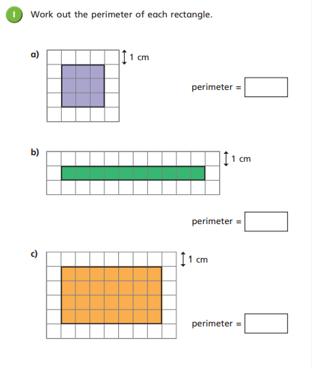
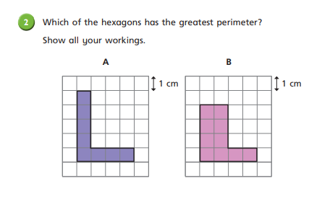
Work through questions 1 and 2 on your worksheet.
You don’t need to use a ruler as one square represents 1cm.

Slide 8
Draw shapes with a perimeter of 12 cm.
1 cm
1 cm
width $+$ length $=$ $\frac{1}{2}$of the perimeter of a rectangle

Slide 9
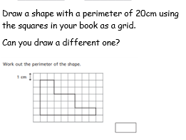
Work through the rest of the worksheet.
There is a challenge if you finish which we will look at together as a class at the end.

Slide 10
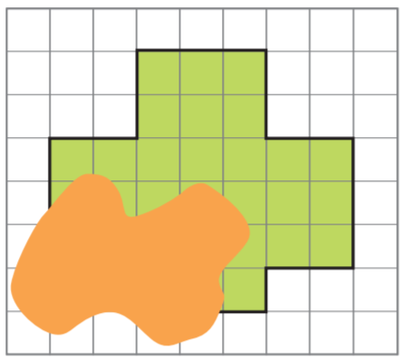
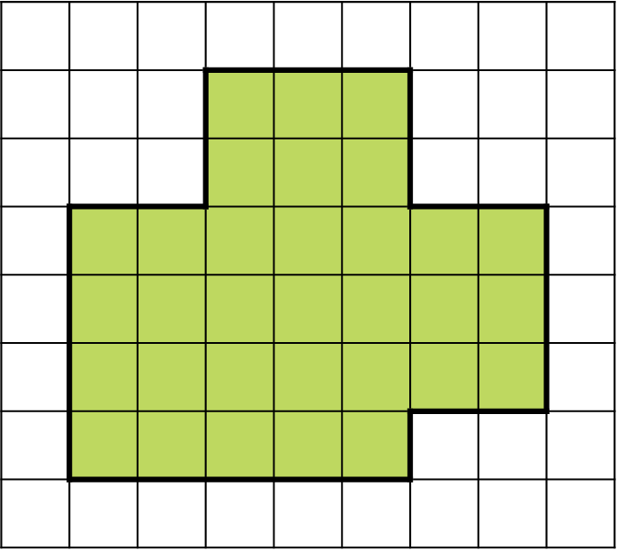
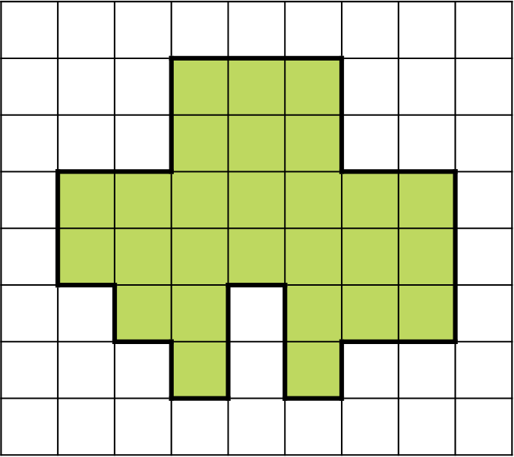
A shape is drawn on a square grid.
Part of the shape is hidden.
What could the perimeter of the shape be?
1 cm
$+$ 6 cm $=$ 26 cm
$+$ 10 cm $=$ 30 cm
20 cm
20 cm

