Slide 1
Art
Claude Monet

Slide 2
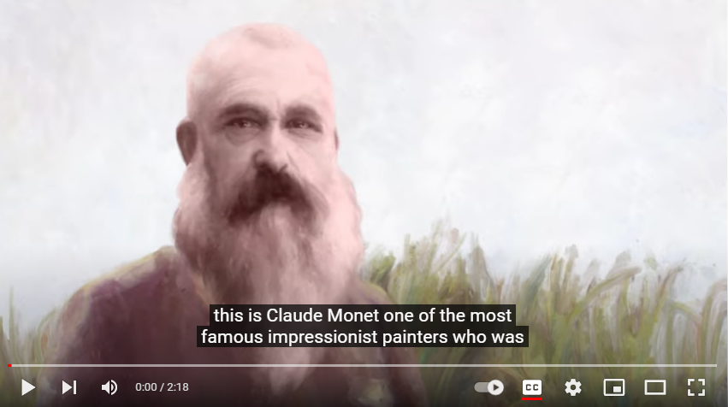

Slide 3
Let’s have a look at some of Claude Monet’s paintings.

Slide 4
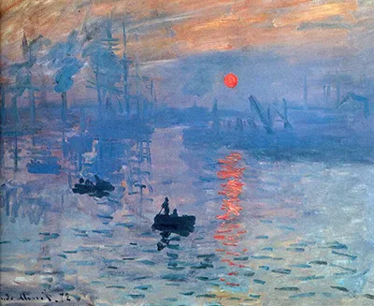
Impression Sunrise

Slide 5
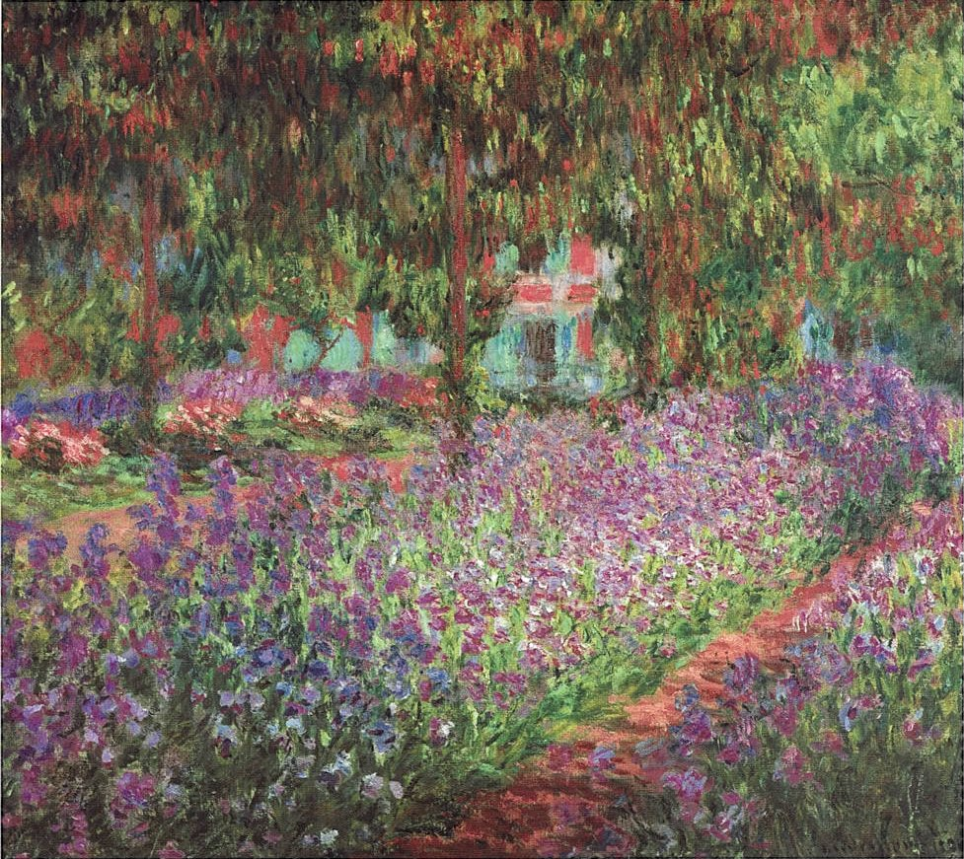
The Artist’s Garden

Slide 6
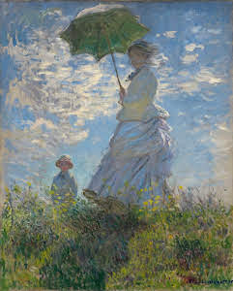
Woman With A Parasol

Slide 7
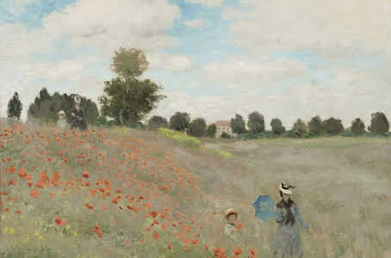
Wild Poppies

Slide 8
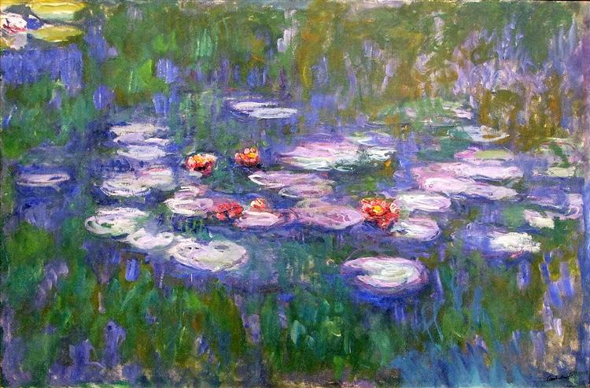
Water Lilies

Slide 9
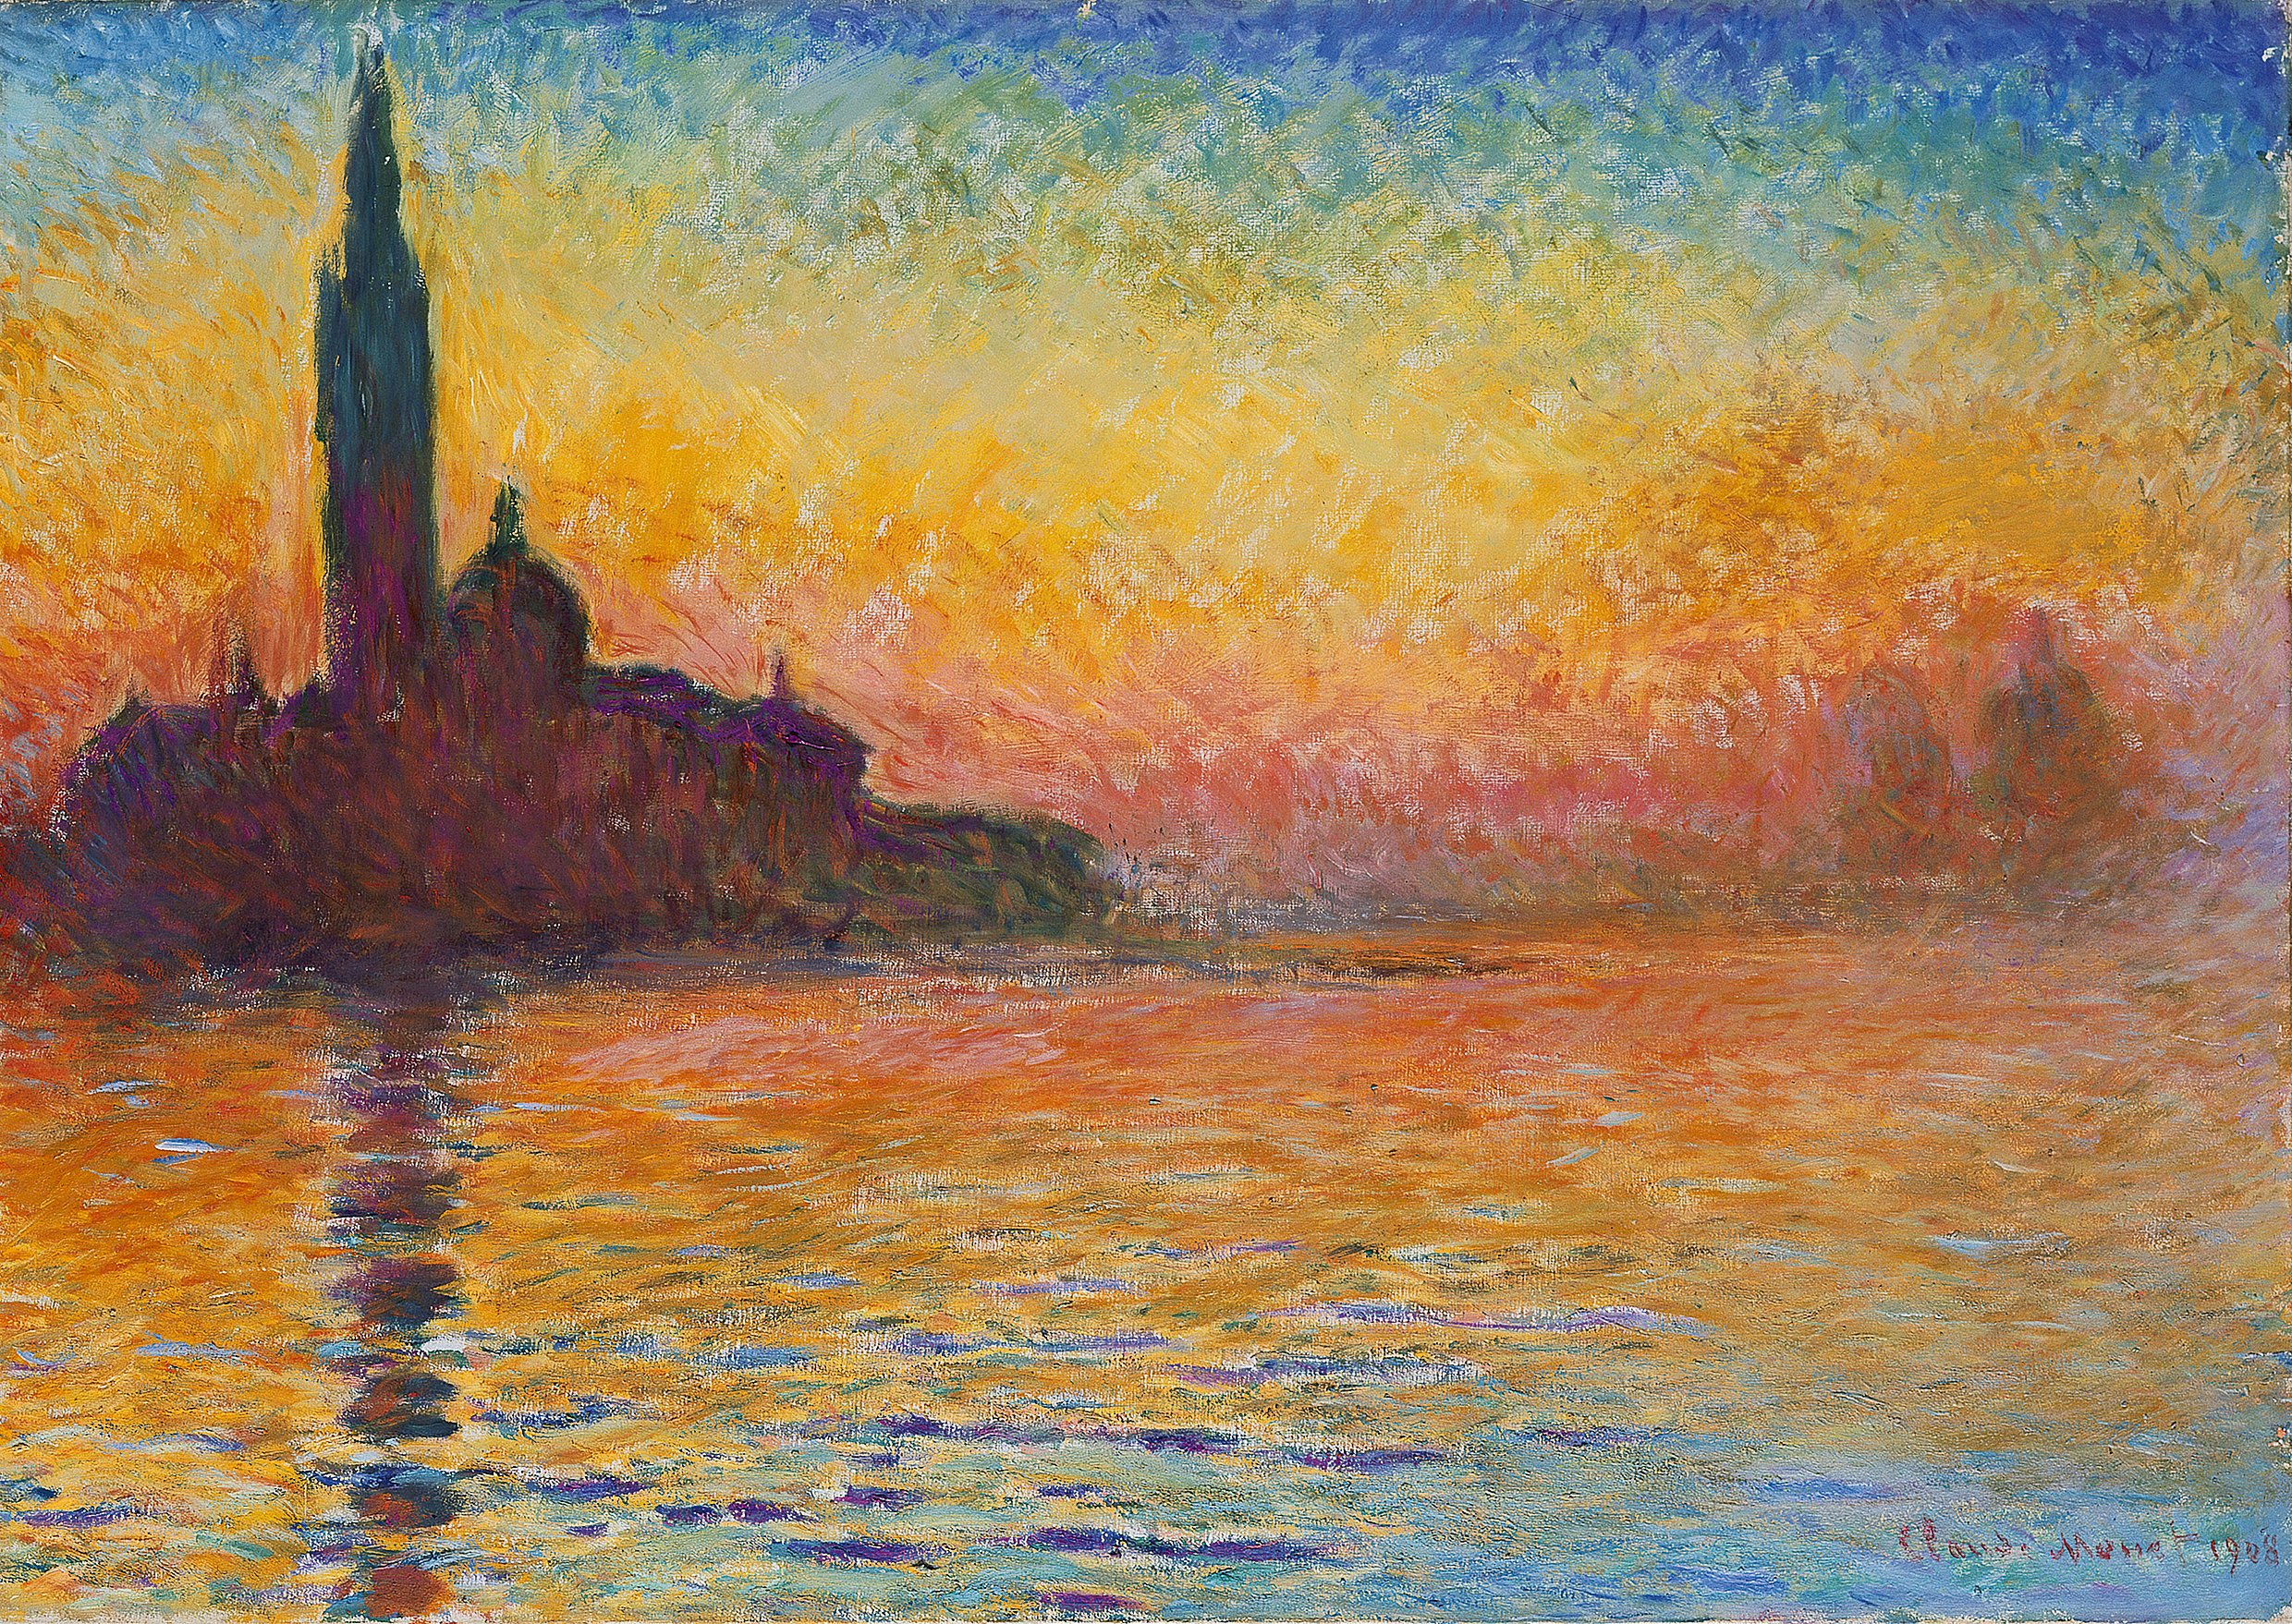
San Giorgio Maggiore at Dusk

Slide 10
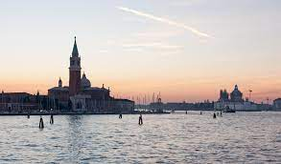
This is the actual place. It is in Venice, Italy.

Slide 11
We are going to paint in the style of Claude Monet. Look closely at his brush strokes.

Slide 12
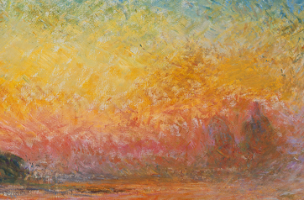
And now look even closer. What do you notice?

