Slide 1
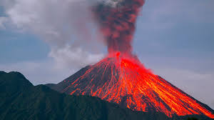
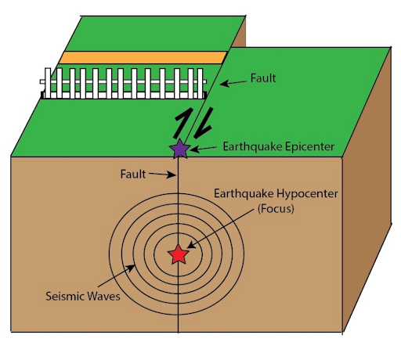
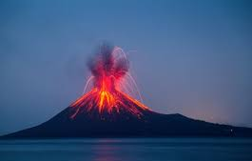
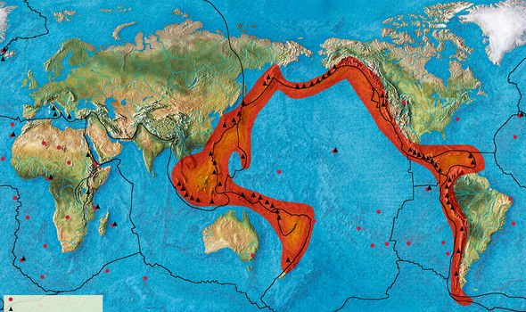
Create a Volcano or Earthquake model – Part 2.

Slide 2
Back in week 3 of this half term, you looked at volcanoes and earthquakes. After making your model of either a volcano or an earthquake, you now need to explain why they occur using the correct geographical vocabulary.
If you are struggling with your explanations, working through this PowerPoint might help.

Slide 3
Why does a volcano form?
A volcano is formed when hot molten rock, ash and gases escape from an opening in the Earth's surface. The molten rock and ash solidify as they cool, forming the distinctive volcano shape shown on this slide.

Slide 4
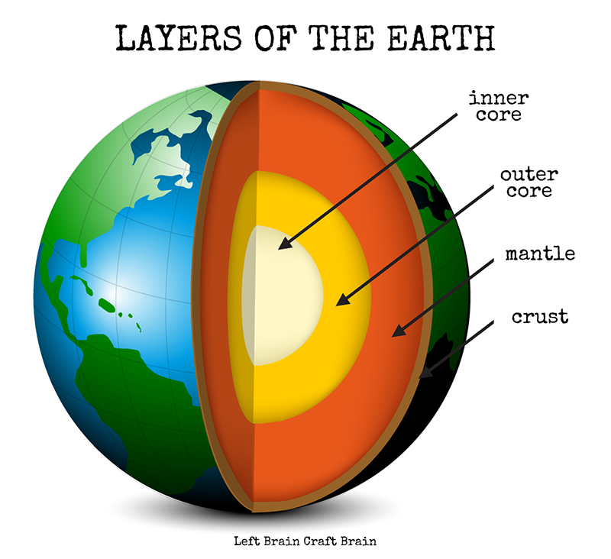
Volcanoes erupt when molten rock called magma rises to the surface. Magma is formed when the earth's mantle melts. ... If magma is thick, gas bubbles cannot easily escape and pressure builds up as the magma rises. When the pressure is too much an explosive eruption can happen, which can be dangerous and destructive.
Why does a volcano erupt?
A short video from Newsround about what causes volcanoes to erupt
.
https://www.bbc.co.uk/newsround/44100737#:~:text=Volcanoes%20erupt%20when%20molten%20rock,rises%20towards%20the%20Earth's%20surface.

Slide 5
What causes an earthquake to happen?
Earthquakes usually happen when rock underground suddenly breaks or jolts along a fault line. ... Over time these plates move very slowly, but when they meet the edges (or fault lines) can get stuck while the plate continues to move. This causes pressure to build up which eventually leads to an earthquake.

Slide 6
Earthquake song.
https://www.youtube.com/watch?v=zfd1VasIETw

Slide 7
I hope this second PowerPoint has helped you understand the geographical reasons why earthquakes and volcanoes occur.
If you haven’t already uploaded pictures of your model and either a written explanation or a video explaining why earthquakes or volcanoes happen please do so. We look forward to seeing your work.
Miss Brewster, Miss Stevens and Miss Lamb.

