Slide 1
Friday 14th January 2022
LO: To plan our innovated finding tale.

Slide 2
First let’s say the story with actions.

Slide 3
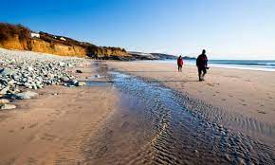
Adventure at Sandy Cove

Slide 4
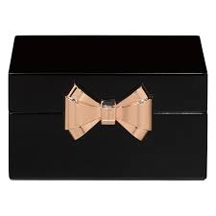
“Hurry up,” shouted Joe as he climbed over the rocks. Carefully, Rahul followed. The two boys stopped at a rock pool and began to search for shells. “Hey, what’s this?” shouted Joe to Rahul. In the rock pool was a small, black box wrapped in plastic. The boys tugged it loose. What was inside? Joe pressed the silver catch and the lid popped open. It was full of jewels!

Slide 5
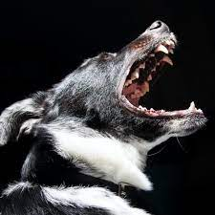
At that moment, a scruffy old man shouted at the boys. His wolf-like dog barked menacingly. Joe snapped the lid down, picked up the box and the two boys began to scramble over the rocks. They slipped and struggled towards the cliffs.

Slide 6
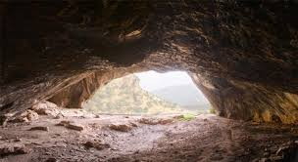
“Quick! Let’s hide in here,” said Joe, rushing into a cave. It was dark and damp inside and they could hear water dripping. They felt their way further in and crouched behind a rock. Rahul’s heart pounded. All at once, the scruffy man appeared at the cave mouth. He shone a torch around. The light cast shadows on the cave wall. The children ducked down and kept as still as stone, but the dog could sense them. It padded closer and closer, growling menacingly. Rahul gripped Joe’s arm. They could see its white teeth, smell its damp hair and feel its hot meaty breath.

Slide 7
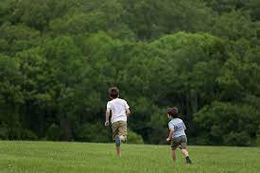
Suddenly there was a distant shout. ‘Here Dog!’ hissed the man, roughly grabbing its collar. “Those boys have got away. Quick. After them!” Joe and Rahul held their breath until they could hear the sound of the man and his dog stumbling back across the rocks. They waited for a long while before creeping out. Even though the beach was empty, the boys ran home as fast as they could.

Slide 8
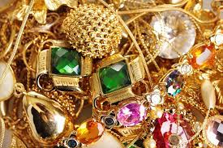
At first Mum didn’t believe them. It was only when Joe opened the box that she decided to call the police. When the police arrived they told Mum that the big house up the road had been burgled only the night before. They had spent all day searching for a trace of the jewels. Their only clue had been the footprints of a large dog. Joe shut his eyes. He could imagine the headlines: ‘PRICELESS JEWELS FOUND BY SCHOOLBOY DETECTIVES. And there was a reward too!

Slide 9
Now tell your friend a summary of the story.

Slide 10
I have boxed up the story for us so that we can use this to help us plan our own story.

Slide 11
We need to decide what our characters are going to find. Let’s watch this short video. It might give us some ideas.

Slide 12
What do you think of the video? What do you think of the treasure the lady finds?
There is a saying:
One man’s rubbish is another man’s treasure.
What do you think this means?

Slide 13
What is junk for one person, might be treasure for someone else.
Imagine your characters went on a walk somewhere e.g. the woods or the beach, and found something unusual or special. Think about what your characters might find in your own innovated version of the story.

Slide 14
You might want to change all or some of the following things: The setting, who your two main characters are, what they find, who or what they are scared of.
Make a plan for your version of the story on the grid provided. Remember it’s is only a plan so don’t include too much detail. You will finish your plan tomorrow.

