Slide 2
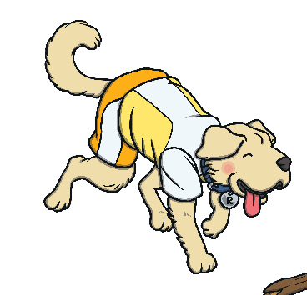
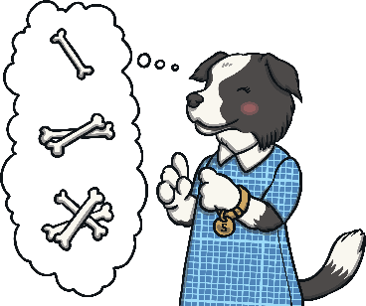
Puffin Book of the Week The Hundred-Mile-An Hour Dog
The Hundred-Mile-An-Hour-Dog
Listen to Chapter 3
To listen to Jeremy Strong read the third chapter of ‘The Hundred-Mile-An-Hour Dog’, click here.
Next
When you’ve listened to Chapter 3, pause the video.
On the next slides, the Totally Pawsome Gang are going to ask you some questions about what you’ve just heard.
Next
Text copyright ©1996 by Jeremy Strong; illustrations copyright ©1996 by Nick Sharratt

Slide 3
Puffin Book of the Week The Hundred-Mile-An Hour Dog
The Hundred-Mile-An-Hour-Dog
To listen to the chapter again, click here.
Vocabulary Victor wants to know…
What words does Trevor use to describe Mouse?
Trevor uses the words furry bulldozer to describe Mouse.
WHOOOOOOSSSSHHHH!! Was it a bird? Was it a plane? No, it was Streaker the Superdog, travelling at light-speed. All that was left was a cloud of dust as she vanished into the long grass. Every now and then her head bobbed above it and then she was off again. Mouse blundered amiably about the field like a furry bulldozer.
Reveal Answer
Back
Click here to read an extract from the book.
Next
Text copyright ©1996 by Jeremy Strong; illustrations copyright ©1996 by Nick Sharratt

Slide 4
Puffin Book of the Week The Hundred-Mile-An Hour Dog
The Hundred-Mile-An-Hour-Dog
To listen to the chapter again, click here.
Rex Retriever wants to know…
How did Tina know that Trevor and Streaker had arrived at her house?
Tina knew that Trevor and Streaker had arrived because she had heard the lady scream.
When we got to Tina's house, she was standing on the path holding the front door open. 'I knew it was you when I heard that lady scream,' she said. 'You'd better come inside and hide.' Streaker had 􀀁already dragged me into the house. I think that
Mouse is probably her best friend. (Funny how nobody makes jokes about them being in love.) I told Tina about the £30.
Reveal Answer
Back
Click here to read an extract from the book.
Next
Text copyright ©1996 by Jeremy Strong; illustrations copyright ©1996 by Nick Sharratt

Slide 5
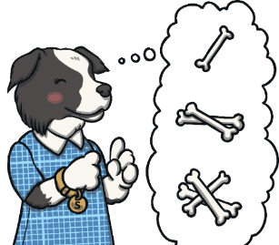
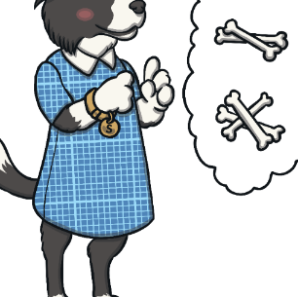
Puffin Book of the Week The Hundred-Mile-An Hour Dog
The Hundred-Mile-An-Hour-Dog
To listen to the chapter again, click here.
Sequencing Suki wants to know…
Which of the following is the last thing that happens in this chapter?
Trevor is dragged along the streets by Streaker.
or Charlie Smugg pops up.
The last thing that happens in this chapter is that Charlie Smugg pops up.
As if life wasn't bad enough already, it was at that moment Charlie Smugg popped up his big, fat face.
Reveal Answer
Back
Click here to read the last paragraph from this chapter.
Next
Text copyright ©1996 by Jeremy Strong; illustrations copyright ©1996 by Nick Sharratt

Slide 6
Puffin Book of the Week The Hundred-Mile-An Hour Dog
The Hundred-Mile-An-Hour-Dog
To listen to the chapter again, click here.
Inference Iggy wants to know…
Why do you think that Trevor decided to meet up with Tina?
Trevor decided to meet up with Tina because they were best friends and she might be able to help him to train Streaker.
I should point out that Tina is an ORGANIZER. (Mind you, you've probably worked that out for yourself already.) She likes deciding what to do and then doing it. What she likes even more is deciding what everyone else should do at the same time. She'll probably be a Business Manager when she grows up, or Prime Minister.
Reveal Answer
Back
Click here to read an extract from the book.
Next
Text copyright ©1996 by Jeremy Strong; illustrations copyright ©1996 by Nick Sharratt

Slide 7
Puffin Book of the Week The Hundred-Mile-An Hour Dog
The Hundred-Mile-An-Hour-Dog
To listen to the chapter again, click here.
Predicting Pip wants to know…
There are lots of different answers that you could have given. You might have said that you think that the next chapter will start with the sentence: Charlie Smugg walked towards Trevor and Tina and asked, “Who owns that crazy dog?”
What sentence do you think the next chapter will start with?
As if life wasn't bad enough already, it was at that moment Charlie Smugg popped up his big, fat face.
Reveal Answer
Back
Click here to read the last paragraph from this chapter.
Finish
Text copyright ©1996 by Jeremy Strong; illustrations copyright ©1996 by Nick Sharratt

Slide 8
If you enjoyed reading The Hundred-Mile-An-Hour Dog, you can discover more at the Puffin Books website.

