Slide 1
This PowerPoint is best used on a computer rather than printed off as it works through each problem as we would in the classroom taking you through to the answer in most cases.
Its purpose is to introduce the concepts on the worksheet which the children can answer once they have worked through the PowerPoint.
There is a separate answer sheet to support checking the worksheet.

Slide 2

12.01.21
LO. I can multiply a 2-digit number by a 1-digit number. Part 2.

Slide 3
Task 1.
Let’s recap our 11 x table.
We will chant it all together.

Slide 4
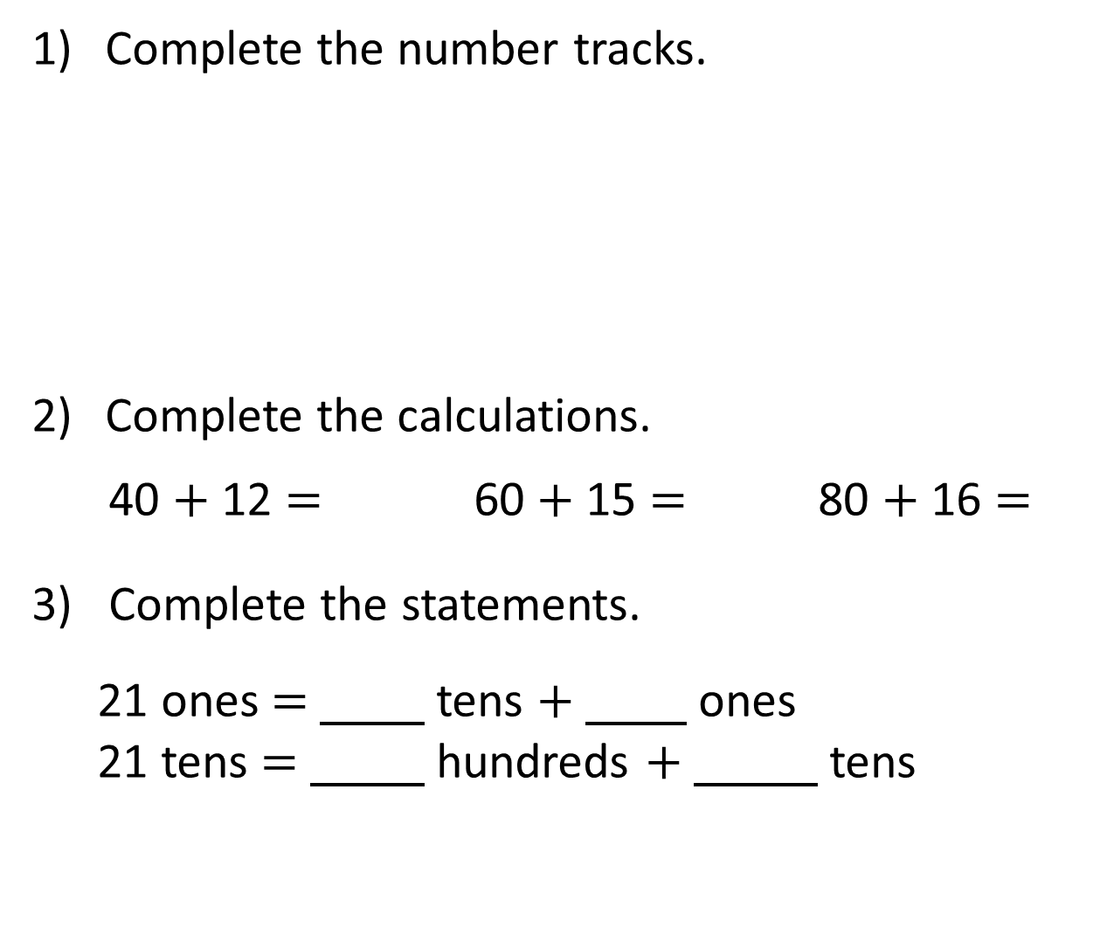
Complete the number tracks.
Complete the calculations.
40 $+$ 12 $=$ 60 $+$ 15 $=$ 80 $+$ 16 $=$
3) Complete the statements.
21 ones $=$ tens $+$ ones
21 tens $=$ hundreds $+$ tens
2 |  |  |  | 10 |  | 14 | 16
4
6
8
12
18
20
20 |  |  | 80 | 100 |  |  |  | 180
40
60
120
140
160
200
52
75
96
2
1
2
1

Slide 5
Yesterday we started learning to multiply 2-digit numbers by 1-digit numbers.
We can use our multiplication knowledge to support our working.
We thought about the fact that multiplication is repeated addition.
That we can partition our 2-digit numbers to support our multiplication.
That we use place value to support our written multiplication work.

Slide 6
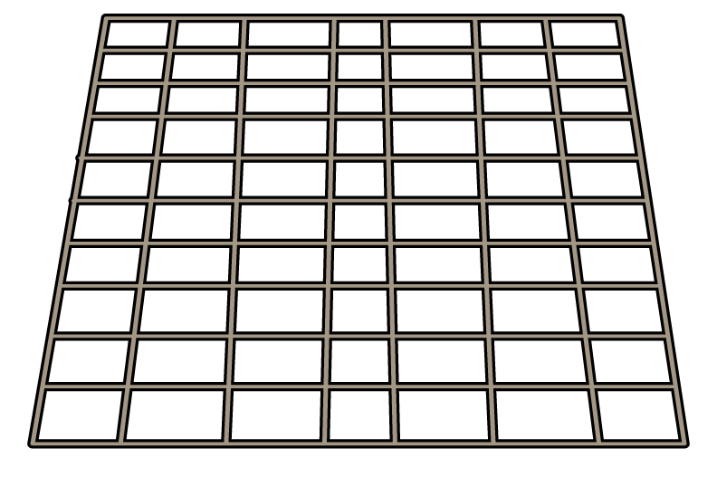


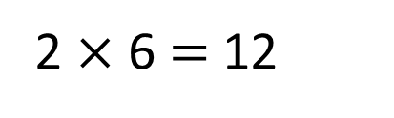
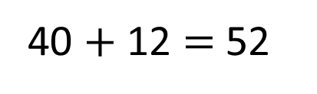
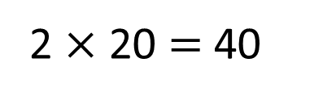
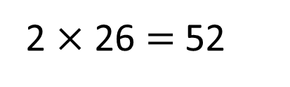
Let’s recap.
We can use partitioning to support our working.
Each tray has 26 rolls.
How many rolls are there in total?
2 $×$ 20 $=$ 40
2 $×$ 6 $=$ 12
40 $+$ 12 $=$ 52
2 $×$ 26 $=$ 52
There are 52 rolls in total.

Slide 7
The following slides will support you in answering questions 1 and 2 on your worksheet.

Slide 8
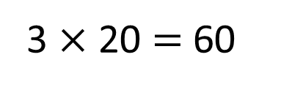
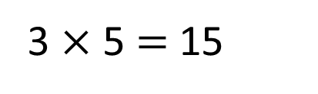
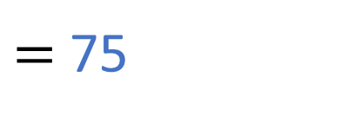
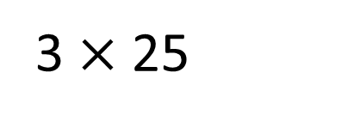
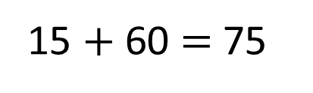
Let’s recap.
We can use concrete resources to support our working.
3 $×$ 25
$=$ 75
T | O
3 $×$ 5 $=$ 15
3 $×$ 20 $=$ 60
15 $+$ 60 $=$ 75

Slide 9



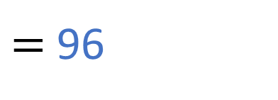
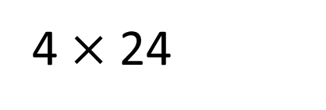
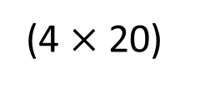
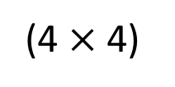

Let’s recap.
Here we are using concrete resources alongside written method.
4 $×$ 24
$=$ 96
T | O
T O
2
4
$×$
4
1 6
(4 $×$ 4)
8 0
(4 $×$ 20)
9 6
Have a think

Slide 10
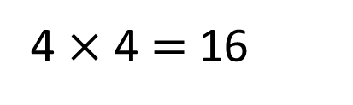
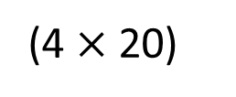

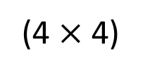
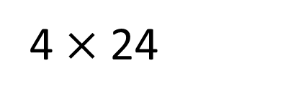

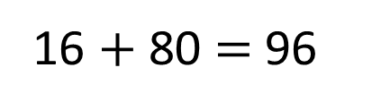
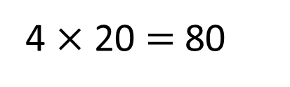

Let’s look at how to use compact written method.
4 $×$ 24
$=$ 96
T O
T | O
T O
2
4
2
4
4 $×$ 4 $=$ 16
4
$×$
4
$×$
4 $×$ 20 $=$ 80
9
6
1 6
(4 $×$ 4)
8 0
1
(4 $×$ 20)
16 $+$ 80 $=$ 96
9 6

Slide 11

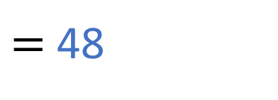
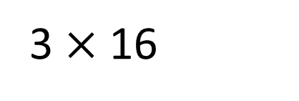
3 $×$ 16
$=$ 48
Have a think
T | O
T O
1
6
$×$
3
4
8
1

Slide 12

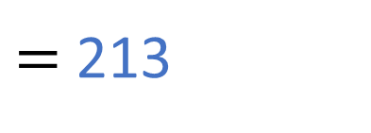
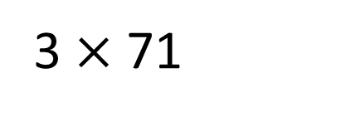

Yesterday our answers were all less than 1 hundred. Today our working will take us over the hundred as well.
3 $×$ 71
$=$ 213
Have a think
T | O
T O
7
1
$×$
3
2
1
3
2

Slide 13

Let’s use written method to support our working now. Can you solve this problem?
Send us your working and answer on Seesaw.

Slide 14
Now have a look at the worksheet and answer the questions.
Use all the teaching from today to help you work out how to solve problems on your worksheet.
Refer back to the PowerPoint if you are stuck, or message on Seesaw for more help.

