Slide 1

10.1.22
LO – I can multiply 2-digit numbers by a 1-digit number.

Slide 2
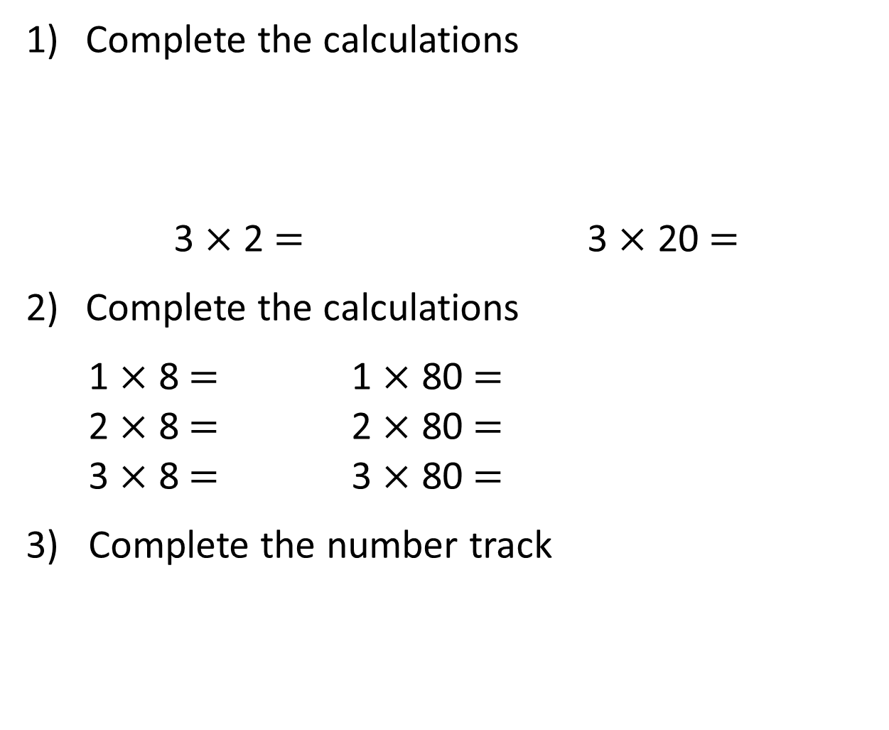
Complete the calculations
3 $×$ 2 $=$ 3 $×$ 20 $=$
Complete the calculations
1 $×$ 8 $=$ 1 $×$ 80 $=$
2 $×$ 8 $=$ 2 $×$ 80 $=$
3 $×$ 8 $=$ 3 $×$ 80 $=$
3) Complete the number track
20 | 40 | 60 |  | 100 |  | 140 | 160

Slide 3
Complete the calculations
3 $×$ 2 $=$ 3 $×$ 20 $=$
Complete the calculations
1 $×$ 8 $=$ 1 $×$ 80 $=$
2 $×$ 8 $=$ 2 $×$ 80 $=$
3 $×$ 8 $=$ 3 $×$ 80 $=$
3) Complete the number track
6
60
8
80
16
160
24
240
20 | 40 | 60 |  | 100 |  | 140 | 160
80
120
180
200

Slide 4
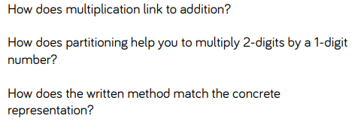
Now we have warmed up, lets look at multiplication and multiplying a 2-digit number by a 1-digit number.
Before we do this – let’s think together:

Slide 5

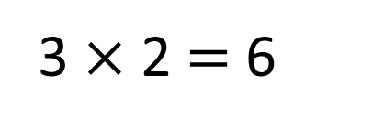
Each child has 2 pears.
How many pears are there in total?
Child 1
Child 2
Child 3
3 $×$ 2 $=$ 6
There are 6 pears in total.

Slide 6

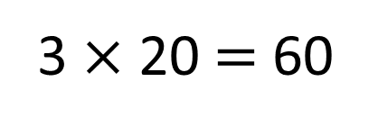
Each class has 20 pears.
How many pears are there in total?
Class 1
Class 2
Class 3
3 $×$ 20 $=$ 60
There are 60 pears in total.

Slide 7
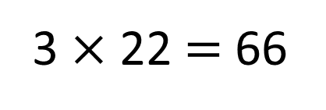
Each class has 22 pears.
How many pears are there in total?
Class 1
Class 2
Class 3
3 $×$ 22 $=$ 66
There are 66 pears in total.

Slide 8
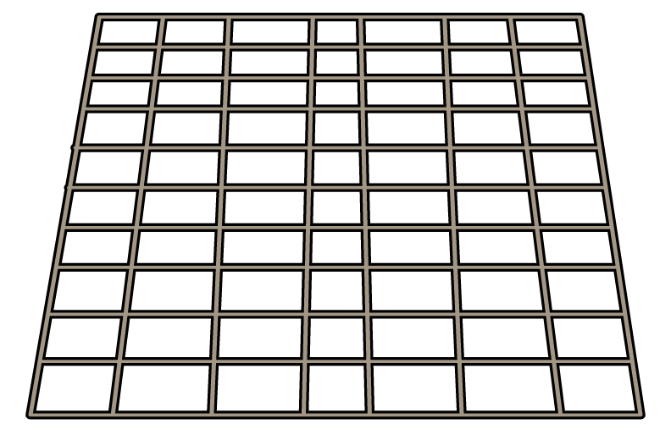



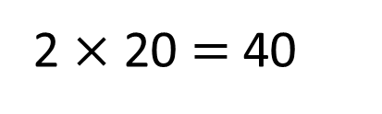
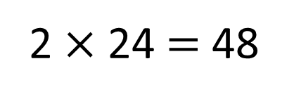
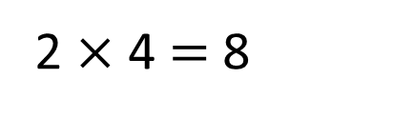
Each tray has 24 rolls.
How many rolls are there in total?
2 $×$ 20 $=$ 40
2 $×$ 4 $=$ 8
T O
2 $×$ 24 $=$ 48
2
4
There are 48 rolls in total.
2
$×$
4
8

Slide 9

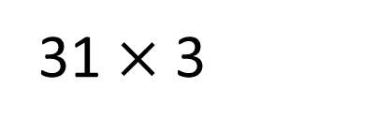
31 $×$ 3
T | O
T O
3
1
$×$
3
9
3

Slide 10

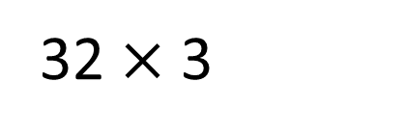
32 $×$ 3
Have a think
T | O
T O
3
2
$×$
3
9
6

Slide 11
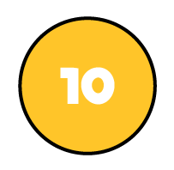

Write a short multiplication to match the counters.
T | O
T O
2
1
$×$
4
8
4
Have a think

Slide 12
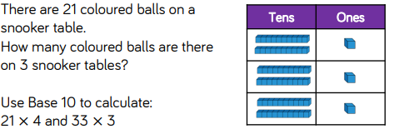
Have a go at questions
1 - 6 on the worksheet

Slide 13
Copy down the following questions and answer them. If you need help with your multiplication tables, use the chart at the front of your maths book.
2a) 41 x 2 =
2b) 22 x 4 =
2c) 33 x 3 =
2d) 21 x 5 = (Think carefully about this one).

Slide 14
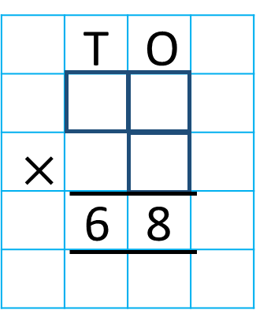
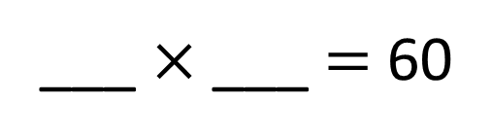
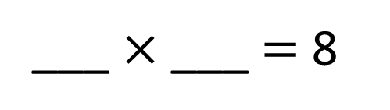
Complete the short multiplication.
4
2
___ $×$ ___ $=$ 8
3
2
4
2
30
___ $×$ ___ $=$ 60
4
Have a think

Slide 15
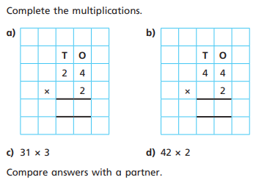

Slide 16
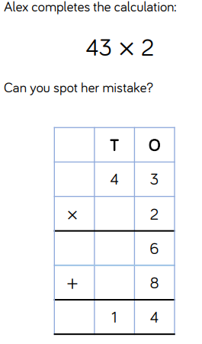
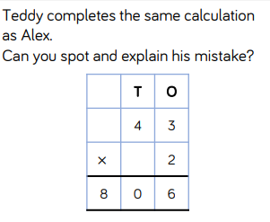
Plenary:
Now let’s look at the last two questions:
Alex and Teddy have both answered the question 43 x 2, and they have both got it wrong. Can you explain what they have done incorrectly. You can TTYP if this helps.

