Slide 1
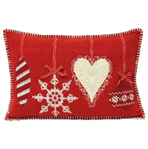
DT
Making Christmas cushions

Slide 2
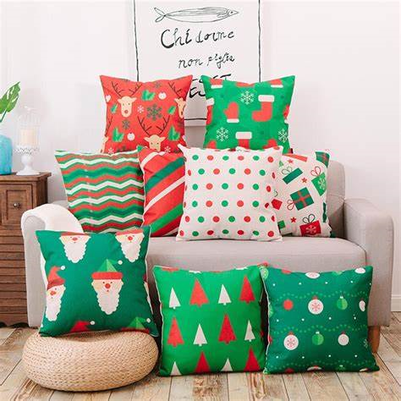
Over the next few lessons, we are going to be designing and sewing our own Christmas cushion.

Slide 3
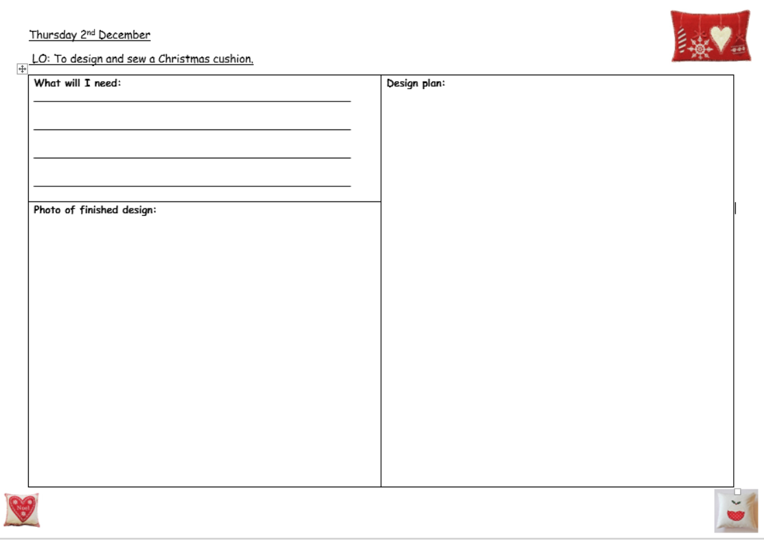
In today’s lesson, we are going to design our cushions using our plan.

Slide 4
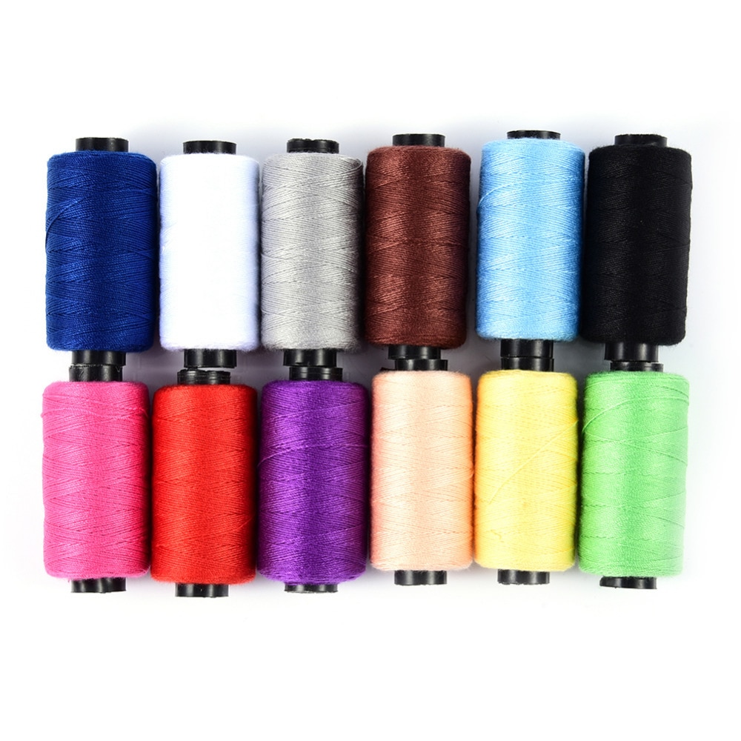
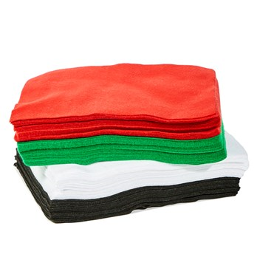
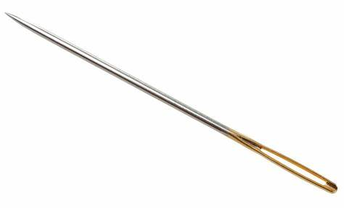
First, we need to think of what we will need to make our cushions.
For example:
Needle
Thread
Felt
Etc.

Slide 5
Next, we are going to draw our design. You need to choose one or two colours for your cushion (front and back) and one colour for the decoration on your cushion. Remember it is a Christmas cushion, so think carefully about your colour choice.
Colour choice: red, green, yellow, brown and white.

Slide 6
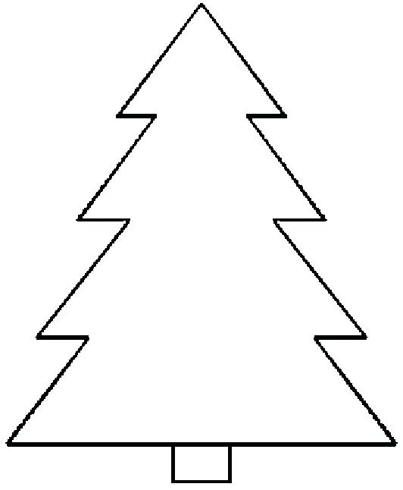
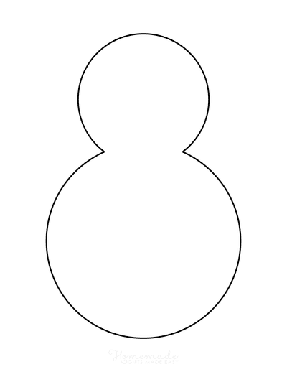
Pick which decoration you would like to use on your cushion: a tree, star, snowman or candy cane.

Slide 7
Draw your cushion with the decoration in the middle. Keep it clear and simple. Remember to label your diagram!

Slide 8
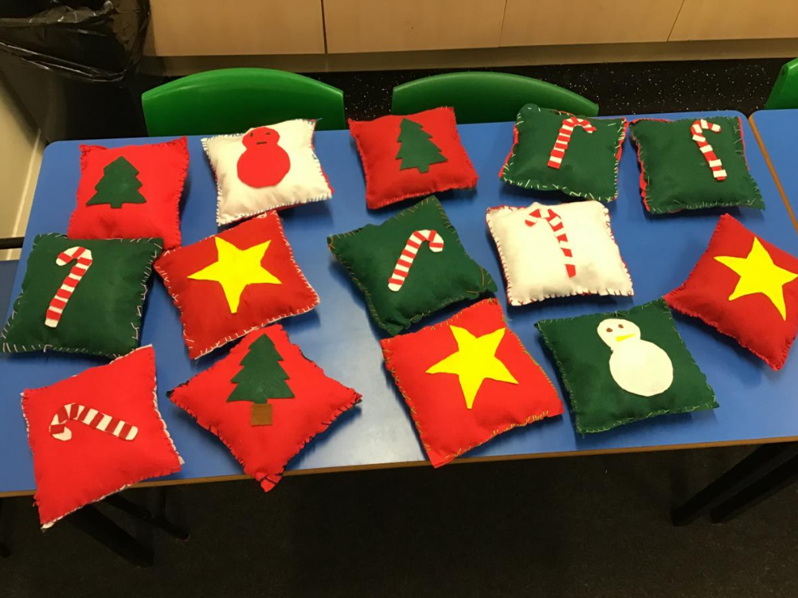
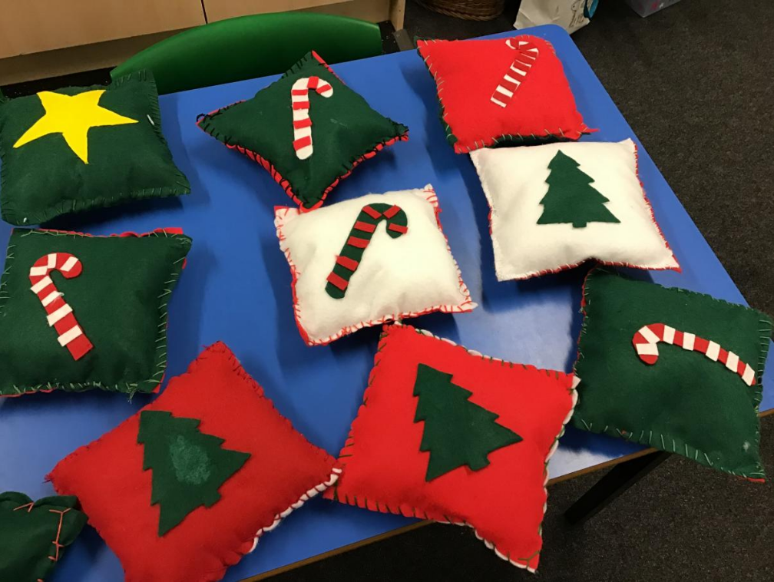
Here are some of the cushions the children made last year…

