Slide 1
Journey to the Jungle

Slide 2
Monday 14th February 2022
LO: To plan a recount.

Slide 3
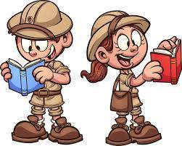
Last week, we imagined that we were exploring a jungle of our very own!

Slide 4
Now, we are going to write a letter to our friend, telling them all about our expedition.
We started to plan our letter last week. Today we are going to finish our plan.

Slide 5
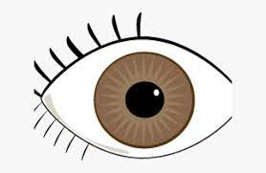
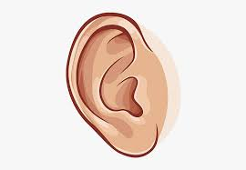
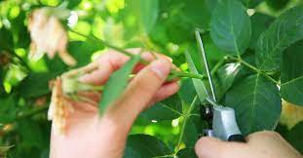
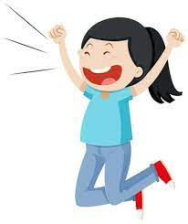
We might want to tell them
what we saw,
what we heard,
what we did and
how we felt.

Slide 6
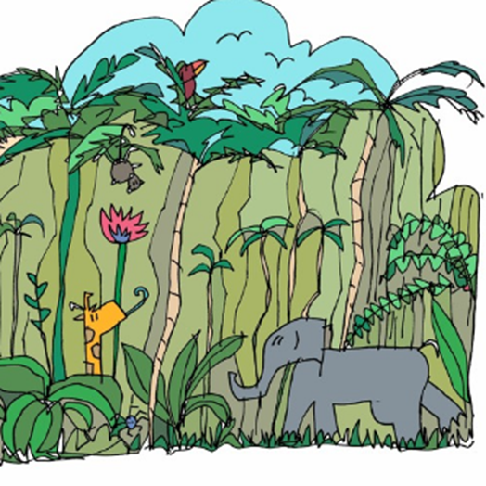
Let’s listen to the text.
Click on the picture to listen (From 0.22 seconds)

Slide 7
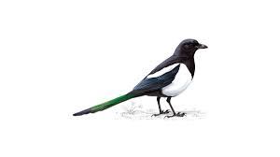
As we plan each part of our text, we can look at the corresponding part of the original text.
Let’s magpie some ideas!

Slide 8
Jungle Log: 31st January, 2022
Today has been an amazing day of discovery! I woke early and got ready for my trek into the Atlanti Jungle. I was excited and couldn’t wait to see what lay ahead of me.

Slide 9
I packed my rucksack and put on my sturdy walking boots. I made sure my camera was working because I wanted to record as much of the day as possible. I left the camp at 6am.

Slide 10
First, I trudged through the dense forest and collected samples of the plant life. My favourite was a thorny bush. It had tiny, yellow flowers growing on it, which smelt like ice cream!

Slide 11
Next, I studied some of the mesmerising insects that were crawling up the rough bark of every tree. One insect looked like a caterpillar but had 2 sets of wings and tiny hands on the ends of its 20 legs. Excitedly, I photographed as many creatures as I could because I wanted to show my explorer friends what I had discovered.

Slide 12
After a short tea break, I measured the circumference of the tallest trees to work out how old they were. One measured 10 metres around and was so tall that I couldn’t see the top of it. It reminded me of the beanstalk in a famous children’s story. Next, I trekked to a clearing and found a beautiful plunge pool. The water was turquoise and tiny neon fish were splashing on the surface. I tried to catch one, but they were too fast for me.

Slide 13
Then it was time for a rest. I lounged on pink grass, soaking up the purple sun beams and listened to the strange jungle noises around me.

Slide 14
Finally, I headed back to camp because the sun began to set. It sets quickly in Oreno and I was worried I might get lost. When I got to my tent, I unpacked my rucksack and stored my plant samples safely. I’m really looking forward to where my wardrobe will take me next week!

Slide 15
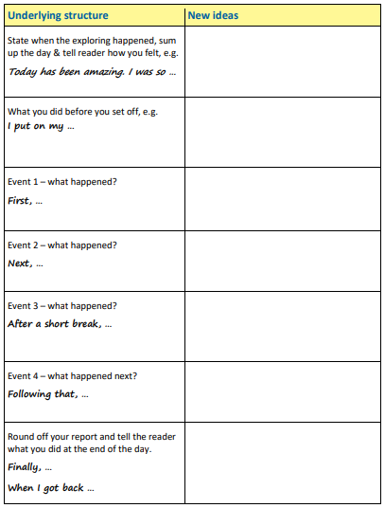
As you finish your plan, Remember to refer to your through the telescope picture to give you ideas.

Slide 16
As you know, our recount is going to be in the form of a letter. We are going to have a quick look at some letter writing examples.
Talk with your group about what is particular about a recount in the form of a letter.
Then we will share some ideas.

