Slide 1
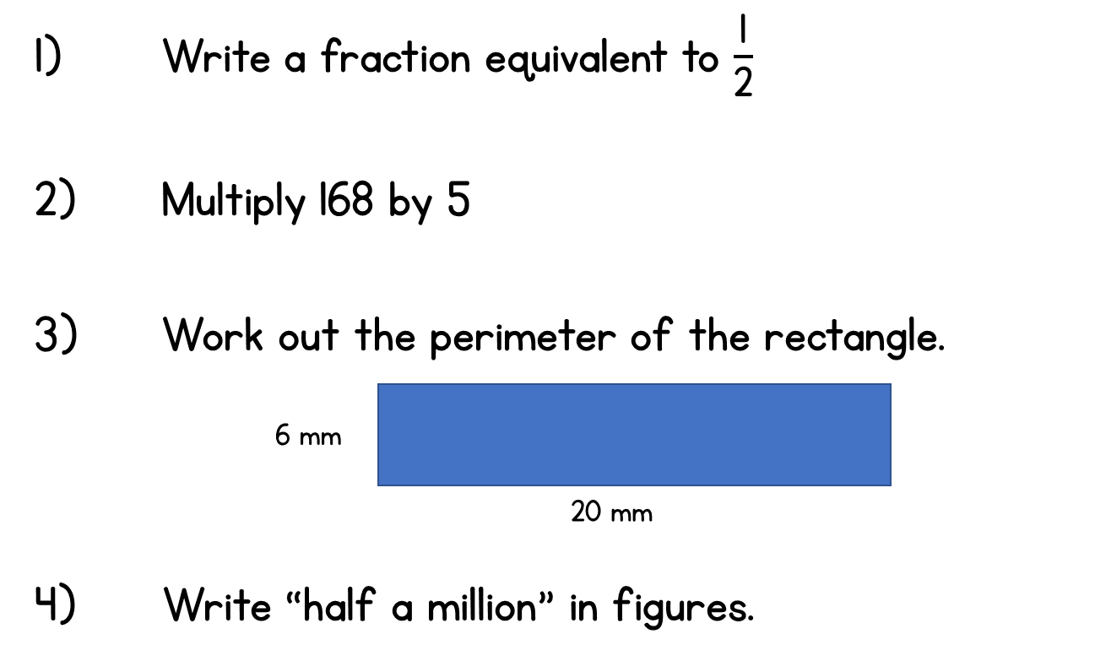
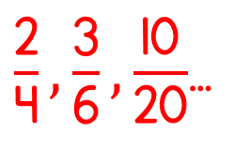
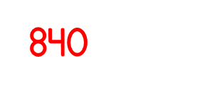
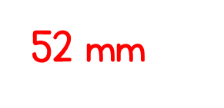
Year 5 | Week 3 | Day 2

Slide 4
1)
2)
3)
4)
$$\frac{\text{1}}{\text{4}}$$
$$\frac{\text{1}}{\text{2}}$$
$$\frac{\text{1}}{\text{2}}$$
$$\frac{\text{7}}{\text{14}}$$
$$\frac{\text{13}}{\text{26}}$$
$$\frac{\text{15}}{\text{31}}$$
$$\frac{\text{3}}{\text{5}}$$
$$\frac{\text{2}}{\text{5}}$$

Slide 5
1)
2)
3)
4)
$$\frac{\text{1}}{\text{4}}$$
<
$$\frac{\text{1}}{\text{2}}$$
$$\frac{\text{1}}{\text{2}}$$
=
$$\frac{\text{7}}{\text{14}}$$
$$\text{1}\text{3 }\text{is} \text{half} \text{of}\text{ 26}$$
$$\frac{\text{13}}{\text{26}}$$
>
$$\frac{\text{15}}{\text{31}}$$
$$\frac{\text{13}}{\text{26}}$$
$$\frac{\text{1}}{\text{2}}$$
$$\text{=}$$
$$\frac{\text{3}}{\text{5}}$$
>
$$\frac{\text{2}}{\text{5}}$$
$\text{1}\text{5 }\text{is} \text{less} \text{than} \text{half} \text{of}$31
$$\frac{\text{15}}{\text{31}}$$
$$\frac{\text{1}}{\text{2}}$$
$$<$$

Slide 7
Equivalent
Equal
The same value

Slide 8
$$\frac{\text{1}}{\text{4}}$$
Numerator –
How many of the parts we are using
Denominator –
How many equal parts there are
$$\frac{\text{2}}{\text{8}}$$
$\frac{\text{1}}{\text{4}}$ is equivalent to $\frac{\text{2}}{\text{8}}$
$\frac{\text{2}}{\text{8}}$ is equivalent to $\frac{\text{1}}{\text{4}}$
What do you notice?

Slide 9
Is $\frac{\text{6}}{\text{9}}$ equivalent to $\frac{\text{2}}{\text{3}}$ ?
$\frac{\text{6}}{\text{9}}$ is equivalent to $\frac{\text{2}}{\text{3}}$
$\frac{\text{2}}{\text{3}}$ is equivalent to $\frac{\text{6}}{\text{9}}$

Slide 10
Have a think
Odd One Out
$$\frac{\text{4}}{\text{9}}$$
$$\frac{\text{6}}{\text{9}}$$
$$\frac{\text{4}}{\text{6}}$$

Slide 11
$\frac{\text{1}}{\text{6}}$ = $\frac{\text{2}}{\text{12}}$
$\frac{\text{3}}{\text{4}}$
$=$ $\frac{\text{6}}{\text{8}}$
$=$ $\frac{\text{9}}{\text{12}}$
$\frac{\text{2}}{\text{3}}$
$=$ $\frac{\text{4}}{\text{6}}$
$=$ $\frac{\text{6}}{\text{9}}$
$=$ $\frac{\text{8}}{\text{12}}$
Have a think
1
$\frac{\text{1}}{\text{2}}$
$\frac{\text{1}}{\text{3}}$
$\frac{\text{2}}{\text{3}}$
$\frac{\text{1}}{\text{4}}$
$\frac{\text{3}}{\text{4}}$
$\frac{\text{1}}{\text{5}}$
$\frac{\text{1}}{\text{6}}$
$\frac{\text{4}}{\text{6}}$
$\frac{\text{1}}{\text{7}}$
$\frac{\text{1}}{\text{8}}$
$\frac{\text{6}}{\text{8}}$
$\frac{\text{1}}{\text{9}}$
$\frac{\text{6}}{\text{9}}$
$\frac{\text{1}}{\text{10}}$
$\frac{\text{1}}{\text{11}}$
$\frac{\text{1}}{\text{12}}$
$\frac{\text{2}}{\text{12}}$
$\frac{\text{8}}{\text{12}}$
$\frac{\text{9}}{\text{12}}$

Slide 12
Have a go at questions 1 - 4 on the worksheet

Slide 13
Always, sometimes, never?
“The greater the numerator, the
greater the fraction.”
$\frac{\text{1}}{\text{7}}$ $\frac{\text{4}}{\text{7}}$

Slide 14
Always, sometimes, never?
“The greater the numerator, the
greater the fraction.”
$\frac{\text{1}}{\text{3}}$ $\frac{\text{2}}{\text{10}}$

Slide 15
Have a go at question 5 on the worksheet

