Slide 1
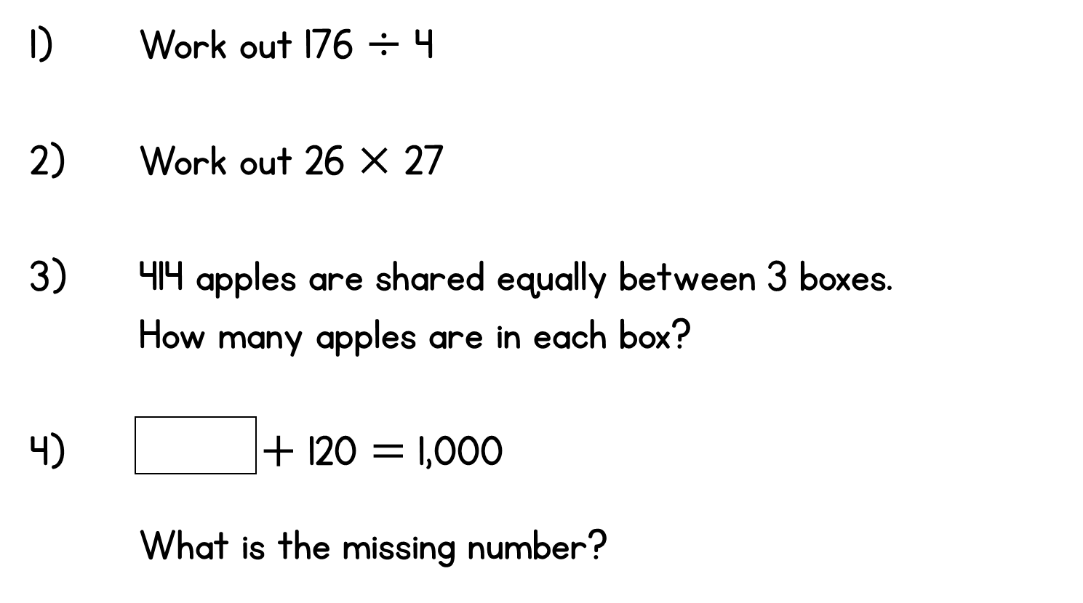
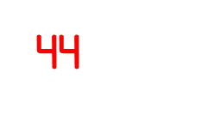
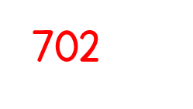
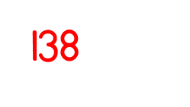
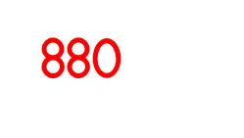
Year 5 | Week 3 | Day 3

Slide 4
1) 48 $÷$ 4 $=$
2) 480 $÷$ 4 $=$
3) 72 $÷$ 9 $=$
4) $÷$ 9 $=$ 800

Slide 5
12
1) 48 $÷$ 4 $=$
2) 480 $÷$ 4 $=$
3) 72 $÷$ 9 $=$
4) $÷$ 9 $=$ 800
120
8
7,200
72 $×$ 100

Slide 7
There are 4,884 crayons and they come
in packs of 4
How many packs are there?

Slide 8
There are 4,884 crayons and they come
in packs of 4
How many packs are there?
1,221 packs
Thousands | Hundreds | Tens | Ones
4 | 4 | 8 | 8 | 4
1
2
2
1
As well as using the place value chart like we have in previous lessons, we will also use the formal written method of calculating division
Because we are dividing by four, how many groups of four thousand can we make?
Similarly, how many groups of four hundred can we make?

Slide 9
9,306 $÷$ 3
Have a think and then let’s do this one together in our books
Thousands | Hundreds | Tens | Ones
3 | 9 | 3 | 0 | 6
3
1
0
2

Slide 10
4,324 $÷$ 2
Let’s do this one together.
Thousands | Hundreds | Tens | Ones
2 | 4 | 3 | 2 | 4
2
1
6
2
1
We can make one group of 2 hundreds, but we have one hundred left over. What do we do now?
Now we need to show that we have exchanged one of the hundreds for 10 tens. We do this by writing a small 1 in the tens column, to show that there are now 12 tens

Slide 11
Have a think, and then we’ll do this one together
6,115 $÷$ 5
Thousands | Hundreds | Tens | Ones
5 | 6 | 1 | 1 | 5
1
2
2
3
1
1
1
We’ve made1 group of 5 thousands, but we have one thousand left over. What do we do?

Slide 12
Have a go at questions 1 - 3 on the worksheet Stick in 1-2, write out 3 a) - f)

Slide 13
3 skateboards cost £72.99
How much does one cost?
It’s really important that we place the decimal point in the answer space directly over the one under the line.
.
3 | 7 | 2 | 9 | 9
2
4
.
3
3
1
1 skateboard $=$ £24.33

Slide 14
 | 9 | 4 | 2
3
1
4
3
3
1
9
Thousands | Hundreds | Tens | Ones

Slide 15
Have a go at the rest of the worksheet – write them in your book

