Slide 1


Slide 3
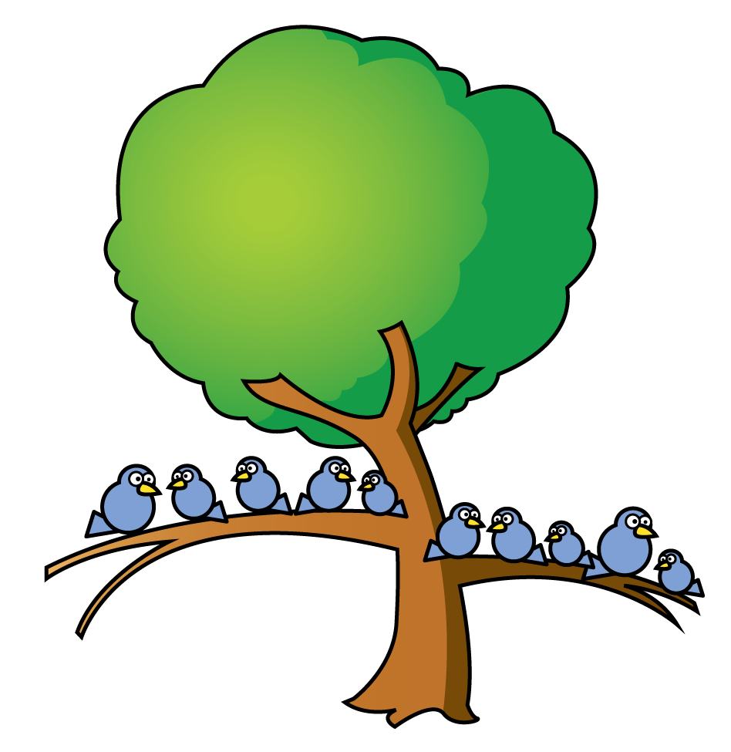
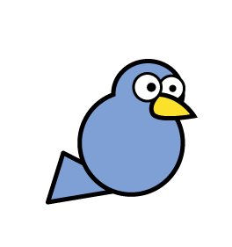
How many birds are there?
1 tree has 10 birds.
There are 3 full trees and 4 more birds.
There are 34 birds.

Slide 4
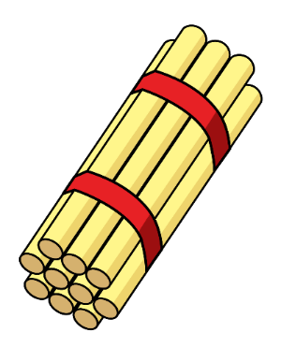
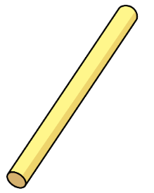
How many straws are there?
1 bundle has 10 straws.
There are 4 bundles of 10 and 3 more straws.
There are 43 straws.

Slide 5
10 ones is equal to 1 ten
How many are there?
There are 3 tens and 6 ones.
There are 36

Slide 6

Complete the stem sentences.
2
7
There are ______ tens and ______ ones.
2
7
27
______ tens + ______ ones = ______.

Slide 7
Complete the stem sentences.
3
3
There are ______ tens and ______ ones.
3
3
33
______ tens + ______ ones = ______.

Slide 8
Complete the stem sentences.
4
5
There are ______ tens and ______ ones.
4
5
45
______ tens + ______ ones = ______.

Slide 9
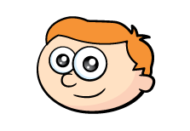
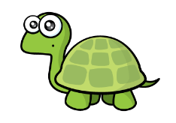
Building numbers up to 50
10 ones is equal to 1 ten
I can build big numbers using these!
How about
35?
35 = 3 tens and 5 ones

Slide 10

Tens and Ones
Have a think
42 = 4 tens and 2 ones
27 = 2 tens and 7 ones
30 = 3 tens and 0 ones
9 = 0 tens and 9 ones

Slide 11
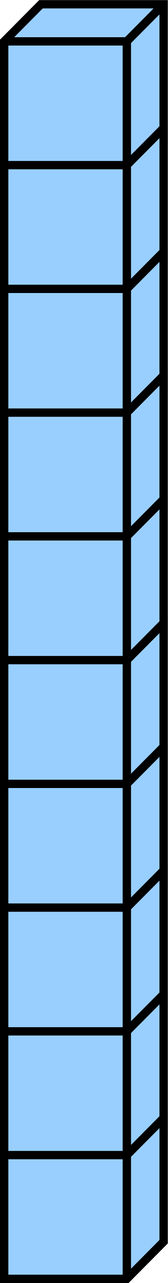
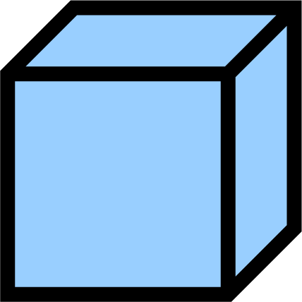
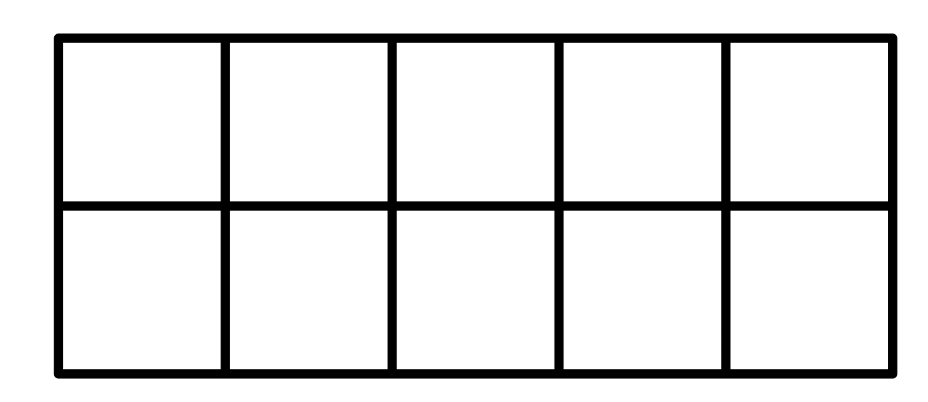
Match the pictures to the numbers.
Number
1 ten
6 ones
16
3 tens
8 ones
38
2 tens
9 ones
29

Slide 12
Can you match the picture representation to the correct number?

Slide 13
Have a think
4 tens and 2 ones = 42
What is the same?
3 tens and 2 ones = 32
What is different?
2 tens and 2 ones = 22

Slide 14
Have a think
4 tens and 2 ones = 42
What is the same?
4 tens and 3 ones = 43
What is different?
4 tens and 4 ones = 44

Slide 15
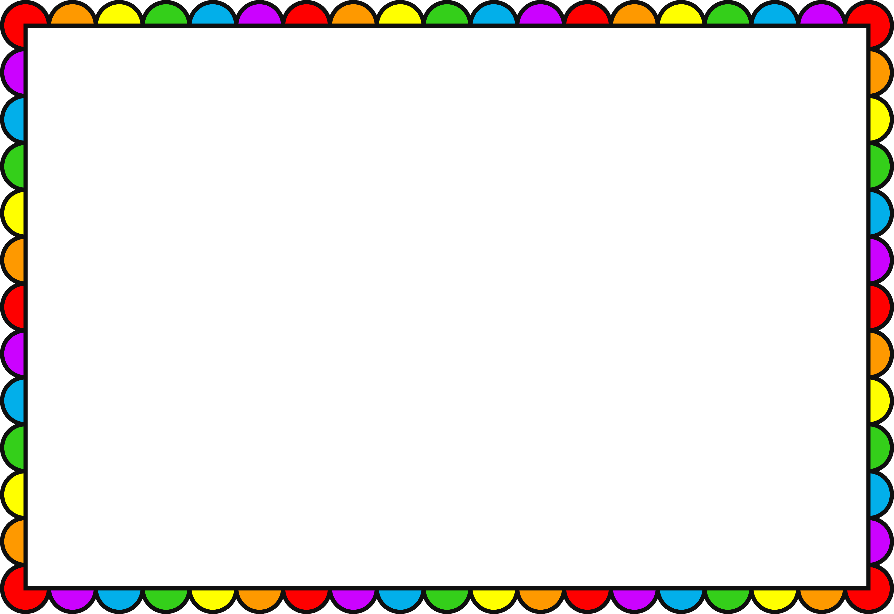
Which picture represents 3 tens and 5 ones?

