Slide 1
31.1.22
LO – I understand what unit and non-unit fractions are.

Slide 2
TTYP…
What is a fraction?
See if you can come up with a good definition for our learning wall.

Slide 3
A fraction is an equal part of something.
1
2
This means you have one out of a possible 2 parts.

Slide 4
How many cubes altogether?
How many green cubes?
out of cubes are green
2) How many cubes altogether?
How many red cubes?
out of cubes are red

Slide 5
How many cubes altogether?
How many green cubes?
out of cubes are green.
2) How many cubes altogether?
How many red cubes?
out of cubes are red.
5
1
1
5
7
3
3
7

Slide 6
Thinking caps on …

Slide 7
Numerator
1
How many parts we are looking at?
of the shapes are triangles.
4
Denominator
How many parts are there?
Have a think
1
of the shapes are green.
5

Slide 8
1
of the shapes are triangles.
4
1
of the shapes are green.
5
What’s the same? What’s different?
These are called unit fractions.
Unit fractions have a numerator of 1
Have a think

Slide 9
Have a think
1
3
5
Yellow $=$
Red $=$
Green $=$
9
9
9
Which is a unit fraction?
What do you notice?
These fractions have a numerator greater than 1
These are called non-unit fractions.

Slide 10
Have a go at questions 1 – 3 on the worksheet
Have a go at questions
1, 2 and 3. Remember to keep all of your work neat.

Slide 11
Have a think
Show $\frac{\text{1}}{\text{4}}$ on each of the representations.
Unit
fraction
Show $\frac{\text{3}}{\text{4}}$ on each of the representations.
Non-unit
fraction

Slide 12
Show $\frac{\text{3}}{\text{4}}$ on each of the representations.

Slide 13
I’m thinking of a fraction…
Have a think
1
2
3
4
5
My fraction has a numerator 3 less than the denominator
Mine is a unit-fraction with an odd number as a denominator
Which digit card will be left?

Slide 14
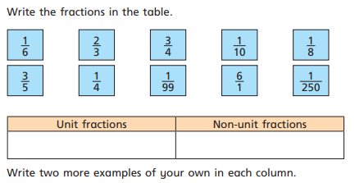
Have a go at the rest of the worksheet
Complete questions 4 and 5.
For question 5, draw your own table in your book.

Slide 15
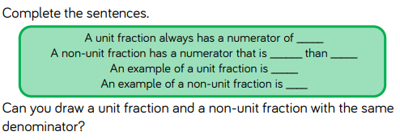
Have a go at the rest of the worksheet
Plenary.
Write out, and complete the sentences.
To finish, draw an example of a unit and a non-unit fraction.

