Slide 1

1.11.21
LO. I can add 2, 3-digit numbers.

Slide 2

1) Partition 14 into tens and ones.
2) Calculate 7 $+$ 6
3) 8 $+$ ___ $=$ 17

Slide 3

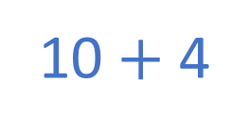
1) Partition 14 into tens and ones.
2) Calculate 7 $+$ 6
3) 8 $+$ ___ $=$ 17
10 $+$ 4
1 ten $+$ 4 ones
13
9

Slide 4
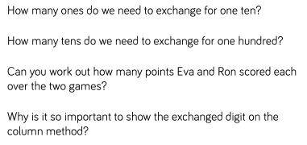
=
=
TTYP and explain why we need to do this.

Slide 5
Mr Rose earns £124 on Monday.
He earns £138 on Tuesday.
How much does he earn in total?
£262
 | Hundreds | Tens | Ones
H | T | O
1 | 3 | 8
1 | 2 | 4
+
2
6
2
2
6
2
12
1

Slide 6





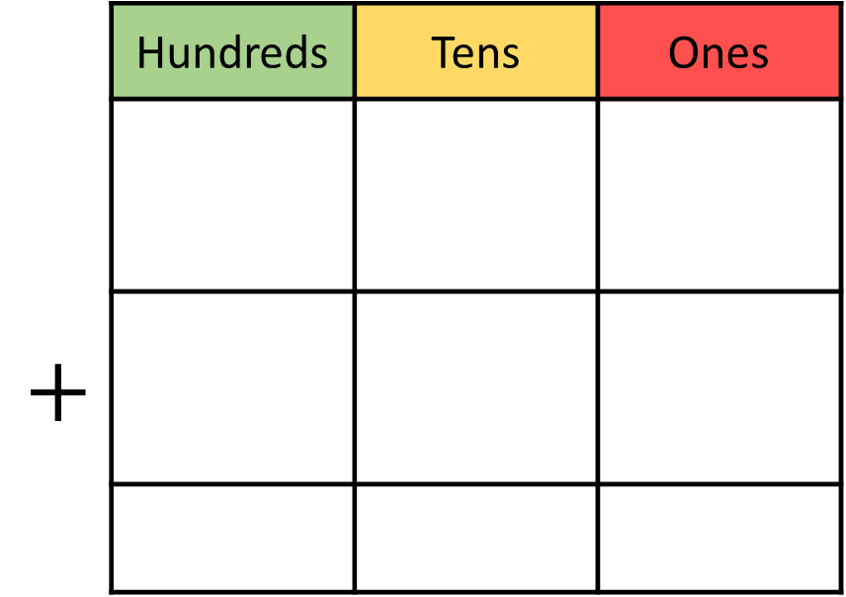
Dexter scores 351 points in a game.
Rosie scores 263 points.
How much do they score altogether?
614
 | Hundreds | Tens | Ones
$$+$$
H | T | O
3 | 5 | 1
2 | 6 | 3
6
1
4
6
1
4
1
Notes:
Can we simplify?
Discuss reduction structure – take away

Slide 7
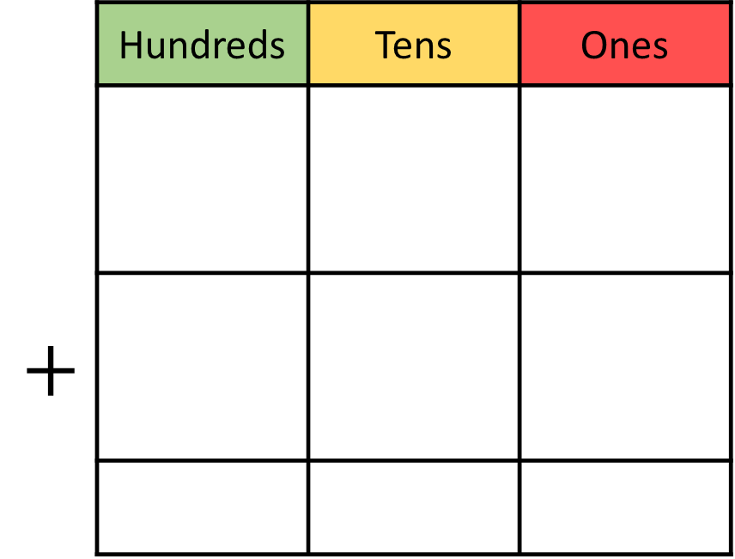
238 + 365 =
603
 | Hundreds | Tens | Ones
$$+$$
H | T | O
3 | 6 | 5
2 | 3 | 8
6
0
3
1
1
6
0
3

Slide 8
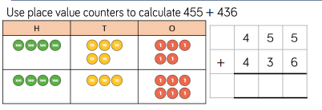
Stick this question in your book
Solve the problem then share your working with
your partner and discuss.

Slide 9

Stick this question in your book
Solve the problem using place value counters as in the previous questions then share your working with your partner and discuss.
How can bar models and part whole models support our addition?
Think about our work done during the place value unit.

Slide 10
Stick these questions in your book and set them out using column addition.
Use place value to support your working.
1) 375 + 216 =
2) 129 + 154 =
3) 482 + 108 =
4) 266 + 227 =

Slide 11
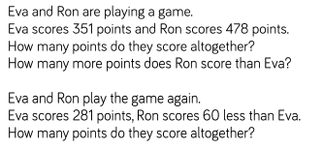
Plenary. What is this question asking?
Stick these questions in your book. Answer it using place value columns. Remember to show your working.
Use place value counters to support your working.

Slide 12
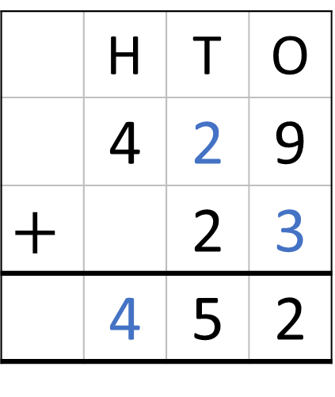
Challenge problem
 | Hundreds | Tens | Ones
 | H | T | O
 | 4 | 2 | 9
$$+$$ |  | 2 | 3
 | 4 | 5 | 2
1
5
2

