Slide 1


Slide 2
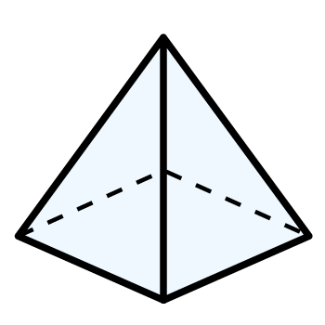
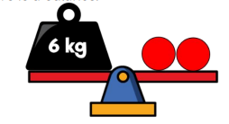

Year 3 | Week 10 | Day 1

Slide 4

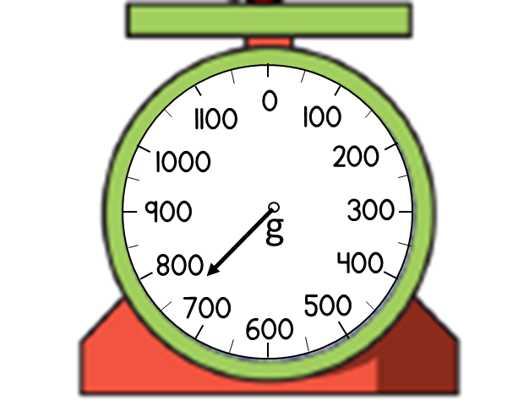
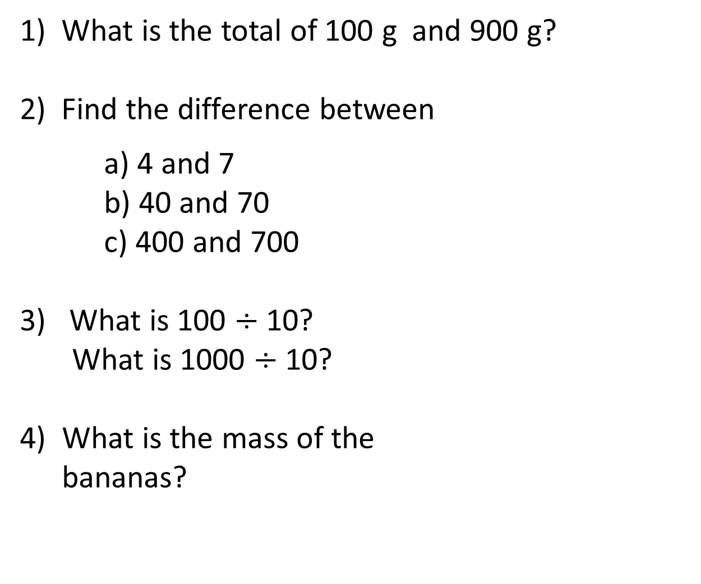
1) What is the total of 100 g and 900 g?
2) Find the difference between
a) 4 and 7
b) 40 and 70
c) 400 and 700
3) What is 100 $÷$ 10?
What is 1000 $÷$ 10?
4) What is the mass of the
bananas?

Slide 5
1) What is the total of 100 g and 900 g?
2) Find the difference between
a) 4 and 7
b) 40 and 70
c) 400 and 700
3) What is 100 $÷$ 10?
What is 1000 $÷$ 10?
4) What is the mass of the
bananas?
1000 g or 1 kg
3
30
300
10
100
750 g

Slide 7
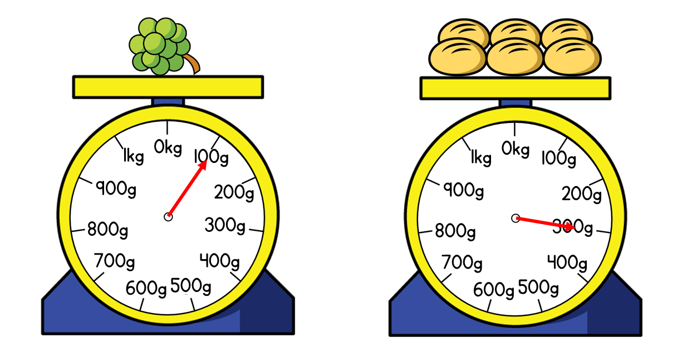

What do you notice? What can you find out?
The mass of the grapes is 100 g
The mass of the bread rolls is 300 g
Have a think
The total mass of the rolls and grapes is 400 g
The rolls are 200 g heavier than the grapes.

Slide 8
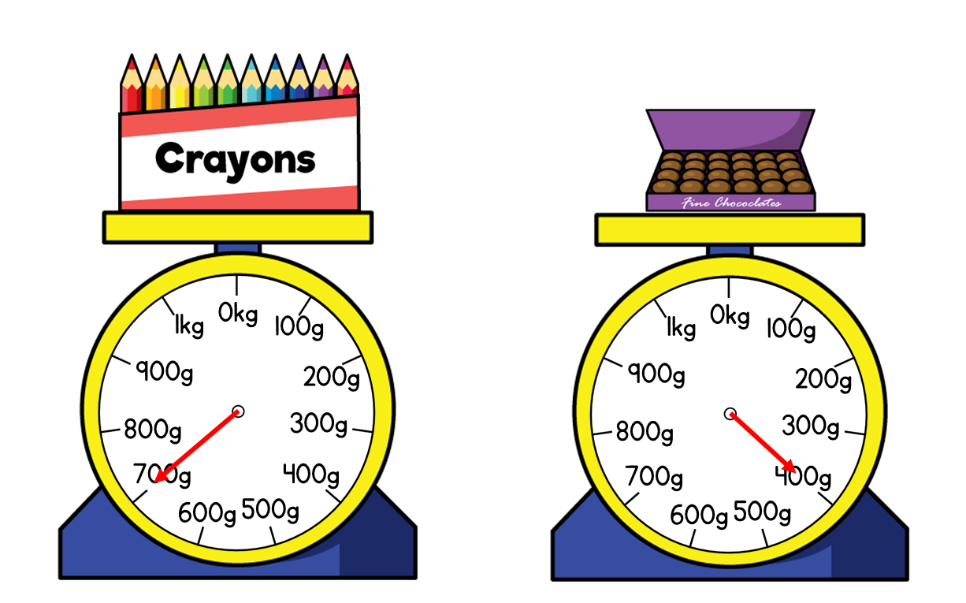
What is the difference between the mass of the crayons and the mass of the chocolates?
700 g – 400 g = 300 g
Have a think
300 g
700g
800g
0
100g
300g
400g
500g
600g
700g
200g
400g

Slide 9

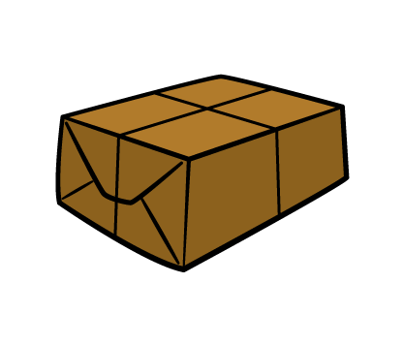
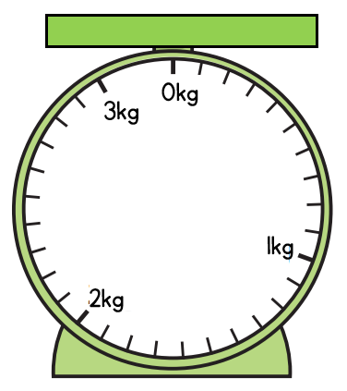
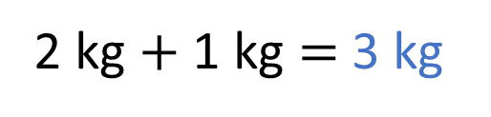
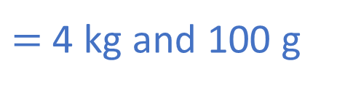
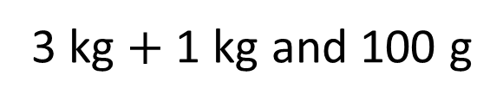
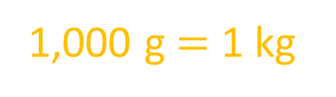
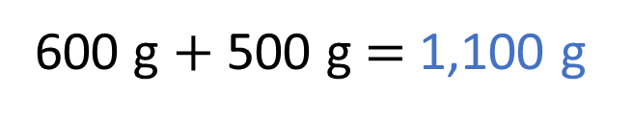
What is total mass of the tractor and the parcel?
2 kg and 600 g
1 kg and 500 g
2 kg $+$ 1 kg $=$ 3 kg
600 g $+$ 500 g $=$ 1,100 g
3 kg and 1,100 g
1,000 g $=$ 1 kg
3 kg $+$ 1 kg and 100 g
$=$ 4 kg and 100 g

Slide 10


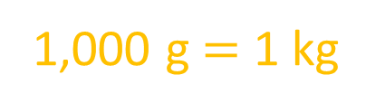
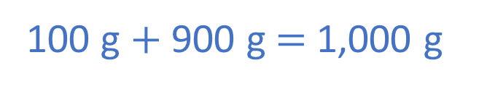
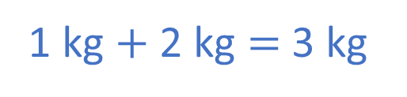
What is total mass of the vase and the fish tank?
1 kg and 100 g
2 kg and 900 g
Have a think
1 kg $+$ 2 kg $=$ 3 kg
100 g $+$ 900 g $=$ 1,000 g
1,000 g $=$ 1 kg
The total mass is 4 kg

Slide 11
Have a go at questions
1 – 3 on the worksheet

Slide 12
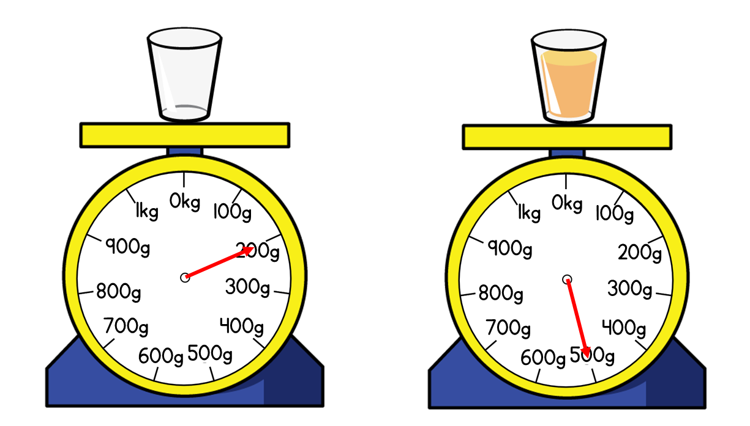
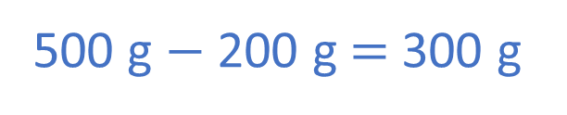
What is the mass of the orange juice?
200 g
500 g
Have a think
glass = 200 g
glass = 200 g
juice =
300 g
?
500 g $−$ 200 g $=$ 300 g
500 g

Slide 13
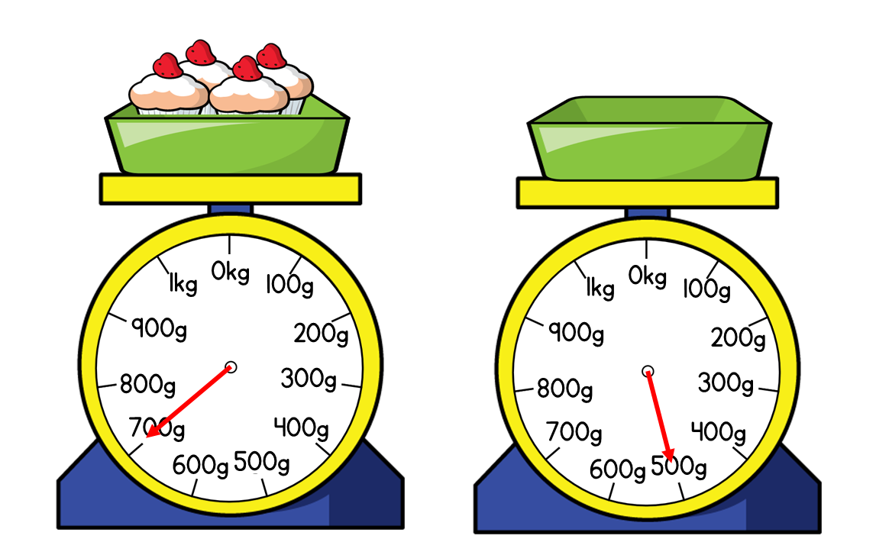
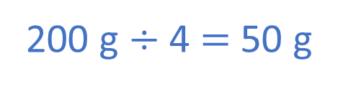
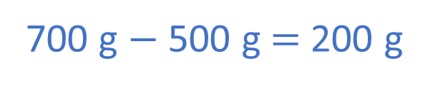
What is the mass of each cupcake?
700 g
500 g
Have a think
700 g $−$ 500 g $=$ 200 g
200 g $÷$ 4 $=$ 50 g
Each cupcake has a mass of 50 g

Slide 14
Have a go at the rest of the questions on the worksheet

