Slide 1
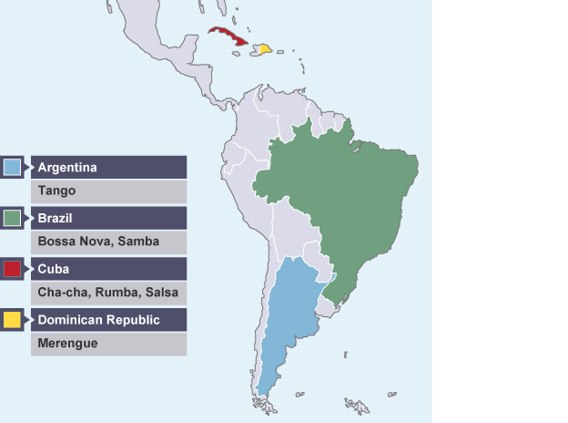
Whole School Genre of the Week Types of Dances: Latin Music: Tango, Salsa and Rumba
Tango
I Can Tango – Children’s song
https://www.youtube.com/watch?v=Vhfx2D7Q0qI
Tango on Strictly Come Dancing
https://www.youtube.com/watch?v=SnIu3DQahWI
https://www.youtube.com/watch?v=lvS0NfIlkFU
Instrumental Tango Music
Background information.
https://www.bbc.co.uk/bitesize/guides/zg4hb82/revision/5
Salsa
How to Salsa – the basic steps
https://www.youtube.com/watch?v=F758q-jifJI
Salsa on Strictly Come Dancing
https://www.youtube.com/watch?v=XGIWHAwuT5Y
Instrumental Salsa music
https://www.youtube.com/watch?v=1LOsAVuNPf8
Rumba
Children’s activity in the style of Rumba
https://www.youtube.com/watch?v=7R64sBEi-7I
Instrumental Rumba music
https://www.youtube.com/watch?v=h7os4KpEwno

Slide 2
Whole School Song of the Week
Local Songs and Songs from around the World
The Keel Row
https://www.bethsnotesplus.com/2019/03/keel-row.html

Slide 3
Reception Music:- Nursery Rhymes – Linked to Supertato Work
One potato, two potato- up to 1min 12sec, a game for choosing who is ‘on’
https://www.youtube.com/watch?v=psCEixuh8wI
Vegetable Counting song- in the style of ‘One potato, two potato’
https://www.bbc.co.uk/programmes/p06kvjcc
The Baked Potato Song #StayHome #WithMe #FeedNHS
https://www.youtube.com/watch?v=yYOkgCkxj9I

