Slide 1
Friday 21st January 2022
National Handwriting Day

Slide 2
On Sunday 23rd January, it is
National Handwriting Day.

Slide 3
What is National Handwriting Day?
National Handwriting Day is a celebration of all things handwriting-related. It's observed every year on the 23rd of January since 1977.

Slide 4
Handwriting Day began as an event organised by the Writing Instrument Manufacturers Association back in 1977 and is intended to celebrate both the purity and power of handwriting.
Since 1977, the importance of handwriting has changed slightly. These days, lots more information is passed on digitally, rather than the written word. But I'm sure you'll agree that there's nothing quite like giving or receiving a hand-written letter. What's more, handwriting remains an important skill in education and the workplace.

Slide 5
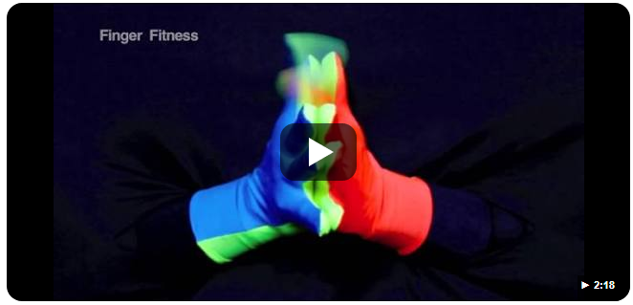
First of all, we are going to do some gross motor warm ups (see cards).
Then we are going to do a fine motor warm up.

Slide 6
Today, we are going to celebrate National Handwriting Day and link it to kindness.
What is kindness?
What could you do that is kind?

Slide 7
Your task today is to choose a kindness poem or quote. What does it mean?
Write out the quote in your neatest handwriting. Take your time. Make it beautiful. Enjoy the process.
You might like to do this while listening to some calm music.

Slide 8
Afterwards you could carefully decorate your page.

Slide 9
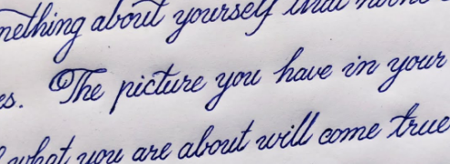
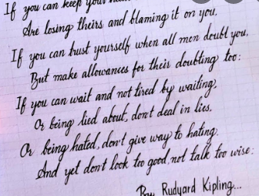
Let’s look at some beautiful handwriting.

