Slide 1
Roman Shield digital art
Friday 26th November
L.O. – I can create a roman shield using digital art.

Slide 2
Today we are going to create a Roman shield using digital art.
First, what do we mean by digital art?
Digital art is work made with digital technology or presented on digital technology.

Slide 3
What is a shield?
An evolution in armed combat, shields were used to block attacks from hand-held weapons like swords as well as projectile weapons such as arrows.
Early shields were typically constructed of wood and animal hide and later reinforced with metal.

Slide 4
Let’s look at some typical examples of Roman shields as inspiration.
What do you notice about them?

Slide 5
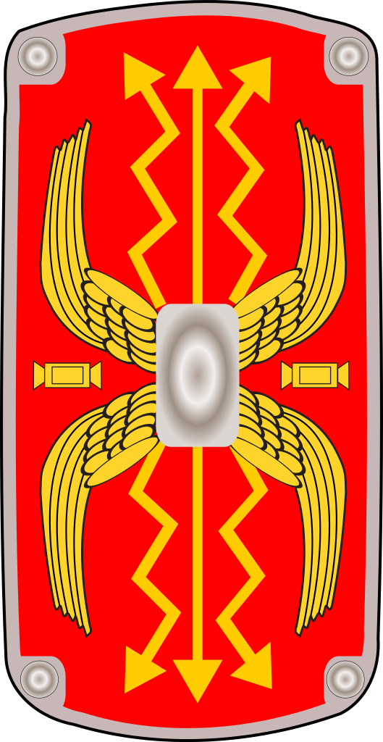

Slide 6
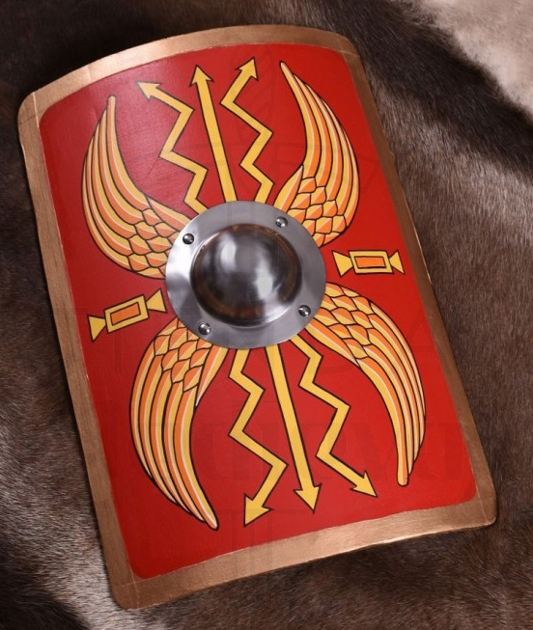
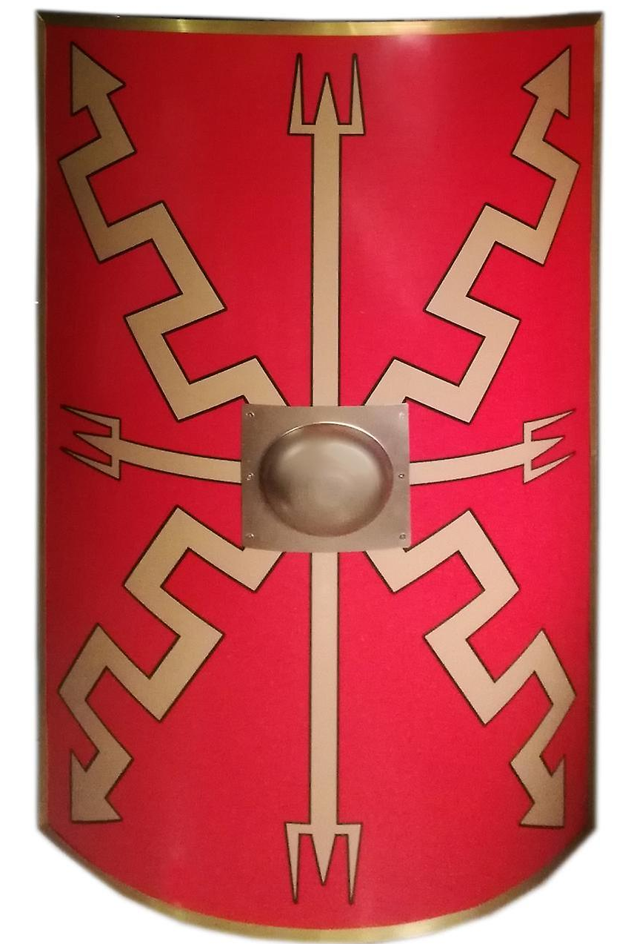

Slide 7
First, we will design our shield using a paper template.
Then, we will be using a website that will help us create different patterns that we see on Roman shields.
https://bomomo.com/
Experiment with all of the features first until you are happy with what each one does and use them to help create your shield. You will need to share with your partner.

