Slide 1
26.02.21
LO. I can recall properties of 2D shapes.
https://www.topmarks.co.uk/carroll-diagrams/2d-shapes

Slide 2
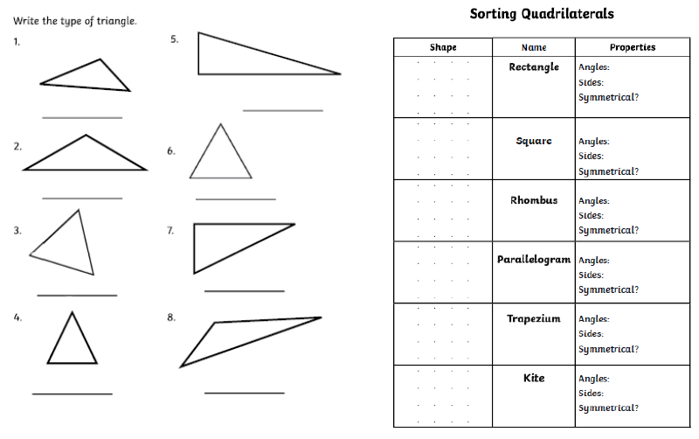
This is the worksheet you will complete for todays session. Use our working from this week to support you in labelling, describing and drawing the shapes.
Pause the video and answer these questions before we go through the answers.

Slide 3
Right Angle
4
2
Scalene
Right-Angle Scalene
Right Angle
4
4
Isosceles
Equilateral
2 pairs of equal angles
4
2
2 pairs of equal angles
4
0
Equilateral
Right-Angle Scalene
2 pairs of equal angles
4
1
Isosceles
Scalene
2 pairs of equal angles
4
1

Slide 4
Times Tables Task
Practise a times tables you find tricky then complete your times tables online check.
https://www.timestables.co.uk/multiplication-tables-check/

