Slide 2
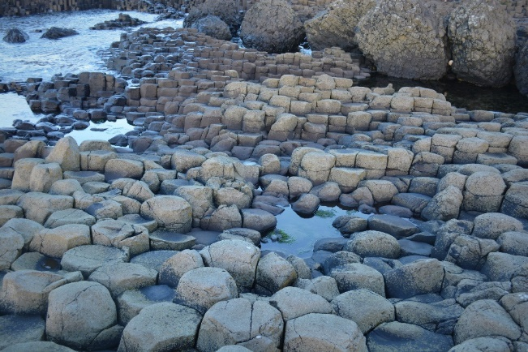
“It looks like the beginning of the world…”
This is what the author W.M. Thackeray wrote about the Giant’s Causeway when he visited in 1842.
That was nearly 200 years ago and the Giant’s Causeway still has that look about it today.

Slide 3
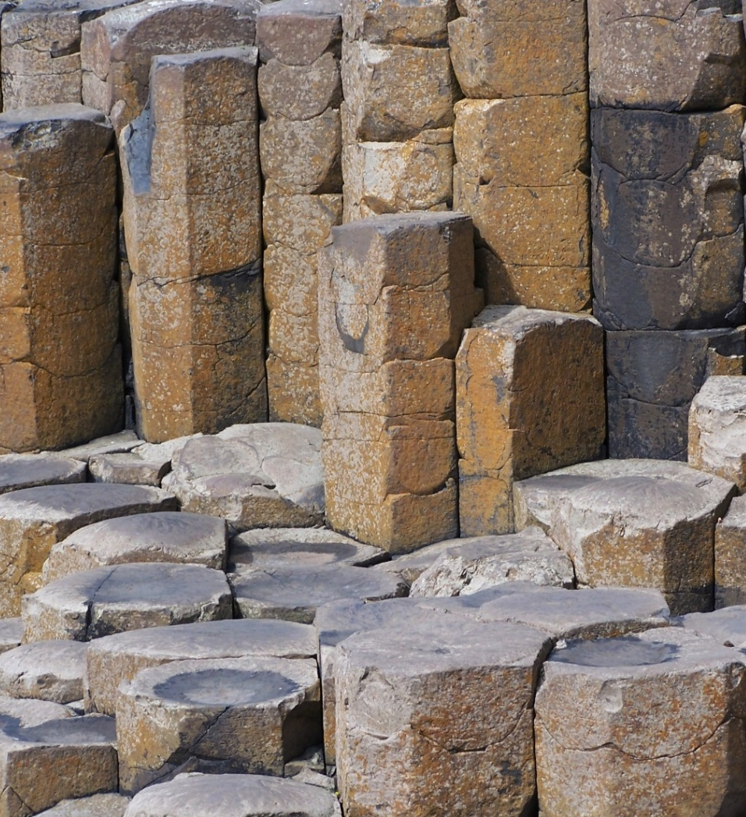
Not Your Ordinary Rock Formation!
Scientists have some different ideas on the creation of the Giant’s Causeway.
However, the most commonly reported idea is that the Giant’s Causeway is the result of a volcanic event.

Slide 4
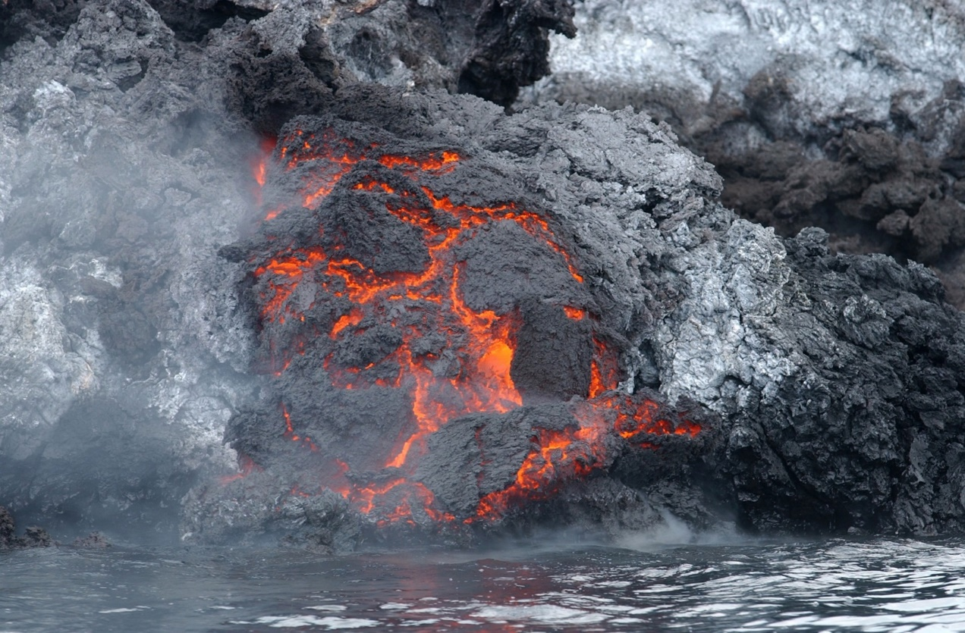
Volcanic eruptions, around 60 million years ago, oozed lava out of the earth slowly.
With flows up to 100 metres thick in places, it soon filled up the whole area of the Giant’s Causeway.

Slide 5
It was when the lava began to cool that things got really interesting!
At the bottom of the deep lava pool, cracks formed as the rocks below were much cooler than the lava on top. This however was not unusual and happens with most rock formations.
As these cracks grew and spread, they formed strange hexagonal shapes.
This is what other lava looks like once it’s cooled!

Slide 6
The size of the pillars was primarily determined by the speed at which the lava from the volcanic eruption cooled.
As it cooled further, the cracks started to creep upwards. They were still keeping the same strange hexagonal shapes, but were now transforming into tall pillars made of basalt.

Slide 7
Welcome One and All!
The new Giant’s Causeway visitor centre was opened in July 2012.
Its design divides the opinions of those that visit.

Slide 8
What do you think?

Slide 9
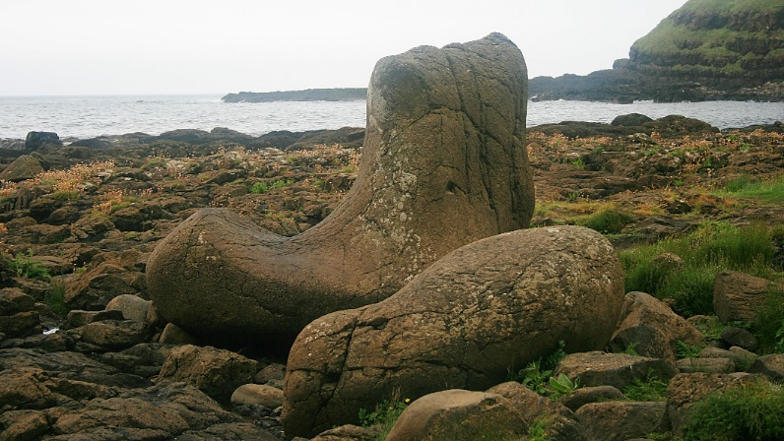
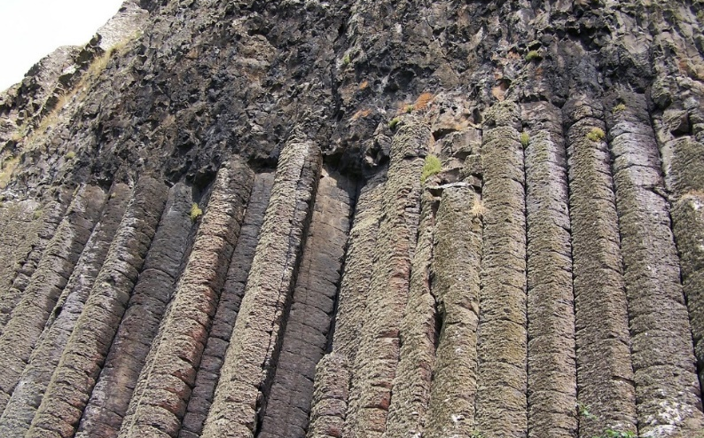
A GIANT musical organ? A GIANT’S boot?
After the million years of weathering, some of the structures in the Giant’s Causeway resemble objects, such as an organ (reportedly played by Finn McCool’s wife, Oonagh) and a giant's boot (reported to have fallen off Finn McCool’s foot as he fled from the ferocious Scottish giant, Benandonner).

Slide 10
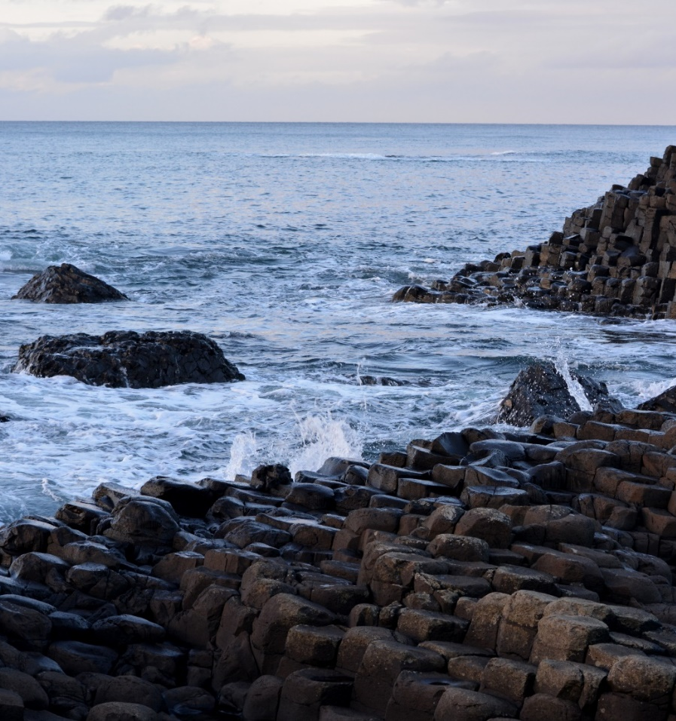
In Conclusion…
The Giant’s Causeway is millions of years old.
It is formed into strange hexagonal pillars from cooling lava flows from a volcanic eruption.
It is visited by millions of people every year.
Its appearance is mysterious and is one of the most spectacular sights in the world!
Photo courtesy of Valdiney Pimenta (@flickr.com) - granted under creative commons licence – attribution

Slide 11
