Slide 1
Stained Glass LO: To know what stained glass is and draw our own stained glass design.

Slide 2
What is stained glass?
Stained glass is glass that has been coloured by adding metallic salts during its manufacture, and usually then further decorating it in various ways. The coloured glass is crafted into stained glass windows in which small pieces of glass are arranged to form patterns or pictures, held together (traditionally) by strips of lead and supported by a rigid frame.

Slide 3
Can you think of anywhere you might have seen stained glass?

Slide 4
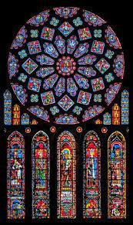
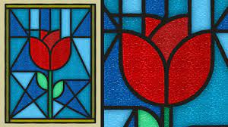
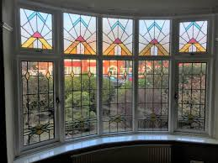
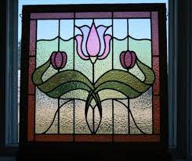
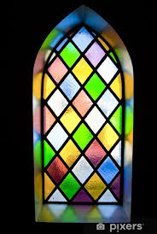
Here are some examples of stained glass.

Slide 5
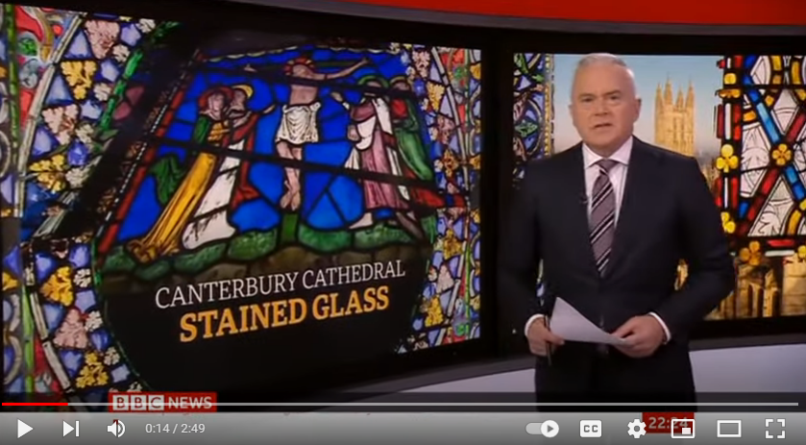
Stained glass

Slide 6
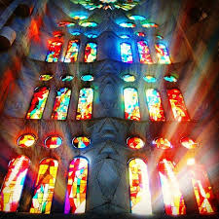
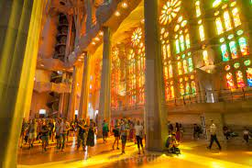
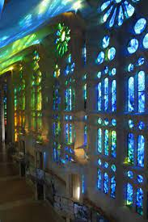
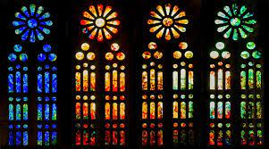
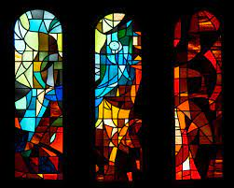
Sagrada Familia is a catherdral in Barcelona that has beautiful stained glass. Can you see what happens to the light inside the cathedral as it shines through the glass?

Slide 7
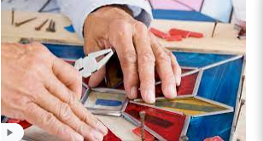
What do you notice about the colours?
What is each colour surrounded by?

Slide 8
Today we are going to draw our own stained glass design.
It might be something from nature like a bird or a flower, or it might just be a pattern.
Remember to separate each colour by black lines.

