Slide 1
Journey to the Jungle

Slide 2
Tuesday 1st February 2022
LO: To create a text map.

Slide 3
Today we are going to finish our text map and practise saying the text out loud with actions.

Slide 4
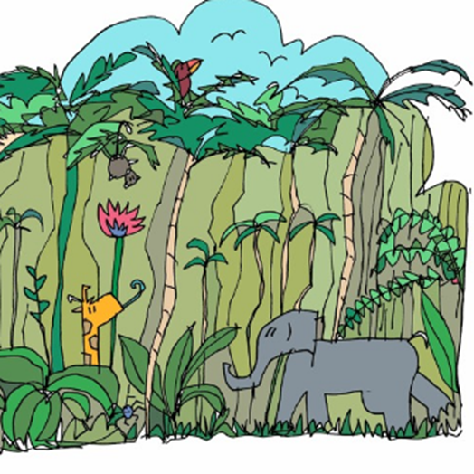
Click on the picture to listen (From 0.22 seconds)
Let’s listen to the text again.

Slide 5
Jungle Log: 31st January, 2022
Today has been an amazing day of discovery! I woke early and got ready for my trek into the Atlanti Jungle. I was excited and couldn’t wait to see what lay ahead of me. I packed my rucksack and put on my sturdy walking boots. I made sure my camera was working because I wanted to record as much of the day as possible. I left the camp at 6am.

Slide 6
First, I trudged through the dense forest and collected samples of the plant life. My favourite was a thorny bush. It had tiny, yellow flowers growing on it, which smelt like ice cream! Next, I studied some of the mesmerising insects that were crawling up the rough bark of every tree. One insect looked like a caterpillar but had 2 sets of wings and tiny hands on the ends of its 20 legs. Excitedly, I photographed as many creatures as I could because I wanted to show my explorer friends what I had discovered.

Slide 7
After a short tea break, I measured the circumference of the tallest trees to work out how old they were. One measured 10 metres around and was so tall that I couldn’t see the top of it. It reminded me of the beanstalk in a famous children’s story. Next, I trekked to a clearing and found a beautiful plunge pool. The water was turquoise and tiny neon fish were splashing on the surface. I tried to catch one, but they were too fast for me. Then it was time for a rest. I lounged on pink grass, soaking up the purple sun beams and listened to the strange jungle noises around me.

Slide 8
Finally, I headed back to camp because the sun began to set. It sets quickly in Oreno and I was worried I might get lost. When I got to my tent, I unpacked my rucksack and stored my plant samples safely. I’m really looking forward to where my wardrobe will take me next week!

Slide 9
Now let’s finish our text map and practise saying the text out loud with actions.

