Slide 1
1.2.22
I understand what a fraction is.

Slide 2
What fractions of the cubes are each colour?
Which of the fractions above are unit fractions?
Which of the fractions above are non-unit fractions?
Yellow $=$
Red $=$
Green $=$

Slide 3
What fractions of the cubes are each colour?
Which of the fractions above are unit fractions?
Which of the fractions above are non-unit fractions?
4
2
1
Yellow $=$
Red $=$
Green $=$
7
7
7
Green $\frac{\text{1}}{\text{7}}$
Yellow $\frac{\text{4}}{\text{7}}$
Red $\frac{\text{2}}{\text{7}}$

Slide 4
Focus and let’s use our growth mindset to learn more about fractions.

Slide 5
What fraction is being represented?
Have a think
5
There are equal parts altogether.
out of equal parts is shaded.
of the shape is shaded.
This is a fraction.
1
5
$\frac{\text{1}}{\text{5}}$
unit

Slide 6
What fraction are shaded red?
Have a think
4
There are equal parts altogether.
out of equal parts are shaded red.
of the shapes are shaded red.
This is a fraction.
3
4
$\frac{\text{3}}{\text{4}}$
non-unit

Slide 7
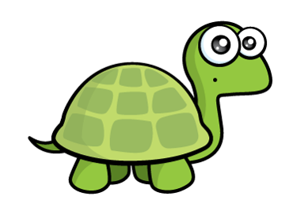
Have a think
Which of these representations shows $\frac{\text{1}}{\text{4}}$? Why?

Slide 8
Have a go at questions 1 – 4 on the worksheet
Let’s have a go at answering the first 3 questions. If you finish, draw some fractions in your book. Use the squares to make each fraction an equal part

Slide 9
0
1
2
3
4
5
$\frac{\text{1}}{\text{4}}$
$\frac{\text{2}}{\text{4}}$
$\frac{\text{3}}{\text{4}}$
0
1
$\frac{\text{4}}{\text{4}}$

Slide 10
Have a think
What fraction is the arrow pointing to?
$\frac{\text{3}}{\text{5}}$
0
1
Where would $\frac{\text{6}}{\text{7}}$ be on this number line?
$\frac{\text{1}}{\text{7}}$
$\frac{\text{2}}{\text{7}}$
$\frac{\text{3}}{\text{7}}$
$\frac{\text{4}}{\text{7}}$
$\frac{\text{5}}{\text{7}}$
$\frac{\text{6}}{\text{7}}$
0
1

Slide 11
Have a go at the rest of the worksheet
Let’s complete questions 4, 5 and 6.
Remember to write the answers at the side of the sheet if there is not room on the sheet.
When you complete this work can you draw four different representations of 3 Good luck ☺
4

