Slide 1
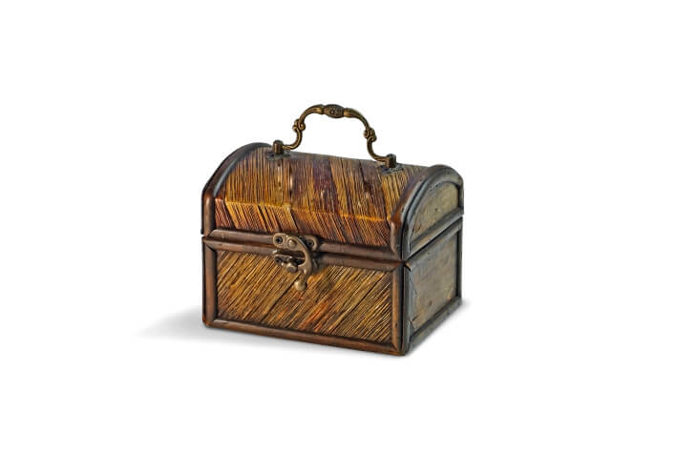
The Magical Box – Day 1
Wales and Northern Ireland class

Slide 2
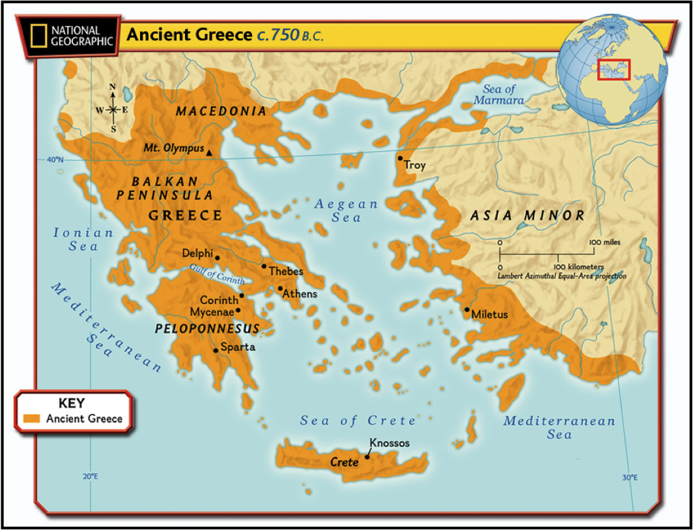
Ancient Greece
We are going to read to a story from Ancient Greece about a girl called Pandora who did not listen to a warning.

Slide 3
The myth of Pandora’s Box
Are you nosy? Do you like secrets? Have you ever done something that you’ve been warned not to, just to find out a secret? All through time there have been stories about people being told not to open doors, cupboards, gates and all sorts of other things, and in many of the stories the people just didn’t listen. One person who did not listen is Pandora. Her story is from Ancient Greece, where her nosiness changed the world forever!

Slide 4
The myth of Pandora’s Box continued…
Not hundreds but thousands of years ago, in ancient Greece, there lived two brothers called Epimetheus and Prometheus. Although they lived in a world where the gods were in charge, they liked nothing more than to annoy the gods. One day, Zeus, a particularly powerful god, decided to teach them a lesson. Zeus ordered the gods to create a beautiful woman. Her name was Pandora and she was to marry Epimetheus. As a wedding present, Zeus gave Pandora a beautiful box but there was one special condition, she was never to open it!

Slide 5
The myth of Pandora’s Box continued…
All day Pandora’s husband Epimetheus was out working. All day all she could think about was what was in the box. Pandora could not understand why Zeus would give her a box that she could not open. It made no sense to her. Pandora was bored and lonely and her curiosity became unbearable.

Slide 6
Stop here!
In the middle of your page, draw a picture of what you think the box might look like.

Slide 7
Myth continued…
One day, when she was sure that Epimetheus was out annoying the gods, Pandora searched for the key to open the box. “I know it’s here somewhere,” she muttered to herself as she opened cupboards and drawers. There it was, high on a shelf in their bedroom! With shaking hands, Pandora slid the key into the lock and turned it.

Slide 8
What do you think might be in the box?
Talk to someone about your ideas.

Slide 9
Myth continued…
She took a deep breath, closed her eyes and slowly, with trembling hands, opened the lid of the box, imagining what could be inside: rubies as red as the blazing sunset, jewel encrusted gowns, piles of gold coins. But there were no coins or jewellery, no gowns or gems, for all at once every evil and spite, every sadness and misery flew out. Like a swarm of insects, they fled the house and infested the earth with heartache and sorrow.

Slide 10
Myth continued…
Pandora slammed the lid shut and turned the key. “What have I done?” she sobbed, holding her head in her hands. Sometime later, Pandora noticed a fluttering sound coming from the box, as if something was trapped inside. Terrified, she pressed her ear to the box. “Let me out,” a small voice pleaded gently, “I mean you no harm.”
Once again, with shaking hands, Pandora unlocked the box and opened the lid. A beautiful butterfly of hope fluttered out of the box, for although Pandora had released pain and suffering into the world, she had also allowed hope to follow them

Slide 11
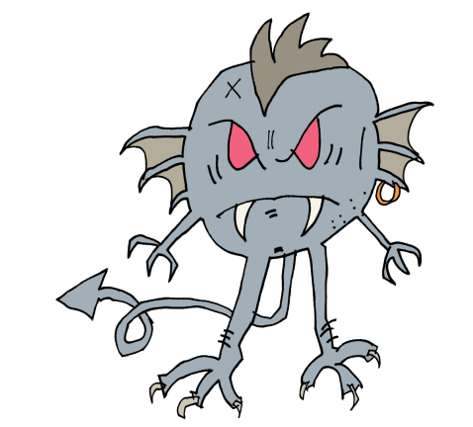
Task continued…
Around your box, draw pictures of the evil that came out of the box.

Slide 12
Can you retell the story to someone at home?
Did you like the story? Why? Why not?

Slide 13
The Magical Box – Day 2
Wales and Northern Ireland class

Slide 14
Can you retell the story from yesterday? See how many details you can remember.
Listen to the story again here:
https://soundcloud.com/talkforwriting/pandora

Slide 15
Today we are going to think about Zeus…
Zeus was a sky god who controlled thunder and lightning. He was a strong, striking man with a muscular body and long, curly hair. He had a short beard and carried his trusty thunderbolt at all times. He was also king of the gods and would sit on his golden throne at the top of Mount Olympus.

Slide 16
Sketch and label….
Read the description carefully and use the key information to draw a picture of Zeus.
Can you add labels or write sentences about Zeus’s different features?

Slide 17
The Magical Box – Day 3
Wales and Northern Ireland class

Slide 18
Can you retell the story of Pandora’s Box? See how many details you can remember.
Listen to the story again here if you feel you need to:
https://soundcloud.com/talkforwriting/pandora

Slide 19
so

Slide 20
Comprehension questions…
Try to answer these questions in your writing book. Use full sentences, so remember you will need to use capital letters and full stops. Try to use a conjunction to extend your ideas further when it is appropriate.

Slide 21
Questions…
How did Pandora change the world forever?
Who was in charge of the Ancient Greeks?
What kind of character was Pandora?
Do you like the ending of the story? Why/why not?

Slide 22
The Magical Box – Day 4
Wales and Northern Ireland class

Slide 24
In school….
In school, we are always trying to use ambitious vocabulary and we think carefully about the words we use in our writing. There are lots of powerful words used in this story…

Slide 25
Alphabetical order…
Your first job is to read the following words and then write them in alphabetical order in your book.
curious | unbearable | tremble | sob
infested | pleaded | release | fled

Slide 26
Match the word to the meaning
Word | Meaning
curious | shaking slightly
fled | unpleasant, painful
infested | asked in a begging way
pleaded | wanting to know about something
release | escaped from, ran away
sob | large numbers of something causing damage
tremble | set free
unbearable | cried

Slide 27
Use the words….
Now you know what these words mean, can you have a go at using some of them in your own sentences?
For example…
Libby’s hands were trembling as she waited for her turn on the roller coaster.

