Slide 1
Children’s Mental Health Week
2022
Theme: Growing Together

Slide 2
What is mental health?

Slide 3
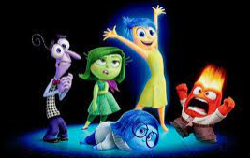
Mental health is the way children think and feel about themselves and the world around them. It affects how children cope with life's challenges.

Slide 4
Today we are going to think about how we support each other to grow together.

Slide 5
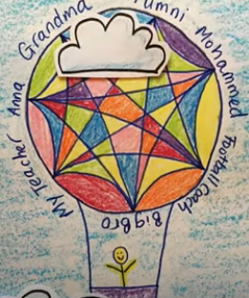
Support Balloon In this activity we are going to draw a hot air balloon to think about your support network and how this can lift you up.

Slide 6
Watch the video to find out how to make your own support balloon.

