Slide 1
4.12.21
L.O. – I can divide by 10

Slide 2

1) 1 hundred = ____ tens
1 hundred $=$ ____ ones
2) £1 = _____ $×$ 1 p
£1 $=$ _____ $×$ 10 p
3) $\frac{\text{1}}{\text{10}}$ of 40 $=$ 40 $÷$ ____
$\frac{\text{1}}{\text{10}}$ of 40 $=$ ____
Please practise your 9x tables, we will then play hit the button. Next week we will be exploring a brand new table so let’s make this our best score yet!

Slide 3

10
1) 1 hundred = ____ tens
1 hundred $=$ ____ ones
2) £1 = _____ $×$ 1 p
£1 $=$ _____ $×$ 10 p
3) $\frac{\text{1}}{\text{10}}$ of 40 $=$ 40 $÷$ ____
$\frac{\text{1}}{\text{10}}$ of 40 $=$ ____
100
100
10
10
4
https://www.topmarks.co.uk/maths-games/hit-the-button

Slide 4
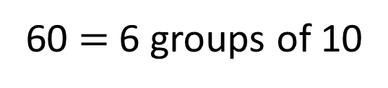
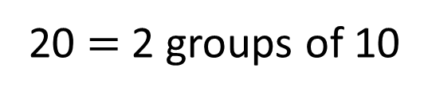
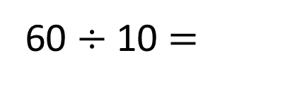
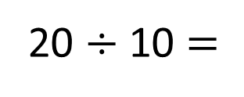
20 $÷$ 10 $=$
2
20 $=$ 2 groups of 10
6
60 $÷$ 10 $=$
60 $=$ 6 groups of 10

Slide 5
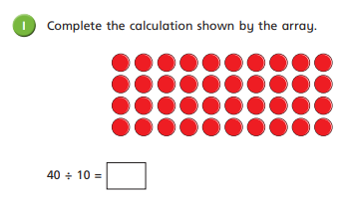
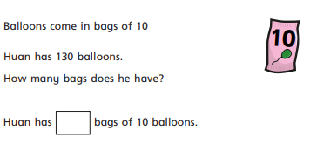
Please complete questions 1 and 2 on your worksheet.
If you finish, can you draw your own array showing a different calculation that is dividing by 10.

Slide 6
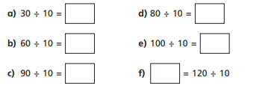
Copy and complete these number sentences in your book.

Slide 7

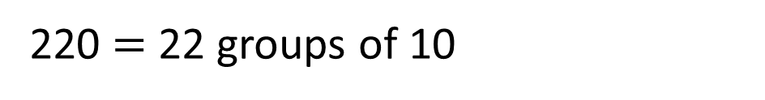
220 ÷ 10 = ___
22
220 = 2 hundreds + 2 tens
We need to find how many groups of 10 are in 220
1 hundred = 10 tens
2 hundreds = 20 tens
There are 22 tens altogether.
220 $=$ 22 groups of 10

Slide 8
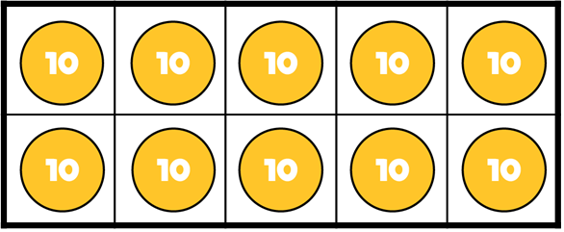
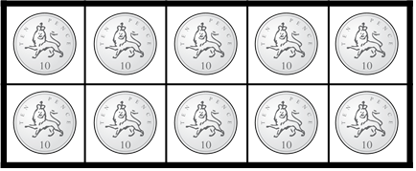
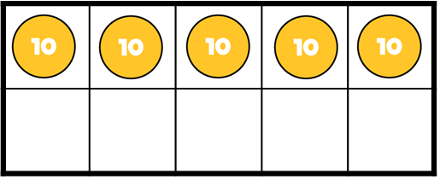
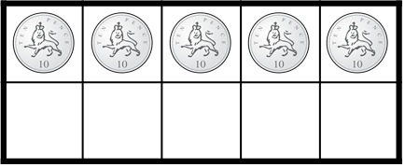


£3 and 50 p ÷ 10 p = ___
350 ÷ 10 = ___
35
35
Ten 10s $=$ 1 hundred
Ten 10 p $=$ £1

Slide 9
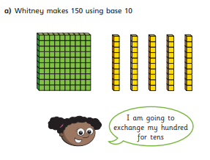
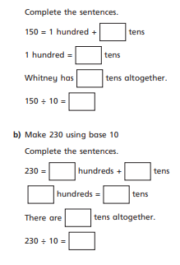
Using the picture on this slide, complete question 3 on your worksheet.

Slide 10
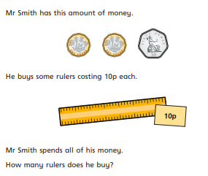
Let’s work through this question as a class.
Write your answer on your whiteboard.

Slide 11
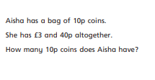
Now, complete question 4 on your worksheet.
If you finish, there is a challenge question.

Slide 12
Th | H | T | O
10 times
the size
10 times
the size
10 times
the size

Slide 13
Th | H | T | O
One tenth
the size
One tenth
the size
One tenth
the size
To find one tenth, we divide by 10

Slide 14






$×$ 10
$×$ 10
$×$ 10
Th | H | T | O
$÷$ 10
$÷$ 10
$÷$ 10

Slide 15




Th | H | T | O
$÷$ 10
$÷$ 10
$÷$ 10
430 $÷$ 10 =
4
3

Slide 16
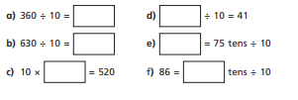
Please, copy and complete these calculations in your book.

Slide 17
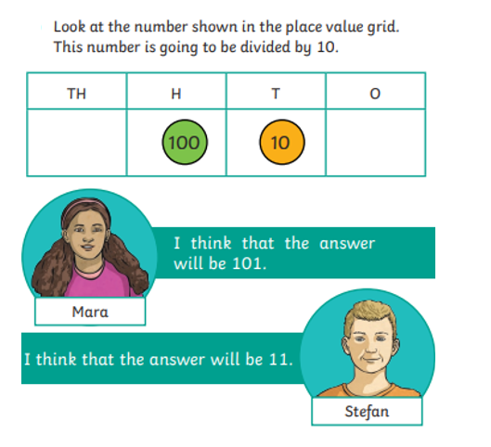
Let’s discuss this question as a class.

