Slide 1
25.1.22
LO – I can work out the area of a shape by counting squares.

Slide 2
Let’s practise our times tables.
Let’s recap on our 4x tables using the counting stick.
Which times tables relate to the 4s.

Slide 3
Complete the missing numbers to describe the array.
___ + ___ + ___ = ____
3 × ___ = ___
2) 8 + 8 + 8 + 8 = ___ × 8
3) What fraction of the shape is shaded?

Slide 4
Complete the missing numbers to describe the array.
___ + ___ + ___ = ____
3 × ___ = ___
2) 8 + 8 + 8 + 8 = ___ × 8
3) What fraction of the shape is shaded?
5
5
5
15
5
15
4
$$\frac{\text{1}}{\text{2}}$$

Slide 5
Let’s
FOCUS…4
Growth mindset… ready!

Slide 6
Area is the space inside a closed 2-D shape.

Slide 7
Have a think
Which shape would be the best to fill the rectangle?
Why?

Slide 8
Gaps
Which shape would be the best to fill the rectangle?
Why?
The area is 20 circles

Slide 9
Which shape would be the best to fill the rectangle?
Why?

Slide 10
The area of the rectangle is:
20 squares

Slide 11
1
2
3
4
5
6
7
7
The area is ___ squares.

Slide 12
1)
Have a think
9
The area is __ squares.
3)
2)
4
The area is __ squares.
4
The area is __ squares.

Slide 13
Have a think
The green area is __ squares.
2
4
The orange area is __ squares.
The purple area is __ squares.
2
The white area is __ squares.
4
12
The total area is __ squares.

Slide 14
Have a go at questions 1 - 4 on the worksheet
Answer the first four questions on your sheet.
Challenge.
If you complete this work can you make a square that has an area of 25 squares.
3 are blue, 6 are red, 4 are green, 7 are yellow and the rest are white. Colour your square correctly and work out how many white squares there are.
The area of this square is 25 squares.

Slide 15
To find the area, I’m going to count the squares.
3
6
9
12
I’m going to use multiples to be more efficient.
4
1
2
3
4
8
5
6
7
8
12
9
10
11
12
4 + 4 + 4 =
12
3 + 3 + 3 + 3 =
12
4 × 3 =
12
3 × 4 =
12
The total area is 12 squares.

Slide 16
Have a think
1)
5 × 2 =
10 squares
2)
1 × 6 =
6 squares
3)
4 × 4 =
16 squares

Slide 17
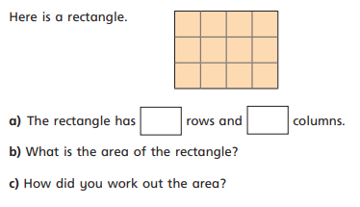
Have a go at questions 5 - 8 on the worksheet
Now answer this question.

Slide 18
$$\frac{\text{1}}{\text{2}}$$
1
2
3
$\frac{\text{1}}{\text{2}}$
3
The area is ____ squares.

Slide 19
Have a think
1)
2)
2
$\frac{\text{1}}{\text{2}}$
3
3)
6

Slide 20
What is the area of each shape. Write your answers on your white board.

Slide 21
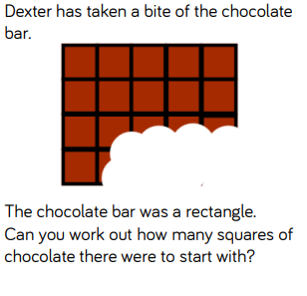
Let’s think about this question together:

